Slide 1


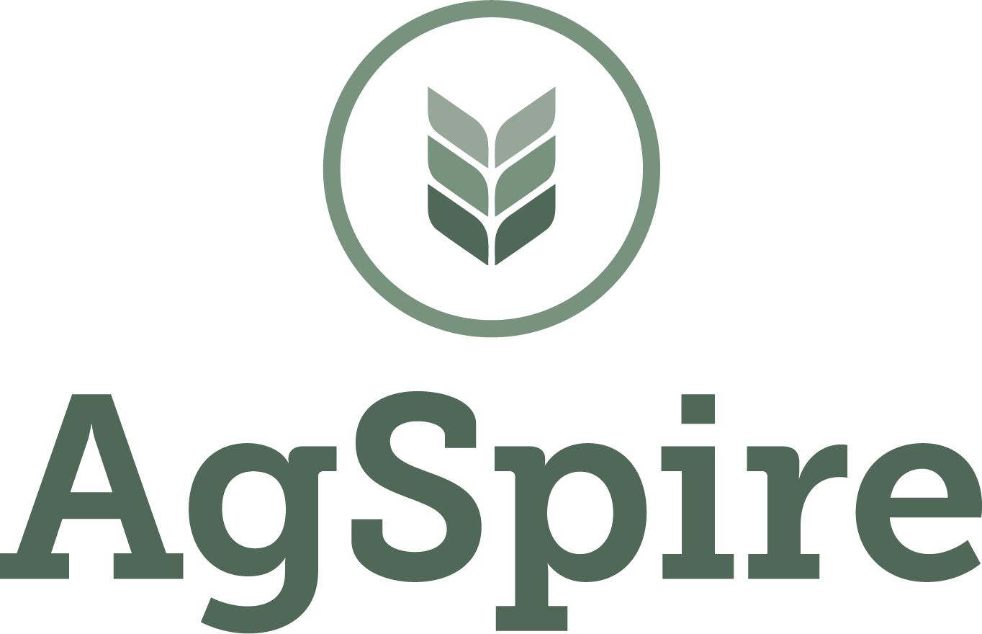
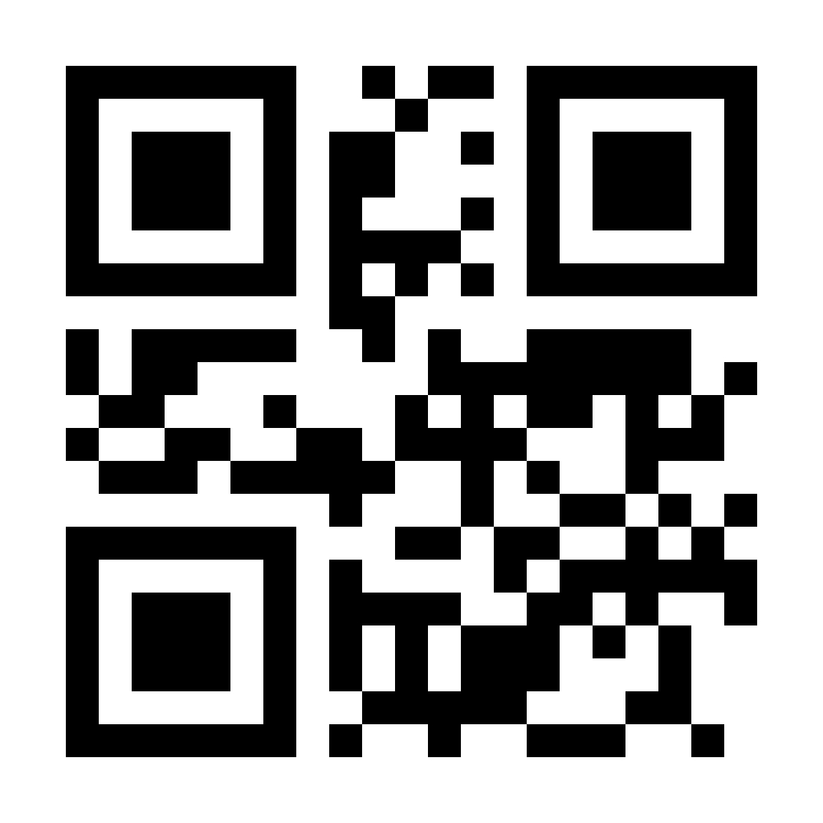
Advancing Sustainability
Through changes on the land
Notes:
Intended for external use by Technical and Producer team.
Suited for associations, private companies, producer meeting, etc.

Slide 2
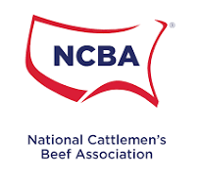
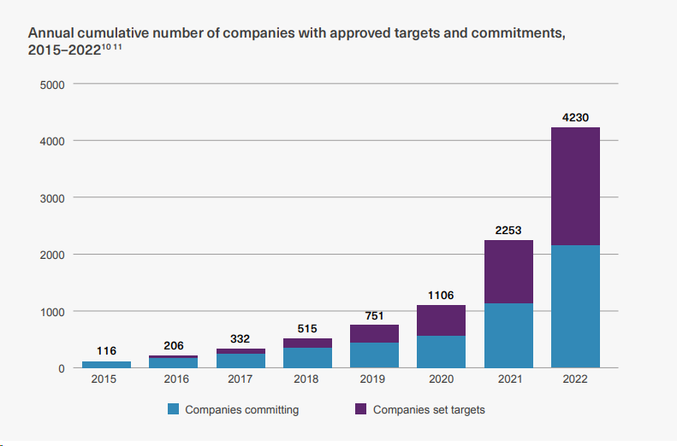


Current Private Sustainability Landscape
Most food & ag corporates and commodity groups have set public 2030 and 2050 GHG reduction targets.
Demonstrate climate neutrality of US cattle production by 2040.
Reduce greenhouse gas emissions by 13% by 2030.
Achieve greenhouse gas neutrality by 2050
Source: Science Based Targets Initiative
Notes:
More than 31% of the largest publicly-traded companies in the world by revenue have committed to net-zero.
Regardless of changing policy related to sustainability, clients are continuing to invest in sustainability and a robust and resilient supply chain.

Slide 3


AgSpire Approach
Producer-Centric Perspective
We lead with deep agricultural roots – building programs that prioritize:
Resiliency, profitability, and long-term viability
The realities of production agriculture
The importance of family legacy and trust
We bridge the gap between producers and ag and food companies – designing flexible, grounded solutions that work for both.
Supply Chains
Our programs are focused on real progress, contributing to:
Claimable, verifiable Scope 3 impacts
Resilient product supply
Healthy producer relationships
Notes:
Work with corporate clients to design programs that make sense for ranchers and farmers.
Tailor the program to meet their sustainability goals.
For some it’s about supporting farmers and ranchers and telling their story on the importance to the food value chain.
Others want to generate insets to reduce their Scope 3 (supply chain) emissions while also having a positive impact on supple sheds they source from.

Slide 4
AgSpire Programs
Free, voluntary, incentive programs – centered around conservation and regenerative practices to increase resiliency, productivity, and profitability for producers.
Programs offered focused on:
Beef
Specialty Grains: Oats, Buckwheat, Winter Camelina, Rye, and Flax
Corn
By State
Enrolling Now
Practices supported through the programs:
Forage and range seeding
Cover crops
Herd productivity & efficiency – herd health, feed efficiency, reproductive efficiency
The Grass is Greener
Ranching for the Future
Covering America
Notes:
We always focus first and foremost on what makes sense for production agriculture producers.
How can we design a program that provides dollars to the support the practices like cover crops, forage or range plantings, or herd efficiency and productivity improvements.
Our goal is always a win-win for producers and buyers.

Slide 5
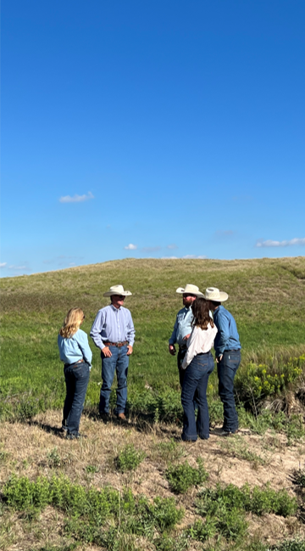
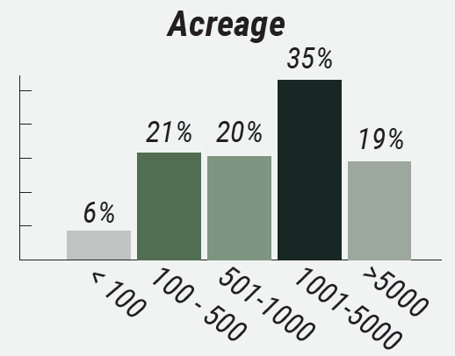
AgSpire works with a broad range of producers
2024
2025
Future
Began producer recruitment and program enrollment
Over 300 producers from 11 states.
Expanding current programs and launching programs in new states
Current Demographics:
Current States Enrolling
Future States Enrolling
150-200
average herd size
>40,000
acres with cover crop, forage, or range seeding
Notes:
As of April 2025

Slide 6
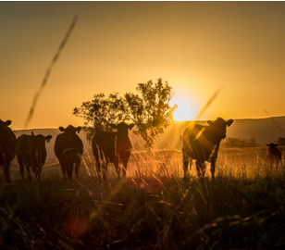


Ranching for the Future
Supporting producers to enhance herd productivity and efficiency, leading to more pounds produced on-farm.
Implementation of best practices for cow-calf operation
> Customized improvement plan and free technical assistance focusing on increasing pounds produced on farm, through:
Feed efficiency
Herd health
Reproductive efficiency
> Sponsored by partners promoting efficiency, productivity, and reduced environmental impact of beef production.

Slide 7
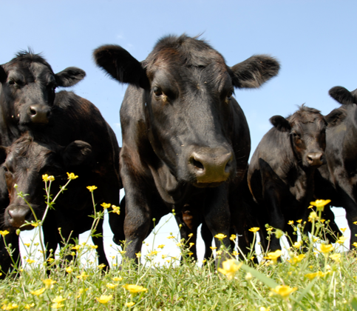
The Grass is Greener
Rewarding producers for the environmental benefits of grazing cattle and sustainable forage production.
Beef + Forage Program for producers in:
> Technical Assistance:
Our advisory team provides one-on-one guidance and technical assistance for seedings and grazing management.
> Seeding & Cattle Payments
$40 - $100
Notes:
Our technical advisors provide custom grazing and seeding plans to improve operational resilience.
Public / Private Partnership (SDSU / OSI & McDonalds)

Slide 8
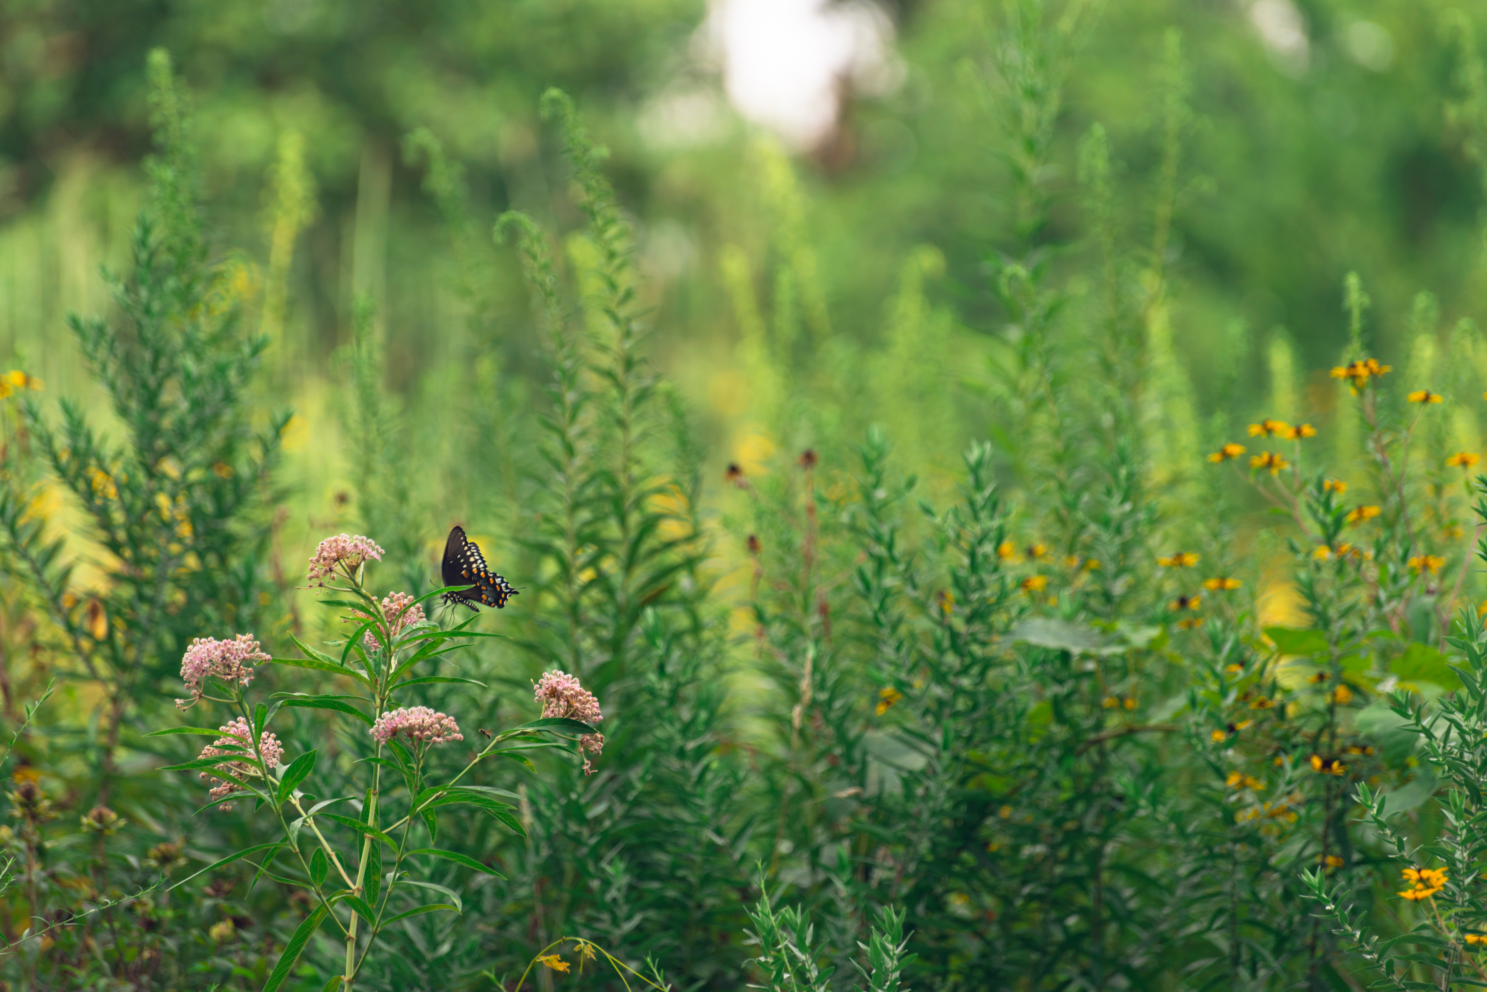
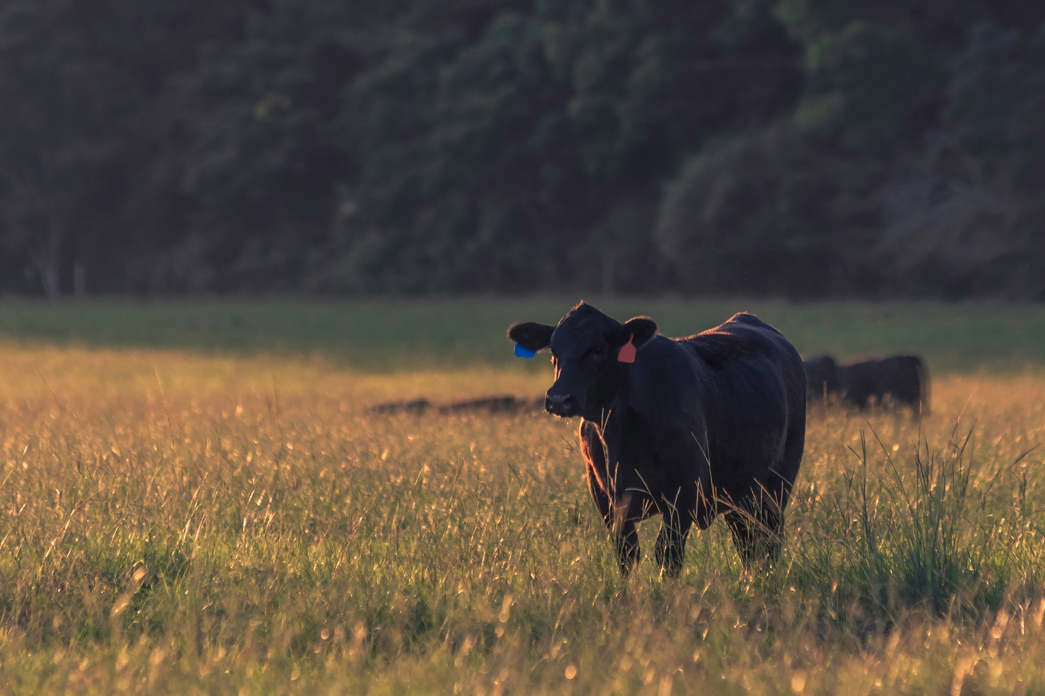
Forage, Feed, and Beef Efficiency Program
Program designed for cow-calf and stocker operations in the Southeast United States
> Technical assistance, payment incentives, and customized implementation plans to support productivity and resilience on your beef operation through:
Use of cover crops
Forage, and rangeland seedings
Herd productivity practices
> Sponsored by partners focused on promoting efficiency, productivity, and reduced environmental impact of beef production.
Phase 1
Phase 2
Enrolling soon:
Kentucky, Tennessee, Virginia, and North Carolina, South Carolina
Examples of possible herd productivity practices:
Use of AI
Synchronization plans
Genetic selection
Vaccinate protocols
Feed efficiency tools
Producer incentives between $40-$115 depending on chosen practices.

Slide 9
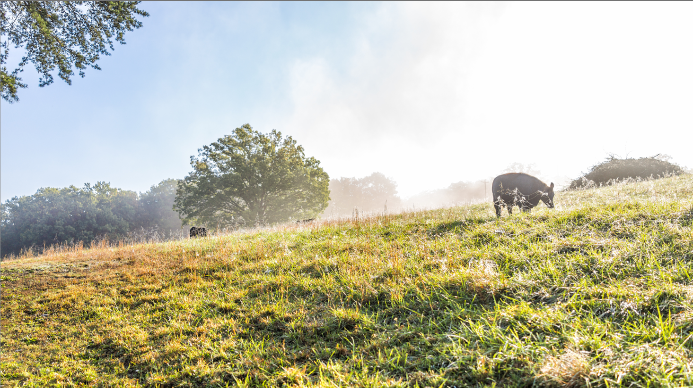
AgSpire’s Approach
Agriculture experts helping farmers and ranchers maximize the impact of regenerative and conservation practices
> Understand your operation and goals
> Connect you with the best programs
Notes:
AgSpire focuses on understanding your operation, your short and long-term goals and then helping identify a program that can help you advance those goals.
We spend time getting to know you
When it comes to developing programs for ranchers and farmers we focus on what's realistic
Understand they have make sense operationally and financially

Slide 10

Thank You

Slide 11
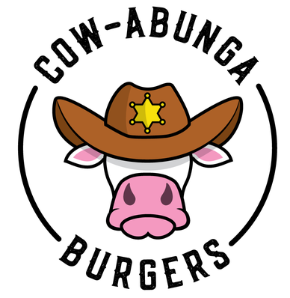
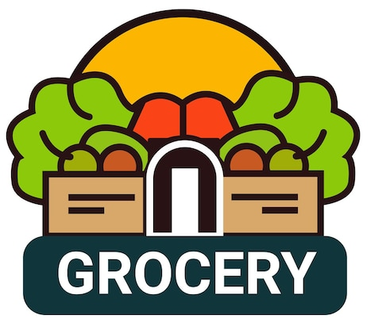
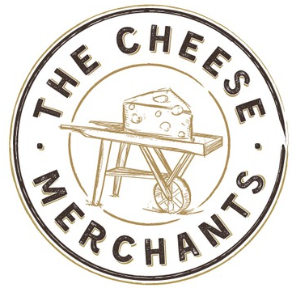
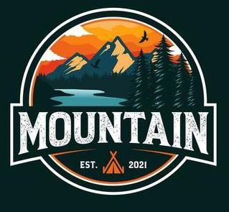
Flexibility for adhering to Corporate Climate Accountability Frameworks (GHG-P, SBTi)
Yes SBT - but doesn’t directly tie sustainability to their brand.
Yes SBT AND does directly tie to their brand. Thought leader in sustainability, core to company culture.
No Science Based Target (SBT)
No SBT - Certified B Corp which is tied to their brand which requires GHG-P adoption
Loose adherence
Strict adherence
BUSINESS FACTORS INFLUENCE WHERE COMPANIES FALL ON THE SPECTRUM
Regulatory Compliance Positioning
Proactive to anticipated regulations
Carbon Asset Development Strategy
Engaged in Scope 3, reporting against SBT
Investor Relations
Investor portfolio or lending requirement
Greenwashing Risk Management
Proactive vs reactive
Supply Chain Climate Risk Management
De-risk supply interruptions
Consumer and B2B Customer Pressure
Brand and company value
Notes:
Company 1 (Costco) - “While we are guided by Science Based Targets, we are not in a position to adopt them until we have plans to meaningfully implement them."
Regulatory Compliance Positioning
Requirements for European operations
Proactive vs. reactive approach to anticipated regulations
Investor Relations
ESG-focused investor portfolio percentage
Financial institution lending requirements
Supply Chain Climate Risk Management
Vulnerability assessment of agricultural suppliers and commodities to climate events
Carbon Asset Development Strategy
Engagement in generating Scope 3 intervention units (fungible, tradeable, certified carbon assets)
Reporting against a SBT
Reporting against GRI, B Corp, Customer Disclosure Requests, CDP, etc.
Greenwashing Risk Management
Proactive vs. reactive to unsubstantiated climate claims
Consumer and B2B Customer Pressure
Brand reputation impact of climate performance
Competitor climate commitment benchmarking

