Slide 1
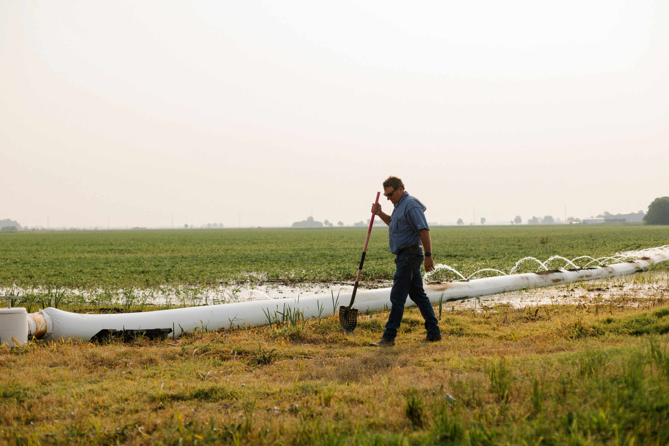

AgriCapture Platform Overview
Decarbonizing rice supply chains.

Slide 2


CHALLENGE
Rice Feeds Half of the World's Population
Yet, as a continuously flooded crop, rice cultivation represents significant…
Methane Emissions
Emissions on par with global aviation
12% of global methane emissions
1.5% of total GHG emissions
Water Intensity
Second most water intensive crop
130 gallons of water consumed per 1lb of rice
Heavy Metals
Largest dietary source of inorganic arsenic
Rice absorbs 10x more inorganic arsenic than other grains due to flooded conditions
AgriCapture has built a scalable solution to mitigate the impact and verify outcomes of all three.

Slide 3
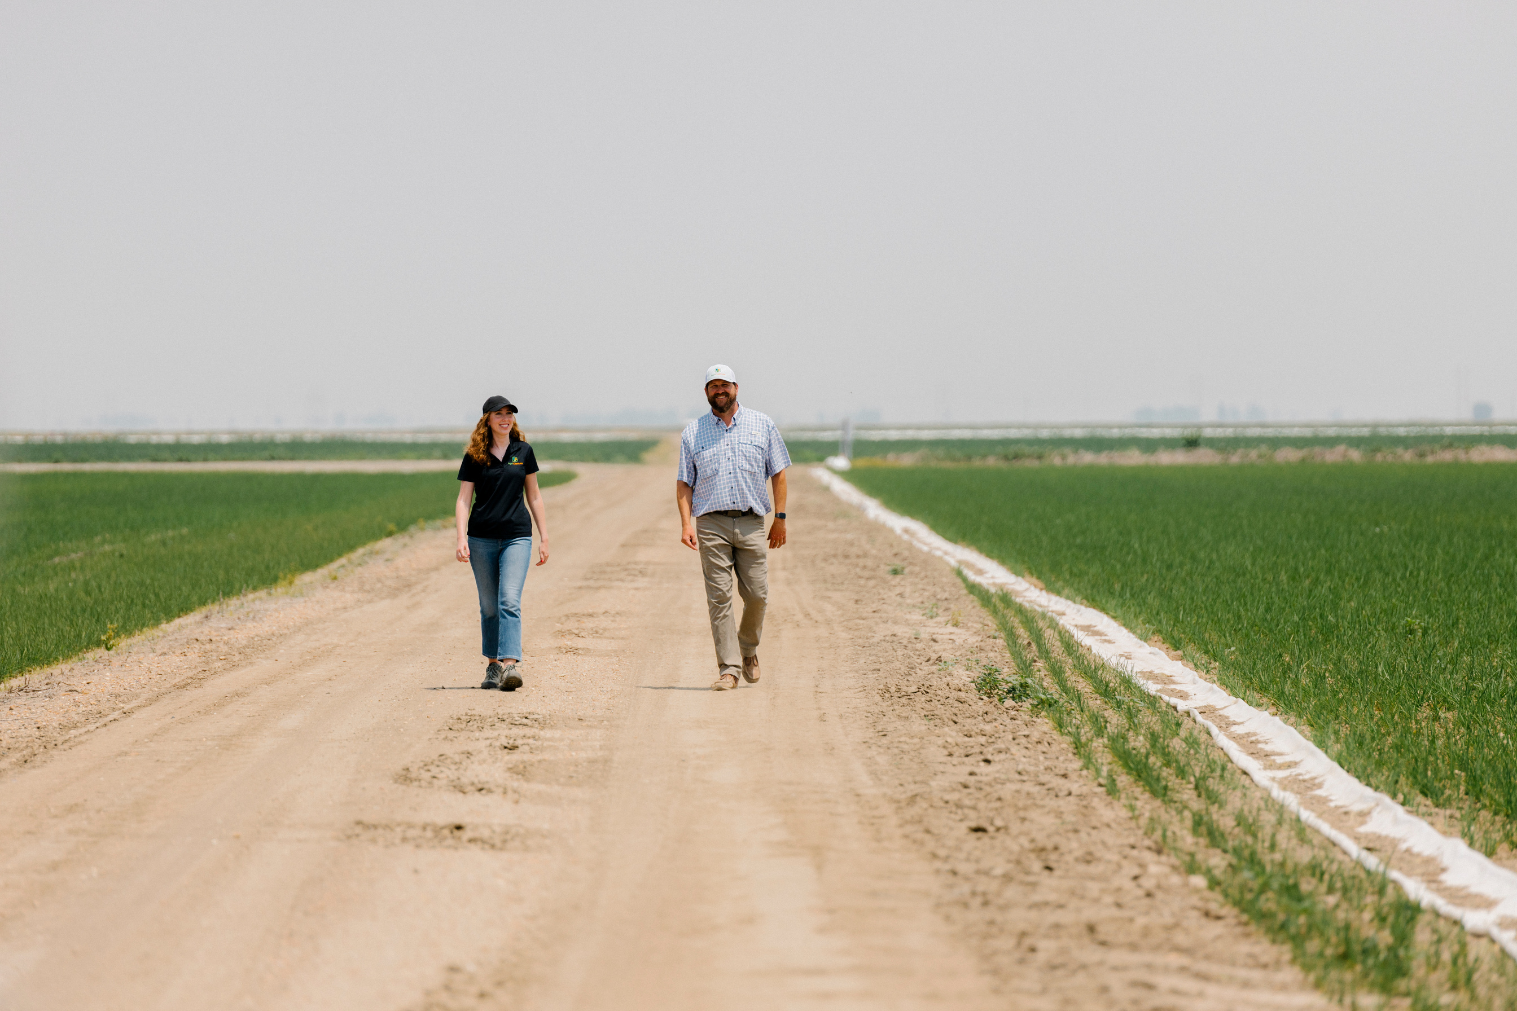
OUR SOLUTION
To grow responsibly, first we build farmer trust.
So, we know-
Real farmers
Real data
Real change

Slide 4
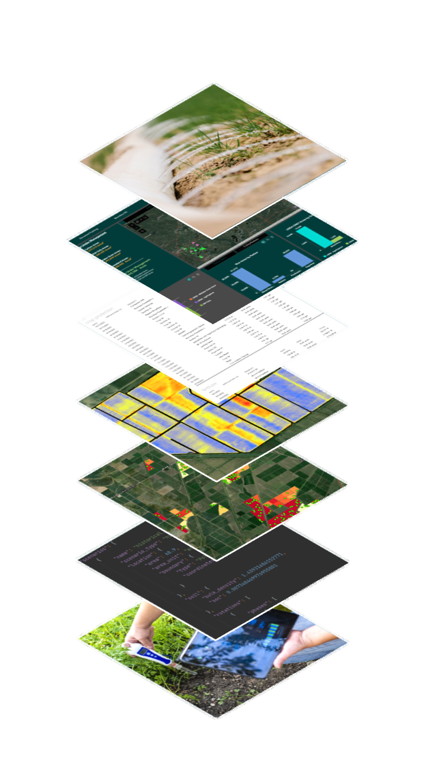
OUR SOLUTION
AgriCapture Tech Stack
Science Backed,
Farmer Approved Process
Sustainable Agriculture + Agronomic Support
Incentivized practice changes to Alternate Wetting and Drying, Furrow Irrigated Rice and Direct Seeded Rice
Agronomic support to grow rice sustainably and maintain yields
Low burden data collection and administration on the farmer
Streamlined remote sending and emissions modeling
Environmental asset creation and farmer revenue share
Enrollment Platform
Field-Level Data Collection
Remote Irrigation Analysis
Soil Sampling
Emission Reduction Modeling
Third-Party Verification

Slide 5
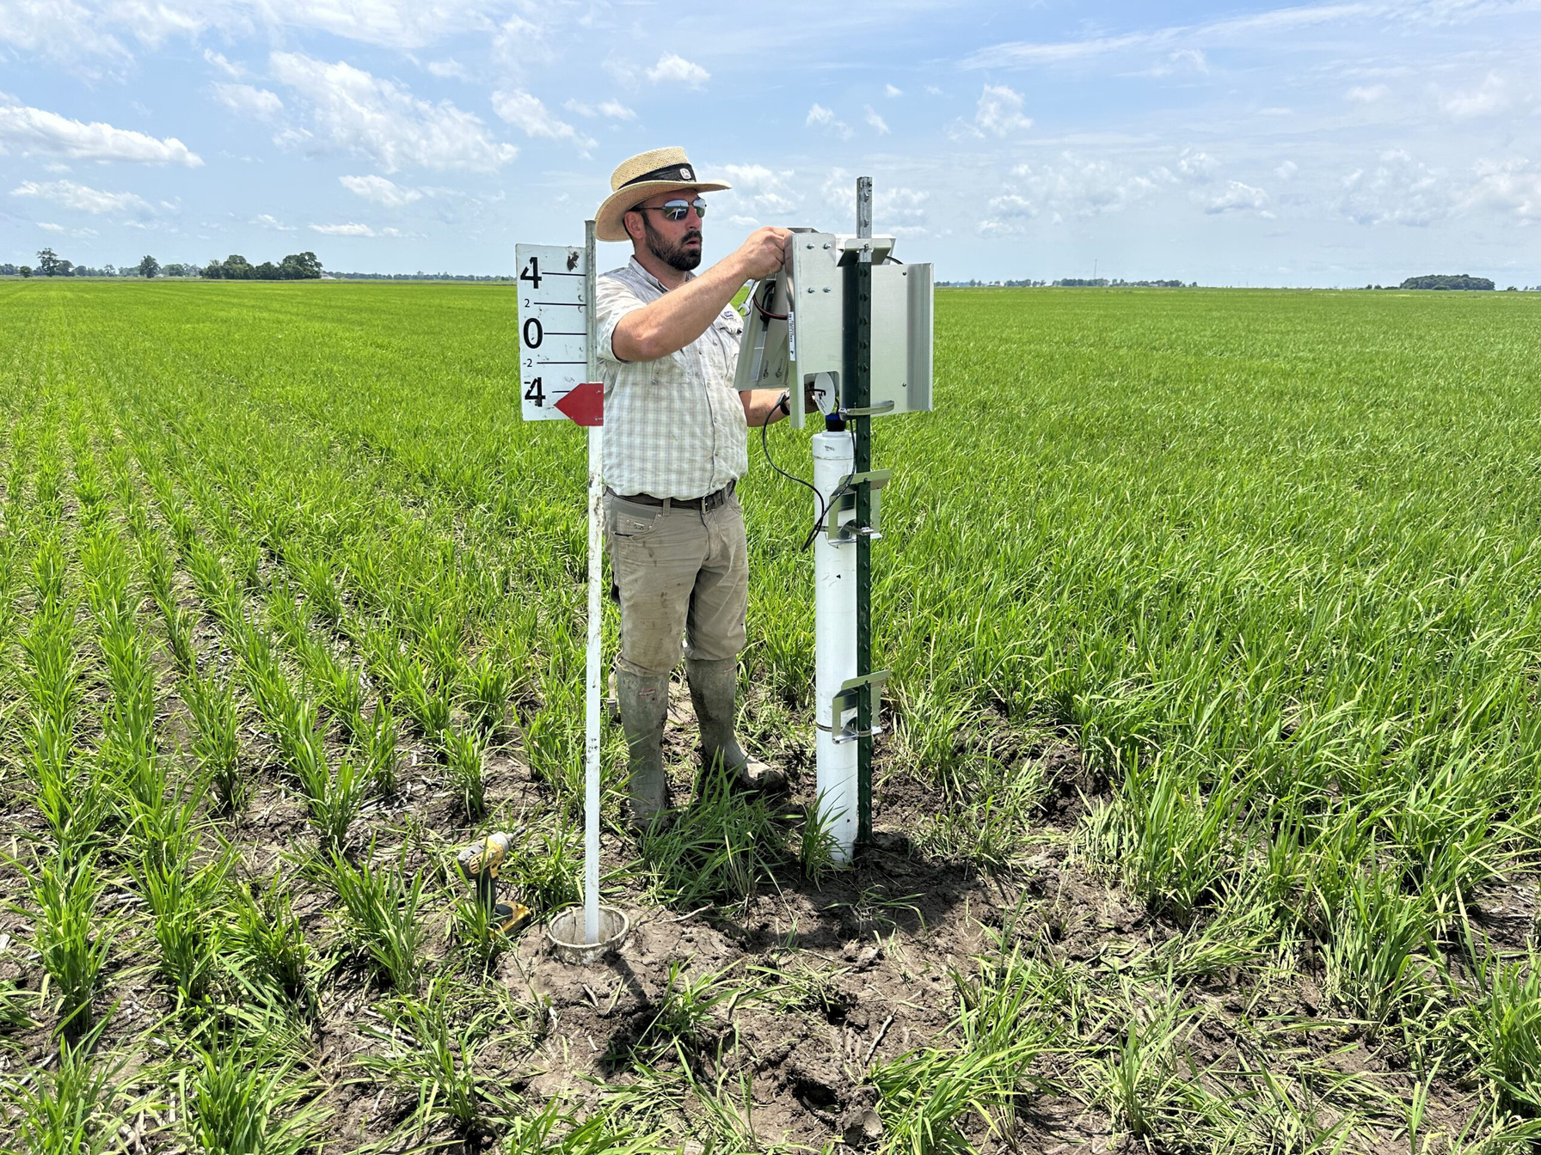
OUR SOLUTION
Measuring what matters
We measure + certify rice growing outcomes that matter across the supply chain.
Water usage
GHG emissions
Carbon intensity
Heavy metals
Average Outcomes Across AgriCapture Farmer Network:
70% Methane Emissions Reductions
30% Water Savings
27% Reductions in Arsenic

Slide 6
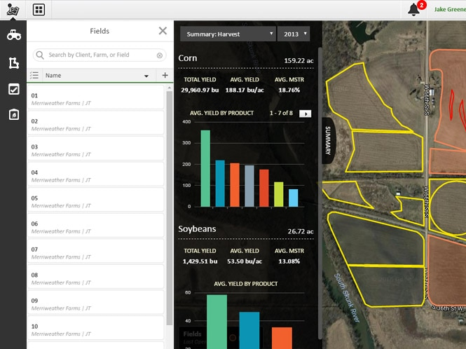

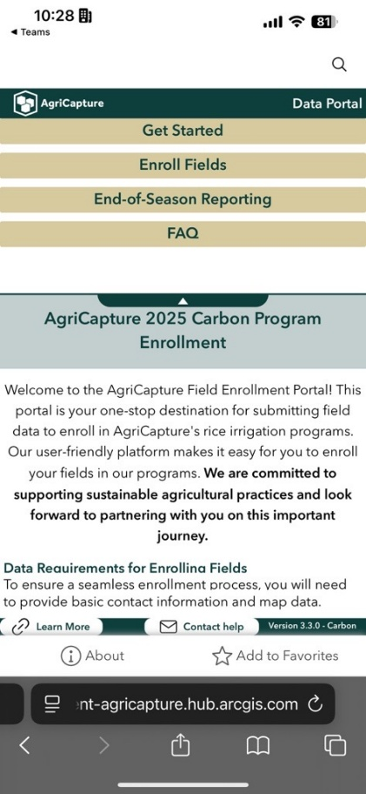
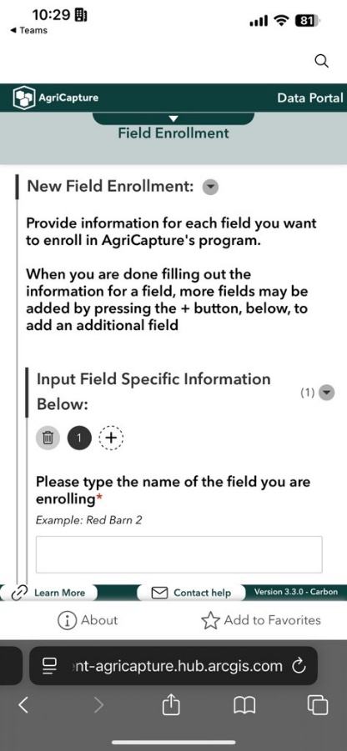
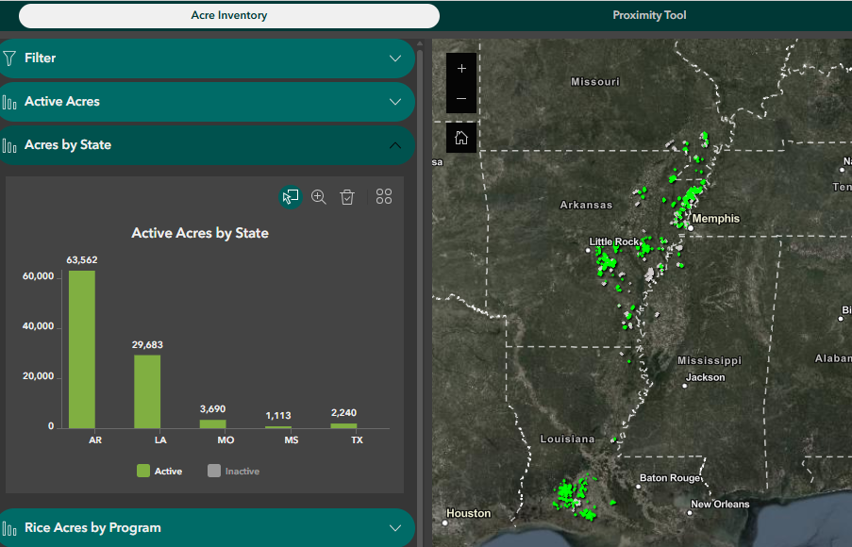
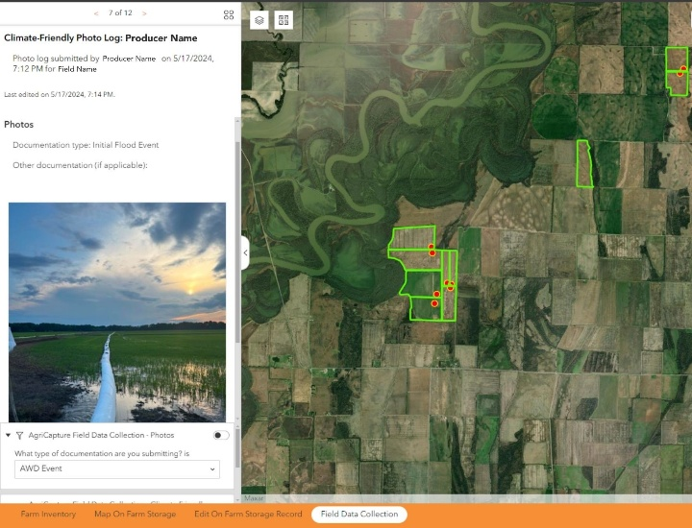
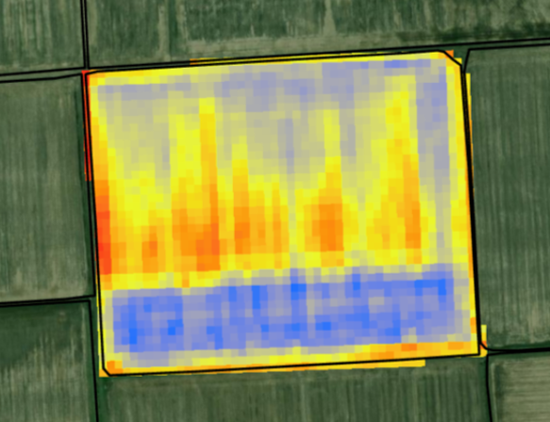
OUR SOLUTION
Farmer Enrollment
Field Data Collection
Acre360: Inventory Management
API with John Deere Operations Center to directly pull data into AgriCapture’s platform
Farmer photo app to record time and location of irrigation events.
Farmer-tested and mobile-friendly enrollment platform
Platform for monitoring and managing all field data and auto-generating reports
Satellite moisture detection to monitor field irrigation.

Slide 7
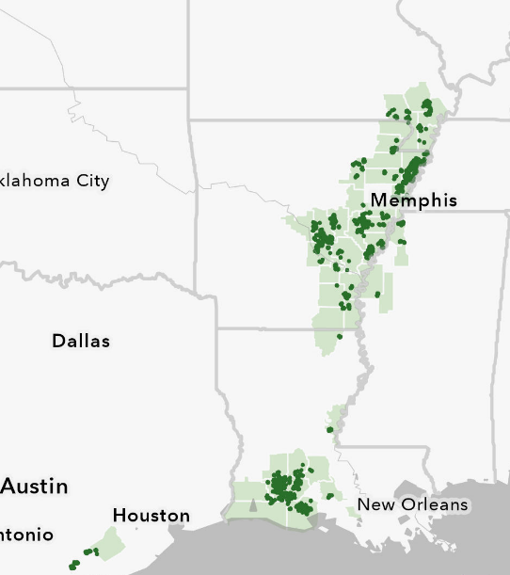
OUTCOMES
Impact to Date
As of 2024 harvest, AgriCapture’s rice programs have resulted in:
70,000 tons of CO₂e reduced
21 billion gallons of water saved
27% reduction in heavy metals in the grain
In 2025, AgriCapture has:
Scaled regenerative farming across 6% of all U.S. rice acres
Increased farmer enrollment by 264%
Expanded project globally to Brazil

Slide 8
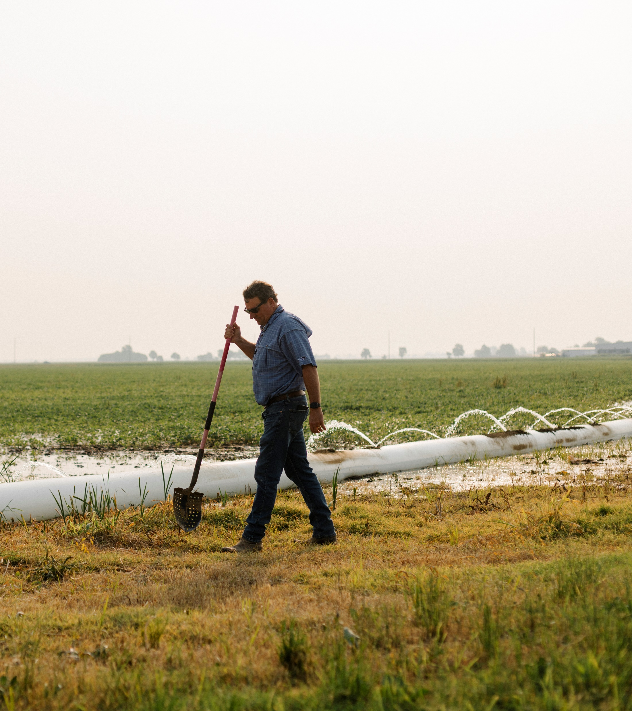
Supporting farmers + farmland
AgriCapture incentivizes regenerative farming to deliver trusted sustainability solutions:
Rice Methane Carbon Credits
Scope 3 Solutions
Identity-Preserved Rice
Water Stewardship
“AgriCapture makes it possible for us to turn our sustainable practices into revenue. It’s a win for both our farm and the environment.“
Michael McCarty
Arkansas Rice Farmer

Slide 9
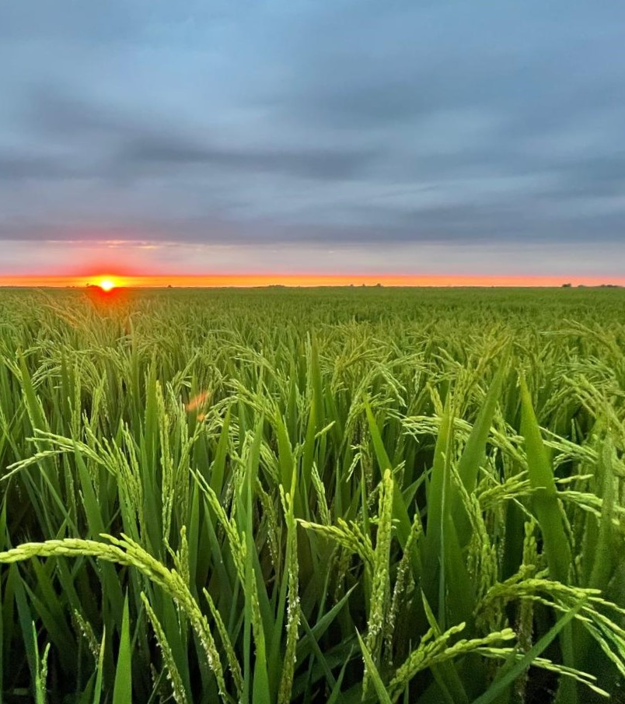
EMISSIONS REDUCTIONS
Rice Methane Reduction Credits
Farmers received historic first-of-a-kind payments for carbon credits generated by adopting methane-reducing practices.
Project Results:
21 billion gallons of water saved
70,000+ tons CO₂e reduced
Sold 33,025 credits to date to large international banks, travel, and technology companies
“Carbon credits help us adopt sustainable practices that require higher investment, and this project allows us to do so in a way that works for our operation.”
Gavin Sullivan
Arkansas Rice Farmer

Slide 10

EMISSIONS REDUCTIONS
Rice Methane Reduction Credits
Farmers received historic first-of-a-kind payments for carbon credits generated by adopting methane-reducing practices.
Project Results:
21 billion gallons of water saved
70,000+ tons CO₂e reduced
Sold 33,025 credits to date to large international banks, travel, and technology companies
Top 10% of projects in the VCM
Highest-rated U.S. agriculture project
Highest-rated rice methane project in the world

Slide 11

SUPPLY CHAIN
Scope 3 Solutions
 | Inventory Accounting | Intervention Accounting
What it Measures | Actual emissions in the value chain | Emissions reduction from a specific project
AgriCapture Process | AgriCapture partners with suppliers, leveraging historical farmer data to measure baselines, and incorporates any emission reductions from AgriCapture farmer network | AgriCapture enrolls additional acres and farmers, incentivizes practice changes, and delivers third party verified emissions reduction credits.
Deliverable | LCA and Emission Factor Report from specific supply shed | Verified emission reduction inset credits
Use case | GHG reporting, SBTi targets | Insetting, climate finance, carbon markets
Example | Lower Emission Factor from switching suppliers | Paying farmers to adopt AWD
Mill Relationships in Priority Rice Regions
AgriCapture Program Emission Factor
Emissions/Finished CWT by Life Cycle Stage
Supreme Rice, Crowley, LA
Producers Rice Mill, Stuttgart, AR
Specialty Rice, Brinkley, AR
Windmill Rice, Jonesboro, AR
Land Use Conversion
Input Acquisition
On-Farm Calculation
+
=
22.36
kg CO₂e
0.0 kg CO₂e
+
6.25 kg CO₂e
16.11 kg CO₂e

Slide 12
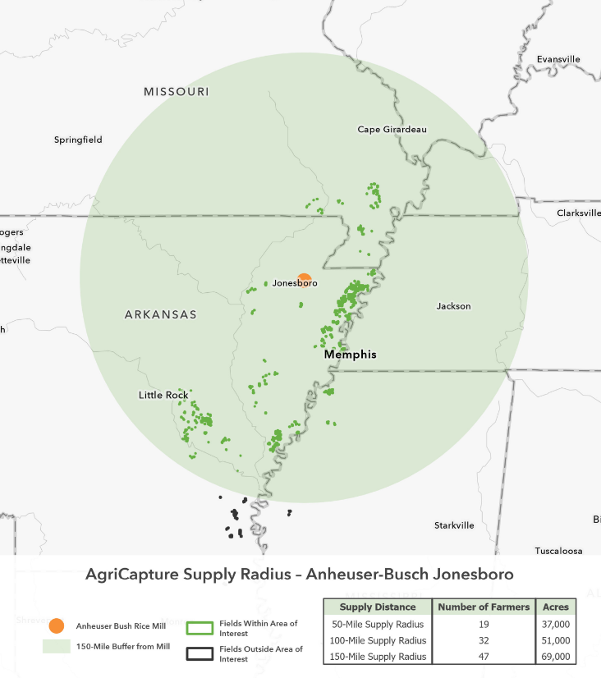
RICE PROCUREMENT
Identity-Preserved Rice
AgriCapture’s logistics network ensures regenerative rice is not comingled at any point in the supply chain:
  Harvest and on-farm storage
  Milling and processing
  Packaging and transport
Make confident product & sourcing claims:
Reduced GHG emissions
Water savings
Farm stories
Nutrition + Heavy Metal content
Carbon footprint data
Homogenized Varietal + Grain Quality
AgriCapture Supply Radius: Sample Mill Location
Sample Mill

Slide 13

WATER SOLUTIONS
Water Stewardship
AgriCapture designs programs tailored to critical watersheds and high-risk regions, quantifying water outcomes with the Volumetric Water Benefit Accounting (VWBA) framework.
Scalable Water Programs
Rice irrigation system conversions that reduce water withdrawals
Regenerative agriculture practices that boost soil moisture retention
Irrigation automation technologies that increase water-use efficiency
Riparian buffers that filter runoff and protect waterways on grazing lands

Slide 14

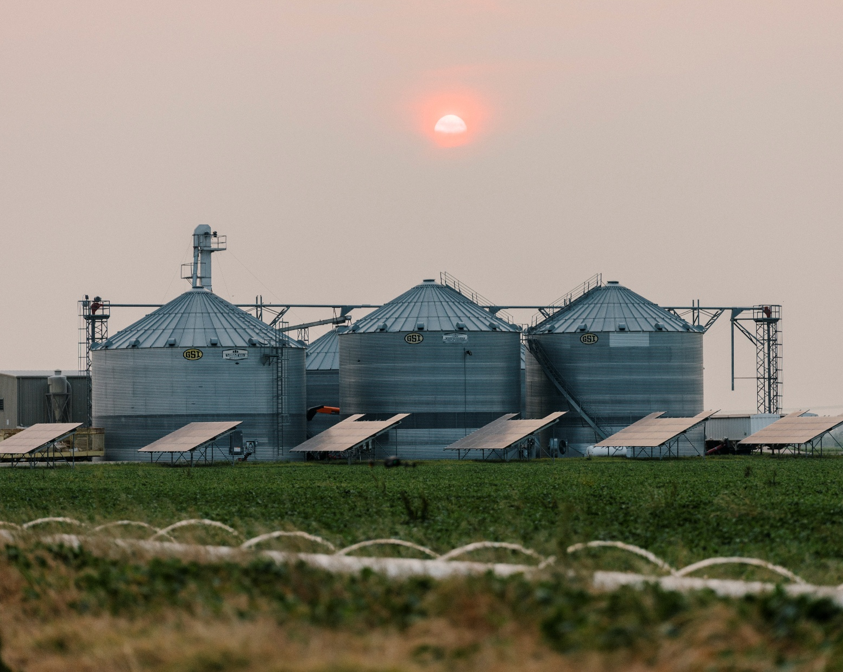
PILOT PROGRAMS
What’s Next
Grasslands Carbon Projects
Avoided Grassland Conversion prevents grassland ecosystems from being developed and converted to cropland, preserving below-ground carbon storage and avoiding greenhouse gas emissions.
Improved Grazing incentivizes ranchers to adopt regenerative grazing techniques that sequester carbon and improve long-term soil and ecosystem health.
45Z Tax Credits (Clean Fuel Production)
Lowering the carbon intensity of feedstocks is essential to maximizing the 45Z credit value per gallon.
In partnership with feedstock co-ops, AgriCapture is implementing MRV services such as
direct grower enrollment
remote sensing to detect cover crops
tracking field activities via farm management software integration

Slide 15
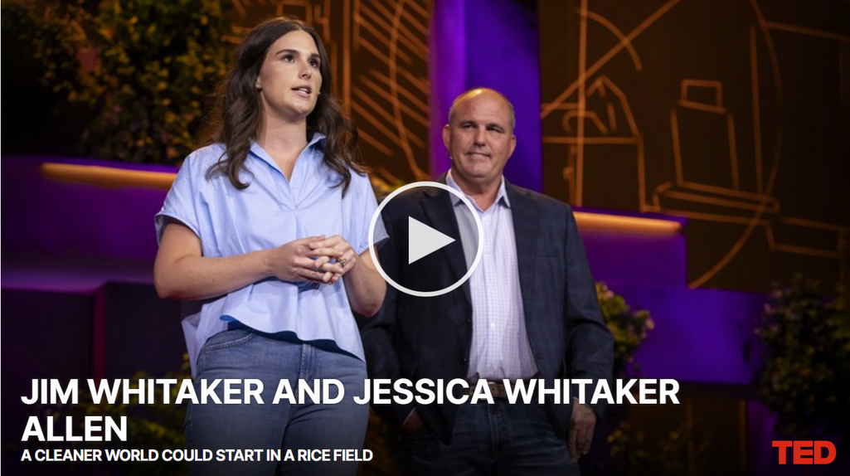
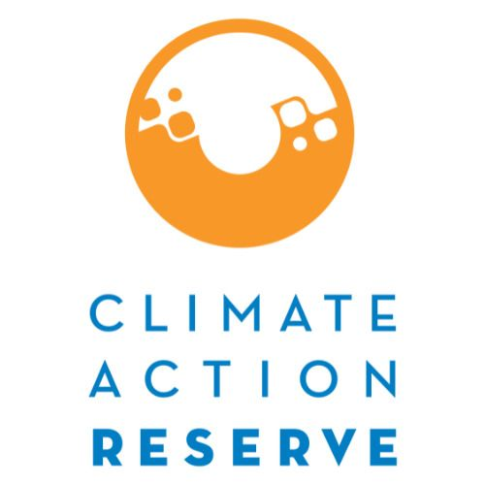







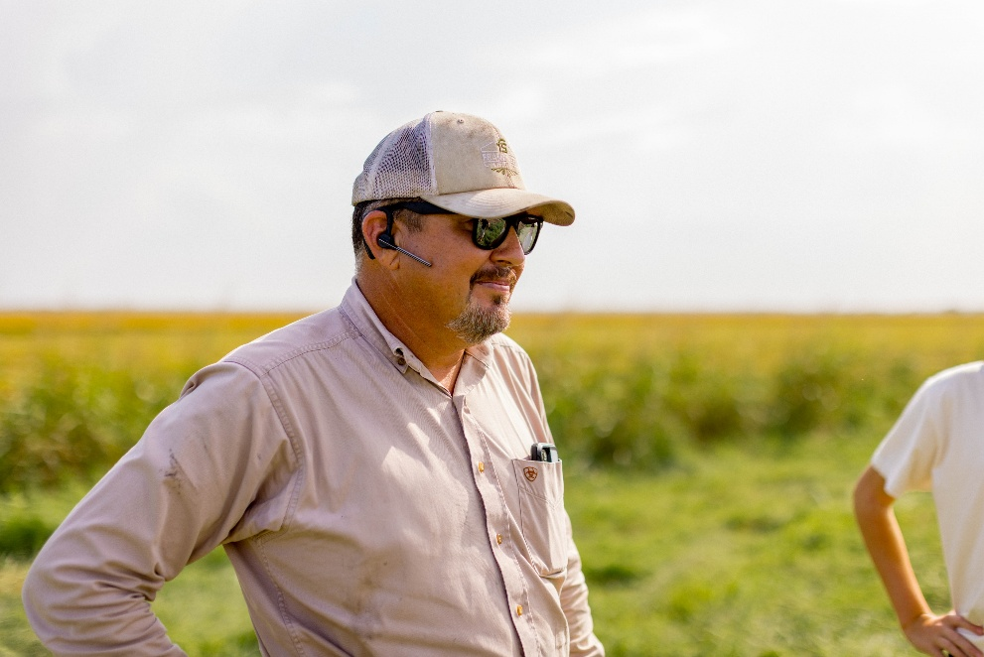
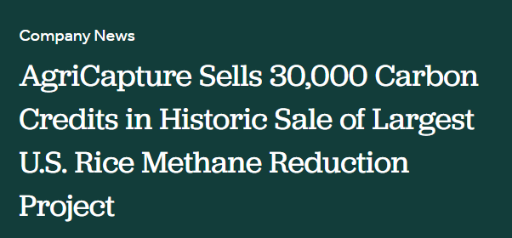


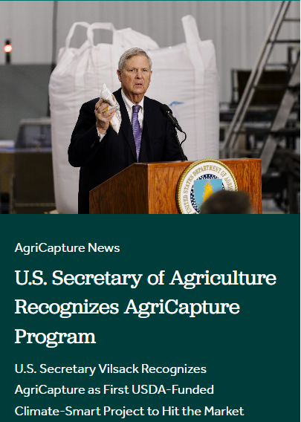



Our Partners
Data Sources + MMRV

Slide 16
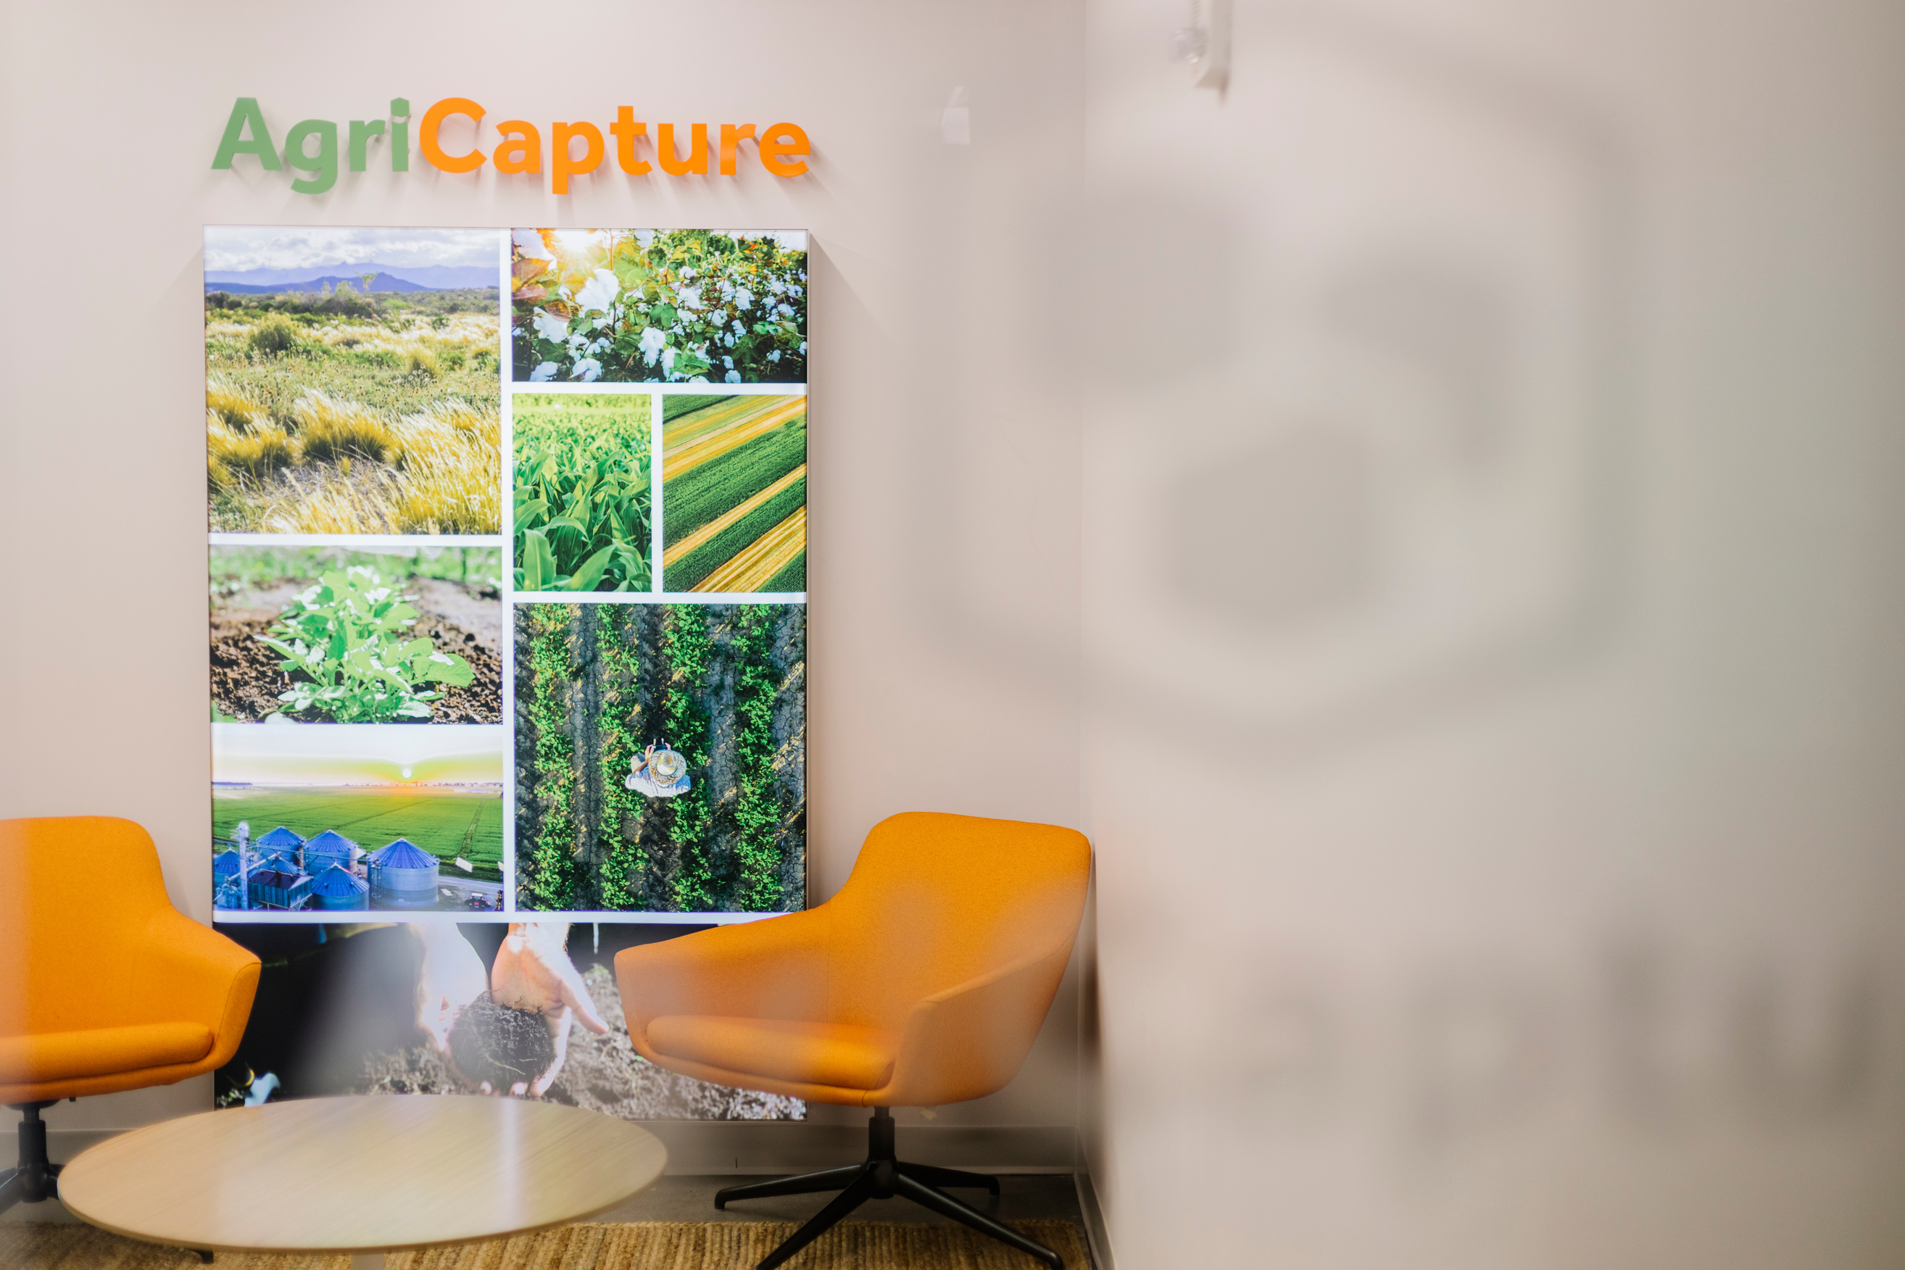
Contact
John Lanahan
Director of Demand
Jlanahan@agricapture.com

