Slide 1
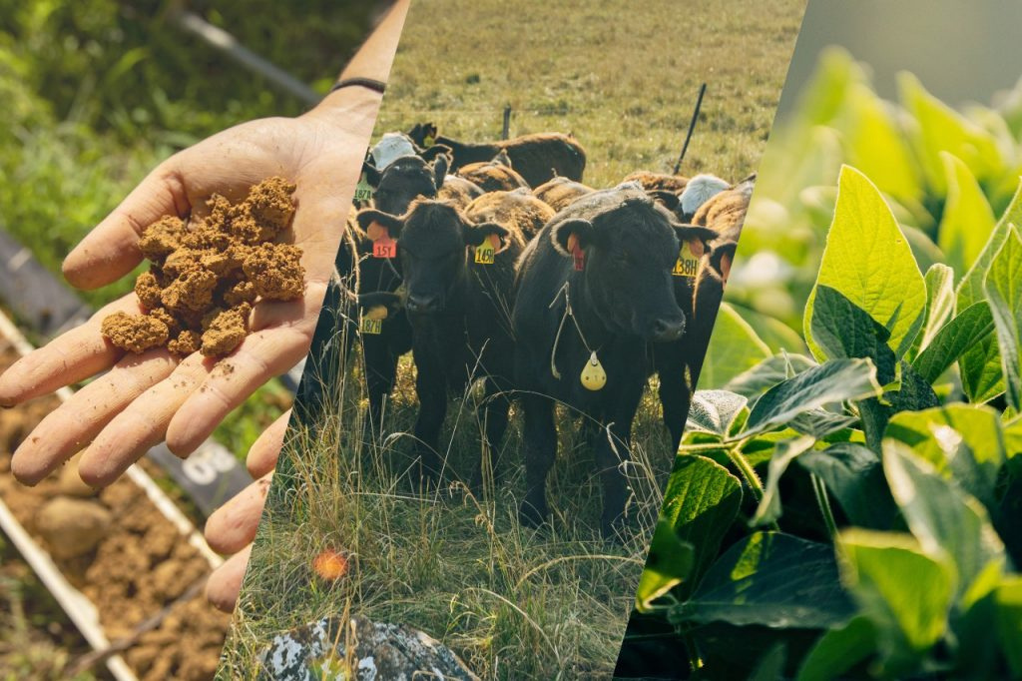
Alliance to Advance
Climate-Smart Agriculture
www.allianceforcsa.org

Slide 2



Slide 3


CIBO transforms agriculture for a profitable, resilient future.
CIBO connects farmers to funding and expertise to adopt sustainable practices and quantifies the financial and environmental impact of those transformations.

Slide 4





Barriers to Farmer Adoption
Knowledge Limitations
Insufficient understanding of farming practices
Capital Constraints
Limited and complicated access to available funding
Financial Vulnerability
Low premiums, advanced market commitments shifts risk to farmers
ROI Measurement
Difficult to credibly measure economic and environmental outcomes

Slide 5
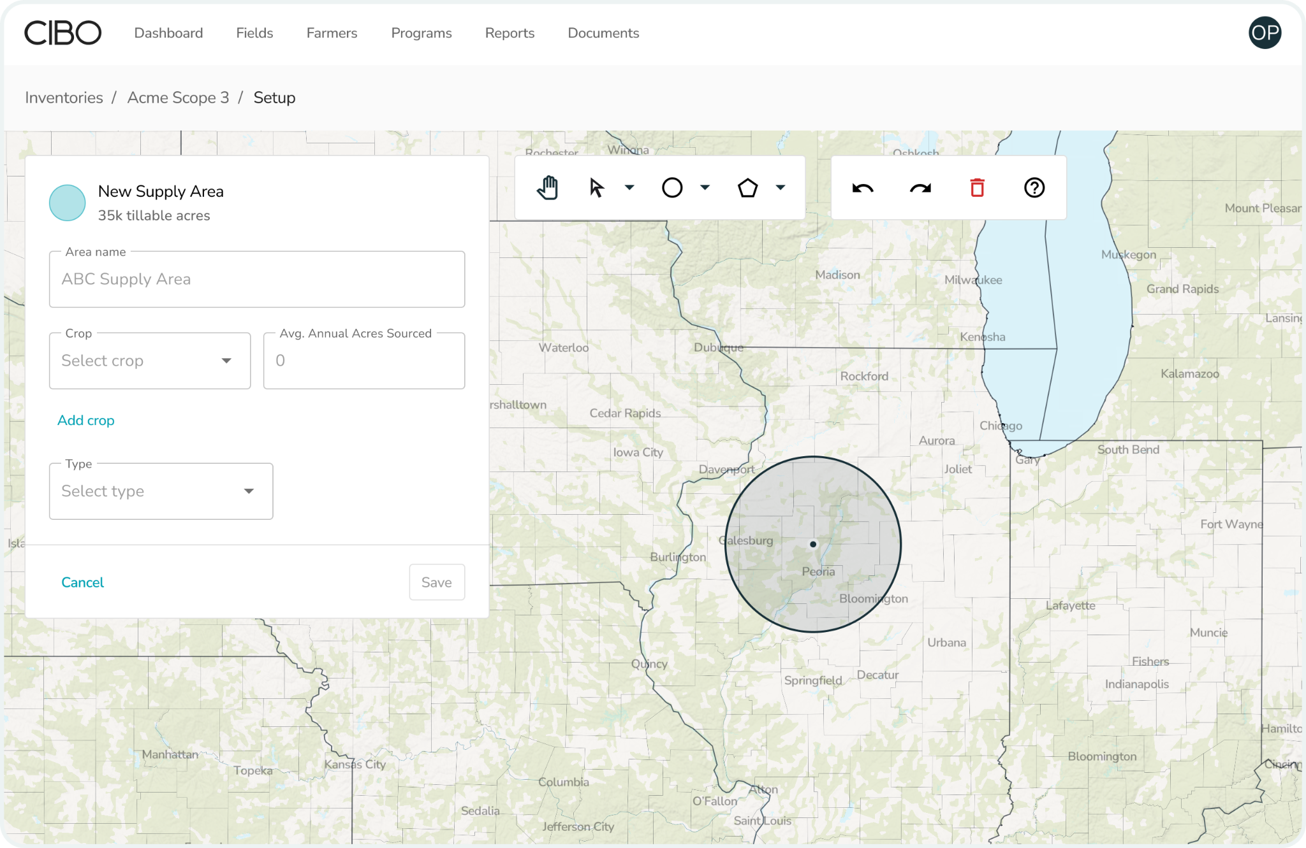
Deploy, Support, and Measure Programs with CIBO Impact
Configurable program and enrollment engine supports any incentive program
Science-based impact quantification and reporting
Scaled analysis of hundreds of millions of acres in real-time
Integrated Government funding supplements corporate dollars

Slide 6







Software Powers Private & Public Programs for
Ag Leaders
Program Acceleration
Design and scale programs faster
Operational Efficiency
Save versus building and maintaining own platform
Long-Term Value Creation
Enables coupling across programs,
ability to create impact assets

Slide 7

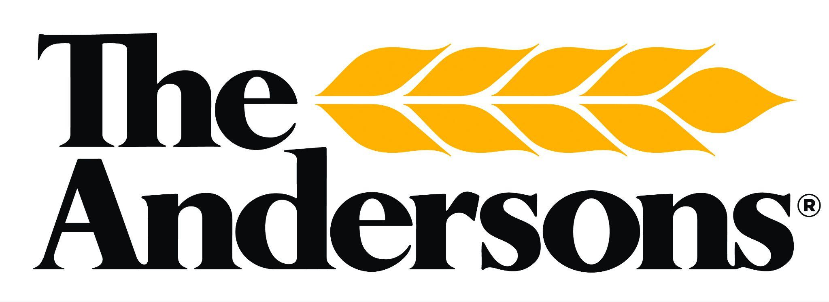

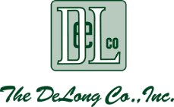

Trusted Advisor Network
CIBO’s Trusted Advisor Network: Driving Adoption at Scale
Covers ~100M acres through ag retailers, certified crop advisors, agronomists and TSPs
30+ regional advisors actively supporting conservation program uptake
Partners include national and regional organizations across the ag value chain
Deep relationships with farmers unfamiliar with NRCS processes
Partners include:

Slide 8



Recent Work in NRCS Programs
EQIP: Trusted Advisor Network
Grower network with access to 100 million acres
Submitted application covering 100 K acres focused on soil health practices
Submitting 1+ million acres for 2026 programs
RCPP: Sand County Foundation
Partner with $13M AFA RCPP grant, led by the Sand County Foundation
Enabling farmer enrollment and application submissions across 15 farming organizations in multiple states; data and documentation reporting for both grant administrators and NRCS officials
AMP: Alliance for Climate Tech
CIBO is the technology partner for $80M AMP grant, led by Virginia Tech university
Supporting complete modeling and reporting needs for both public and private grant stakeholders

Slide 9


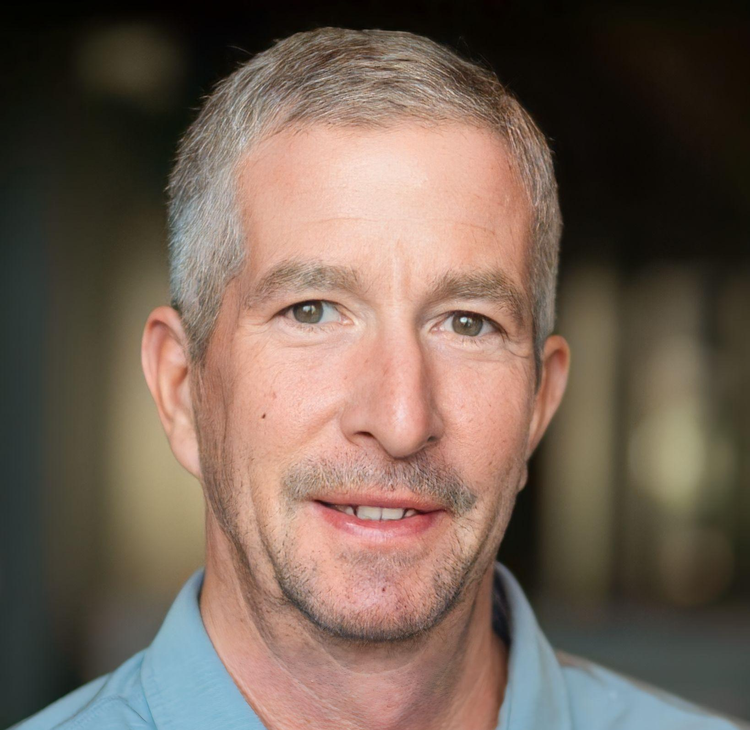
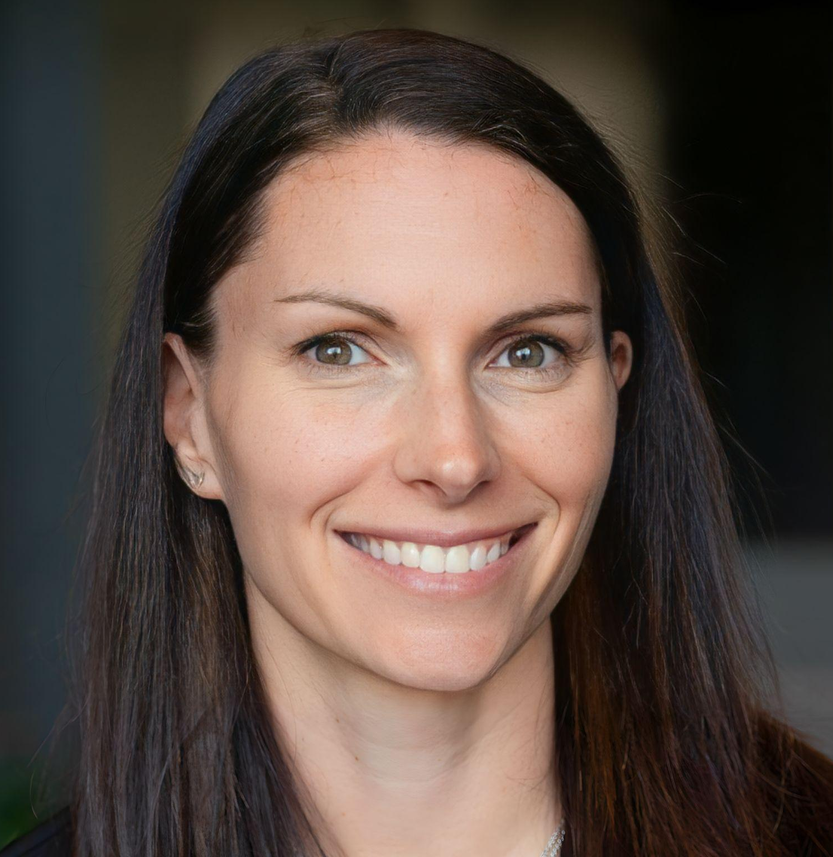

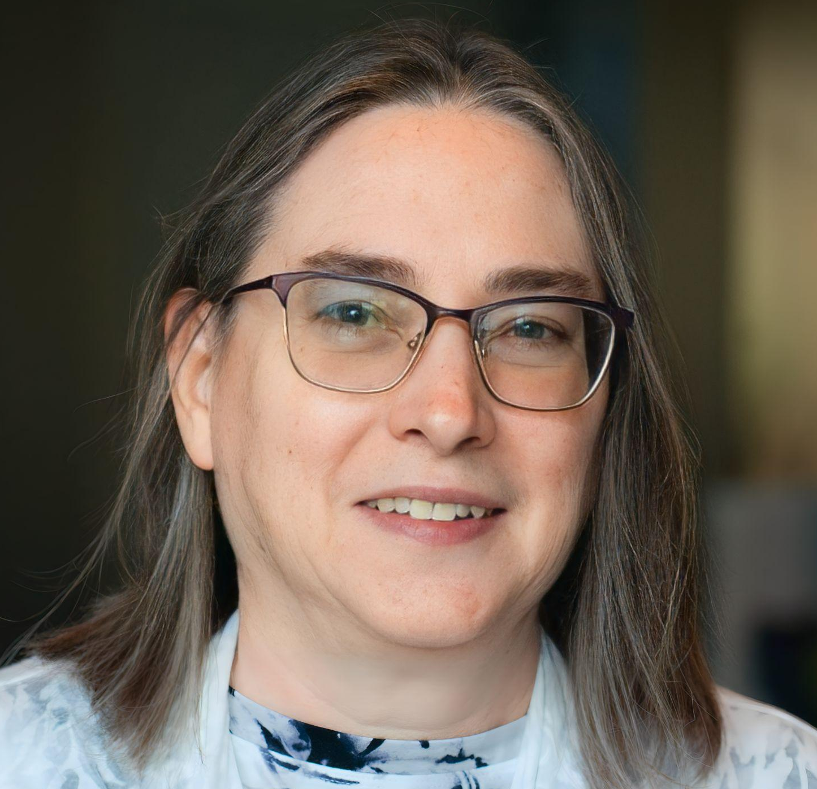


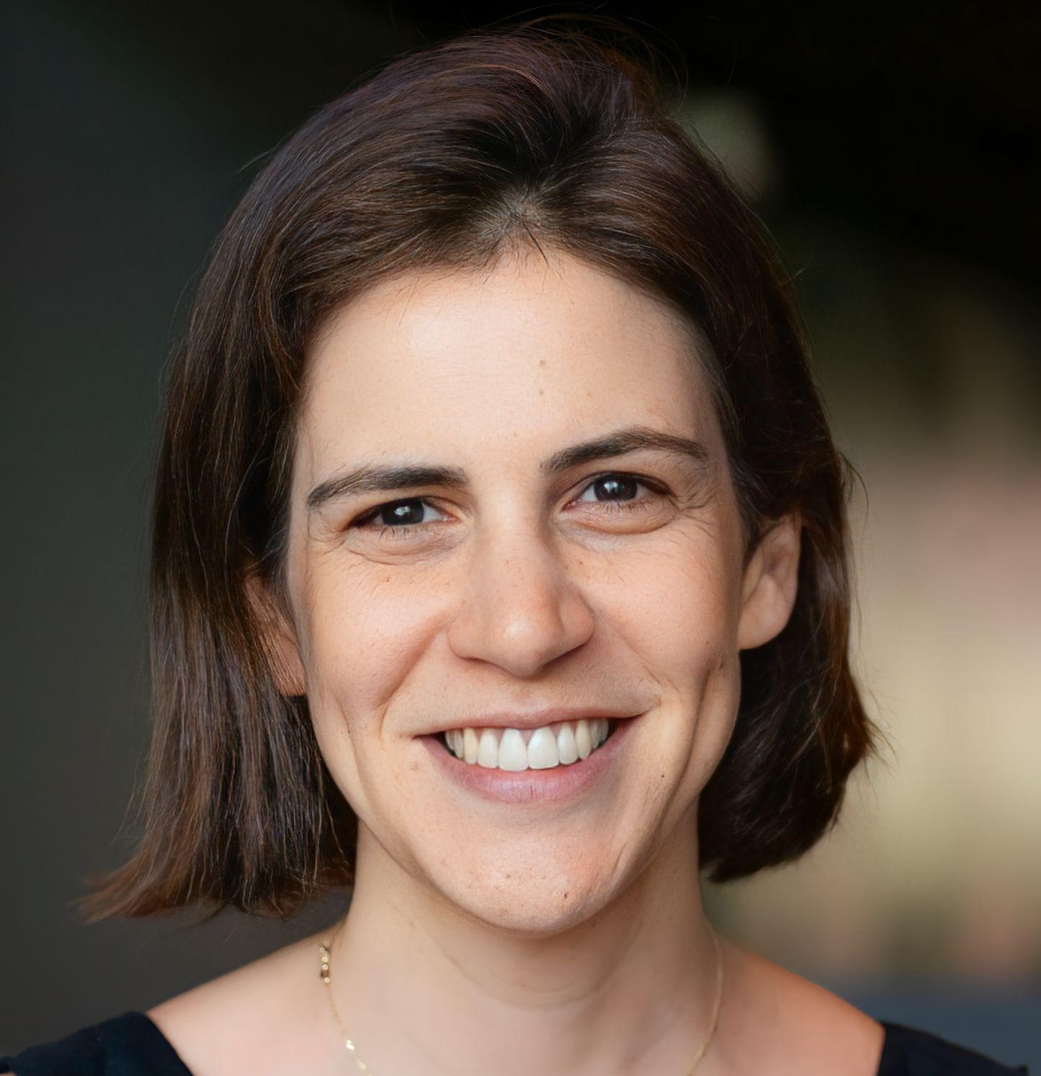


Leadership Team
BOARD MEMBERS
Ignacio Martinez
CHAIRMAN
CIBO Co-Founder, General Partner
at Flagship Pioneering, Syngenta
Ventures founding member
TEAM
Margo Georgiadis
CEO-Partner at Flagship Pioneering, former President and CEO of Ancestry
Daniel Ryan
CHIEF EXECUTIVE OFFICER
Jennifer Lovequist
VP, PRODUCT MANAGEMENT
Hugh Grant
Former Monsanto Chairman & CEO
Marie Coffin, PhD
VP, SCIENCE & MODELING
Michael Browne
VP, BUSINESS DEVELOPMENT
Trisa Thompson
Former Dell Executive & Social Responsibility Leader
Nitzan Haklai
VP, SALES & MARKETING
Bruno Basso, PhD
CO-FOUNDER & CHIEF SCIENTIST, CIBO
Michael Toelle
Owner, T & T Farms, Board member, Nationwide Insurance & CF Industries Holdings.

Slide 10
Alliance to Advance
Climate-Smart Agriculture
www.allianceforcsa.org

Slide 11
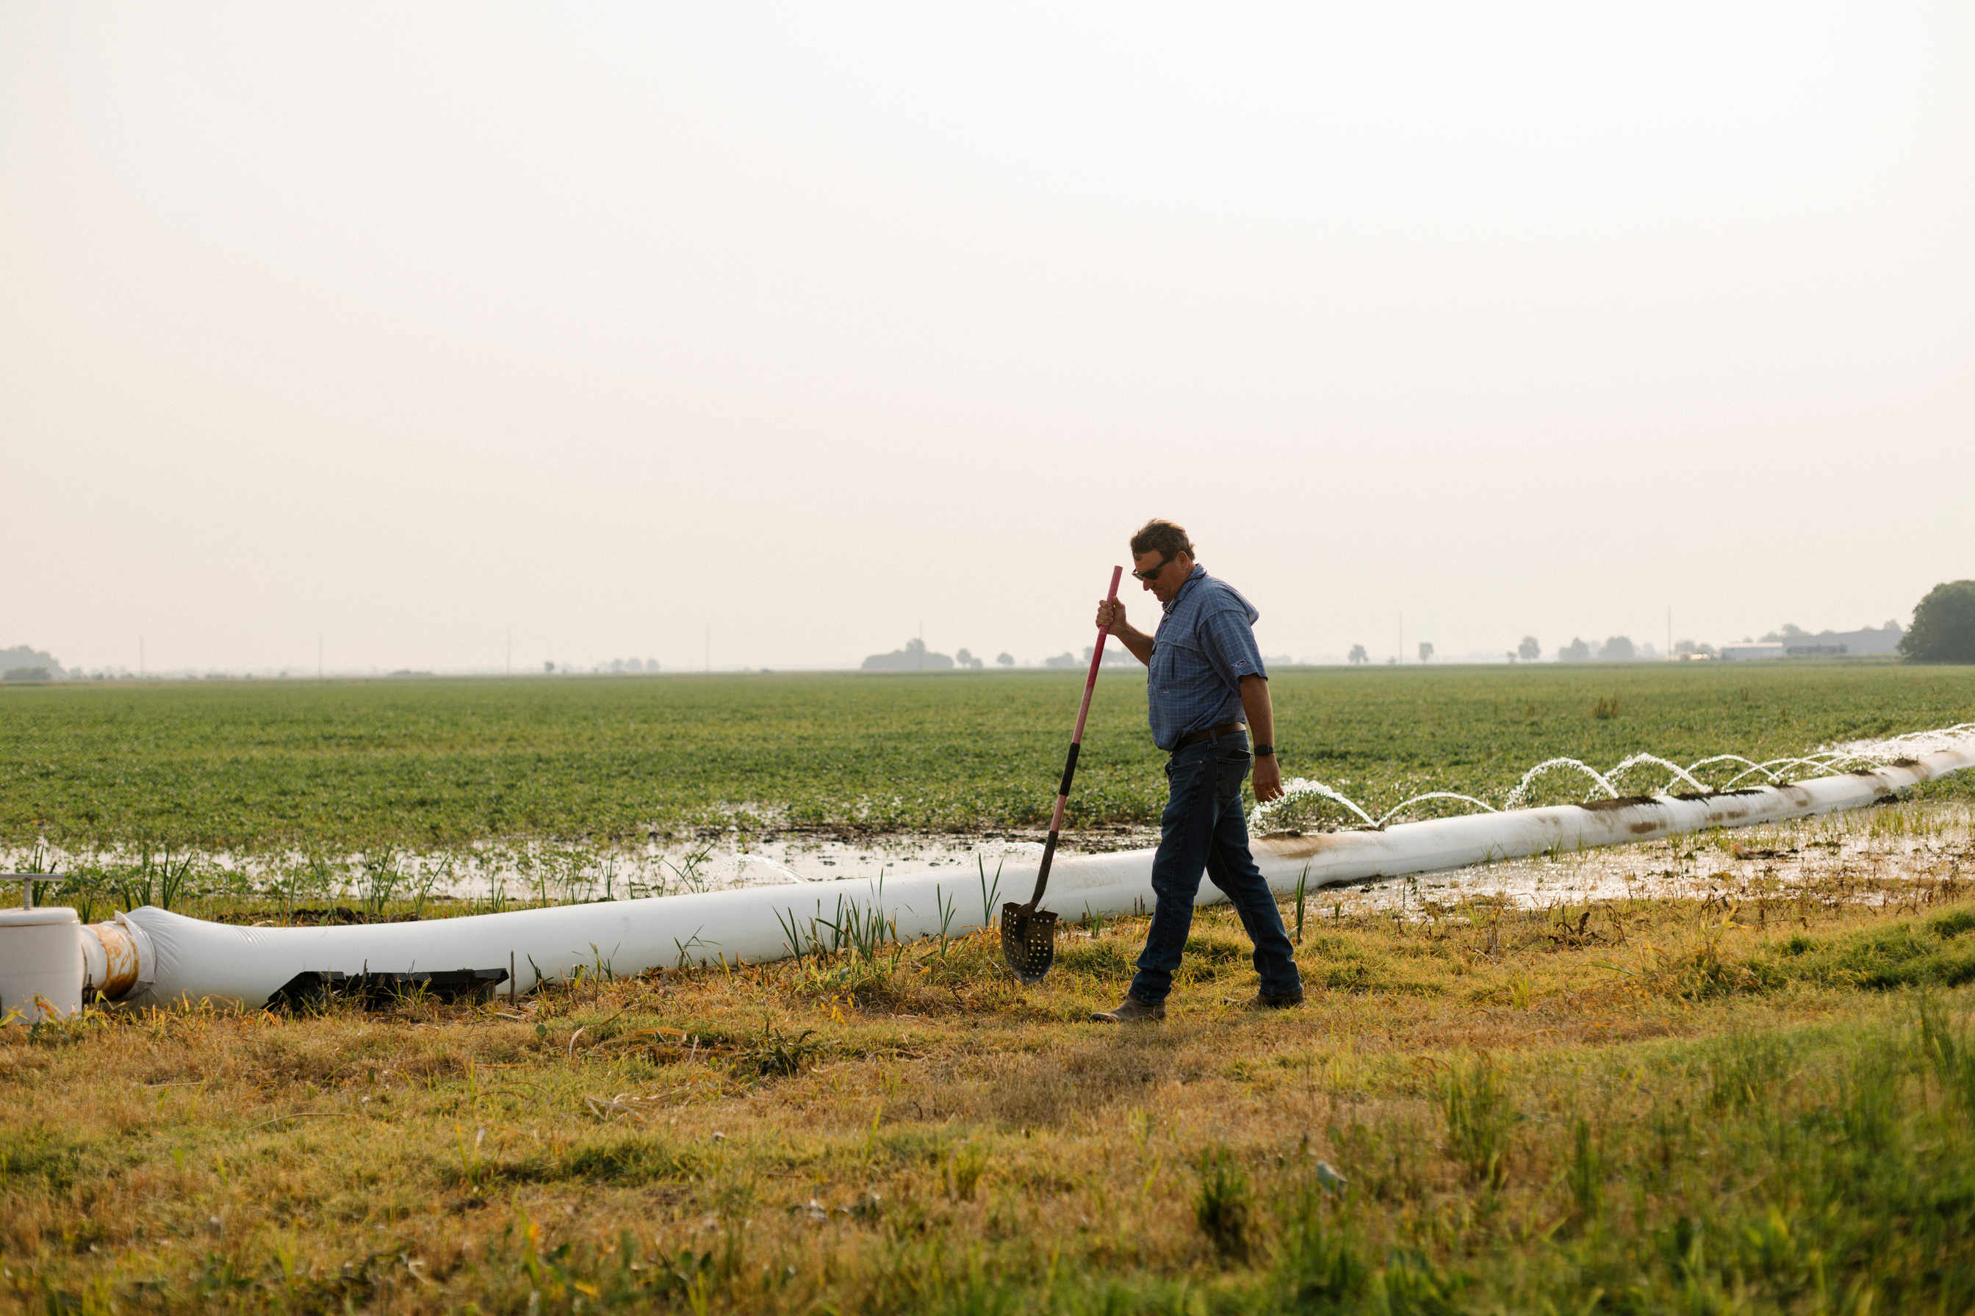

AgriCapture Platform Overview
Decarbonizing rice supply chains.

Slide 12


CHALLENGE
Rice Feeds Half of the World's Population
Yet, as a continuously flooded crop, rice cultivation represents significant…
Methane Emissions
Emissions on par with global aviation
12% of global methane emissions
1.5% of total GHG emissions
Water Intensity
Second most water intensive crop
130 gallons of water consumed per 1lb of rice
Heavy Metals
Largest dietary source of inorganic arsenic
Rice absorbs 10x more inorganic arsenic than other grains due to flooded conditions
AgriCapture has built a scalable solution to mitigate the impact and verify outcomes of all three.

Slide 13
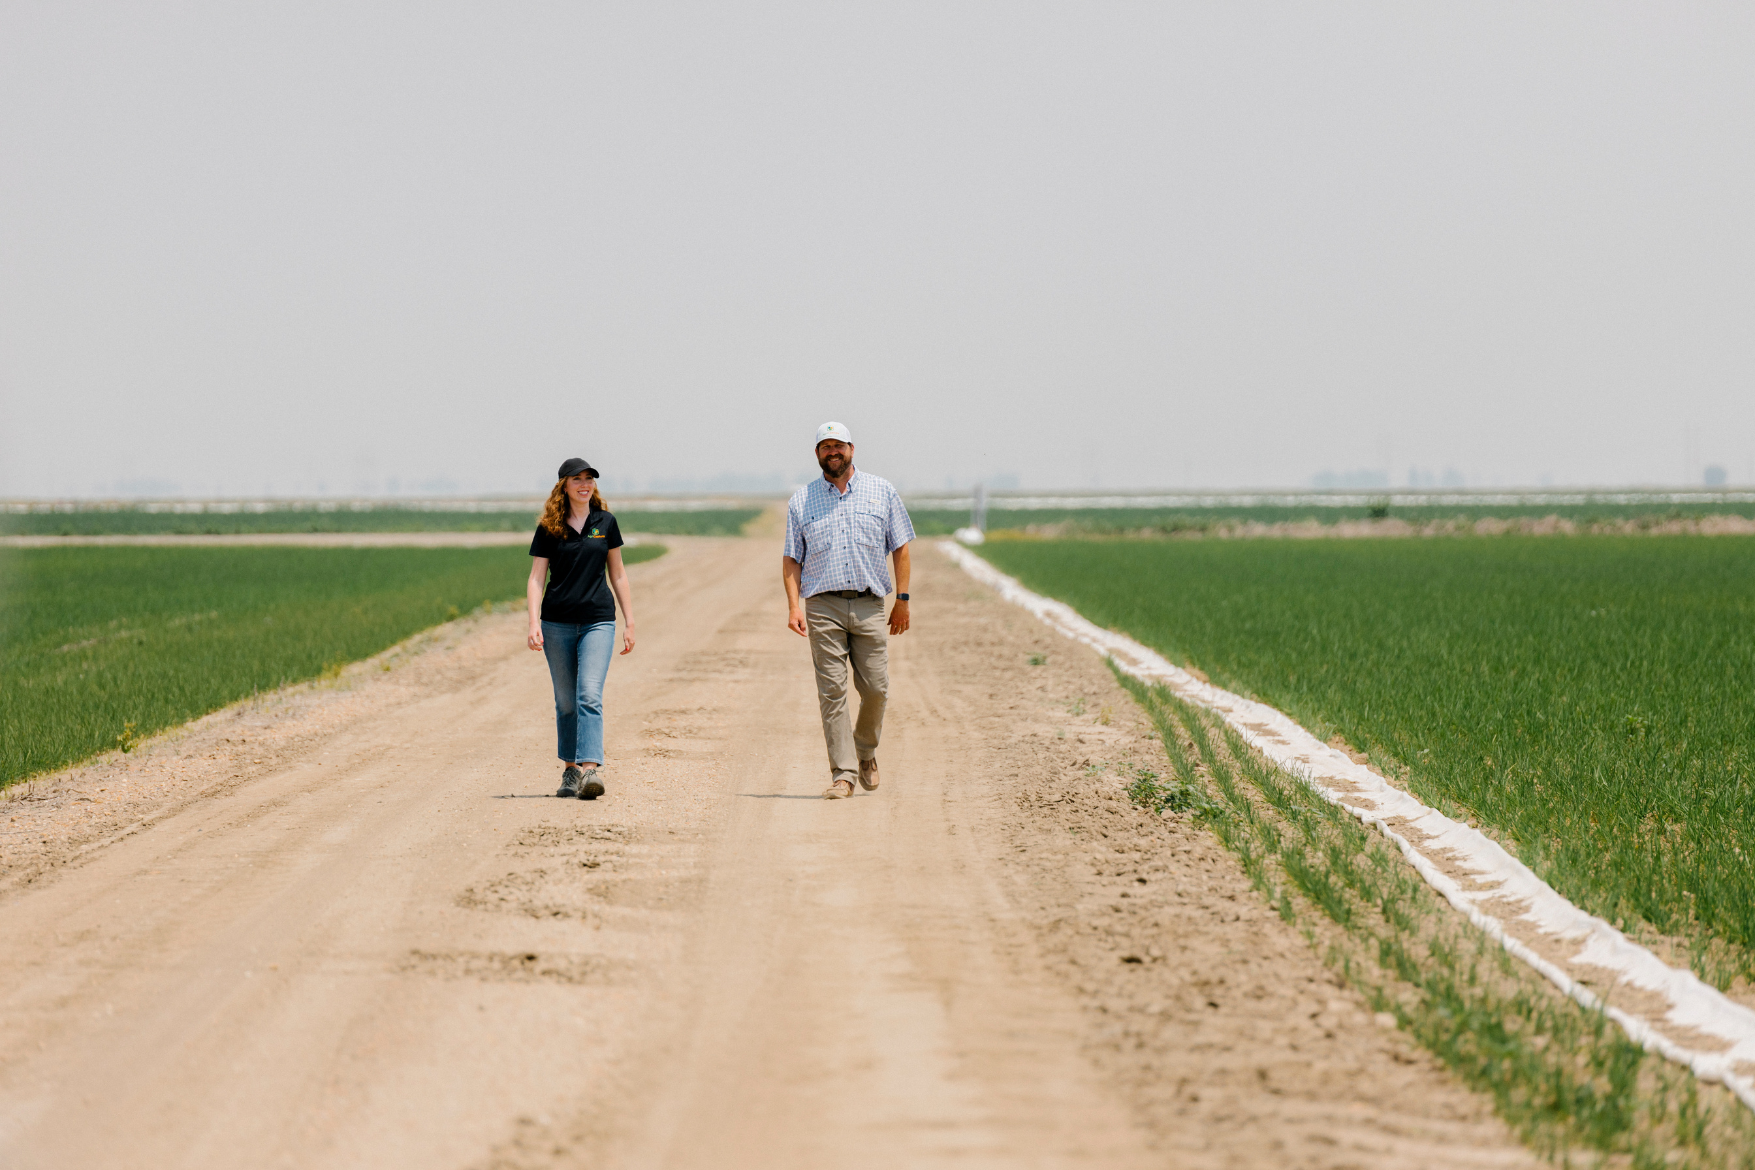
OUR SOLUTION
To grow responsibly, first we build farmer trust.
So, we know-
Real farmers
Real data
Real change

Slide 14
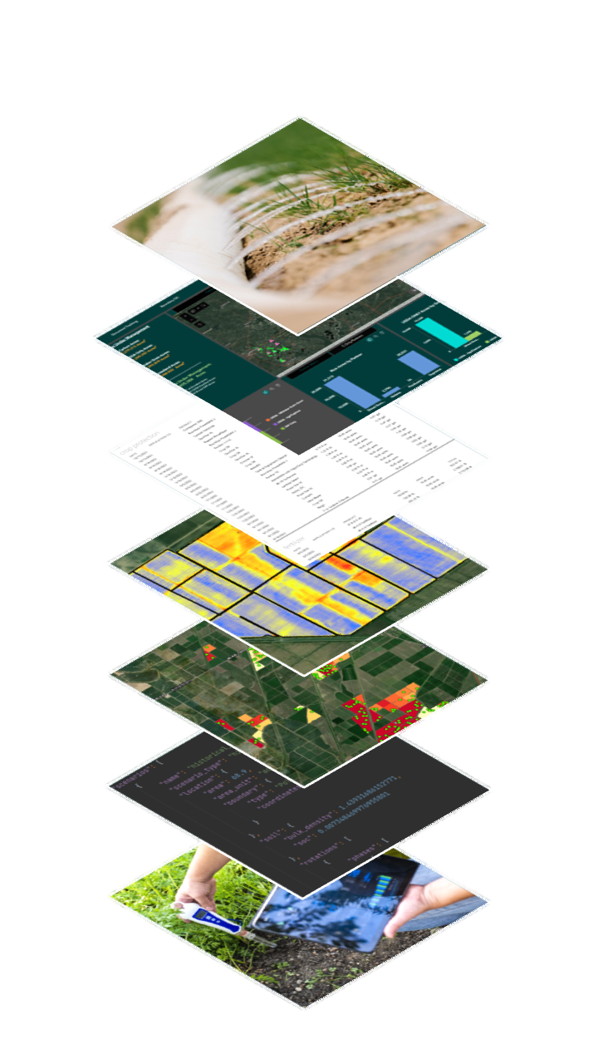
OUR SOLUTION
AgriCapture Tech Stack
Science Backed,
Farmer Approved Process
Sustainable Agriculture + Agronomic Support
Incentivized practice changes to Alternate Wetting and Drying, Furrow Irrigated Rice and Direct Seeded Rice
Agronomic support to grow rice sustainably and maintain yields
Low burden data collection and administration on the farmer
Streamlined remote sending and emissions modeling
Environmental asset creation and farmer revenue share
Enrollment Platform
Field-Level Data Collection
Remote Irrigation Analysis
Soil Sampling
Emission Reduction Modeling
Third-Party Verification

Slide 15
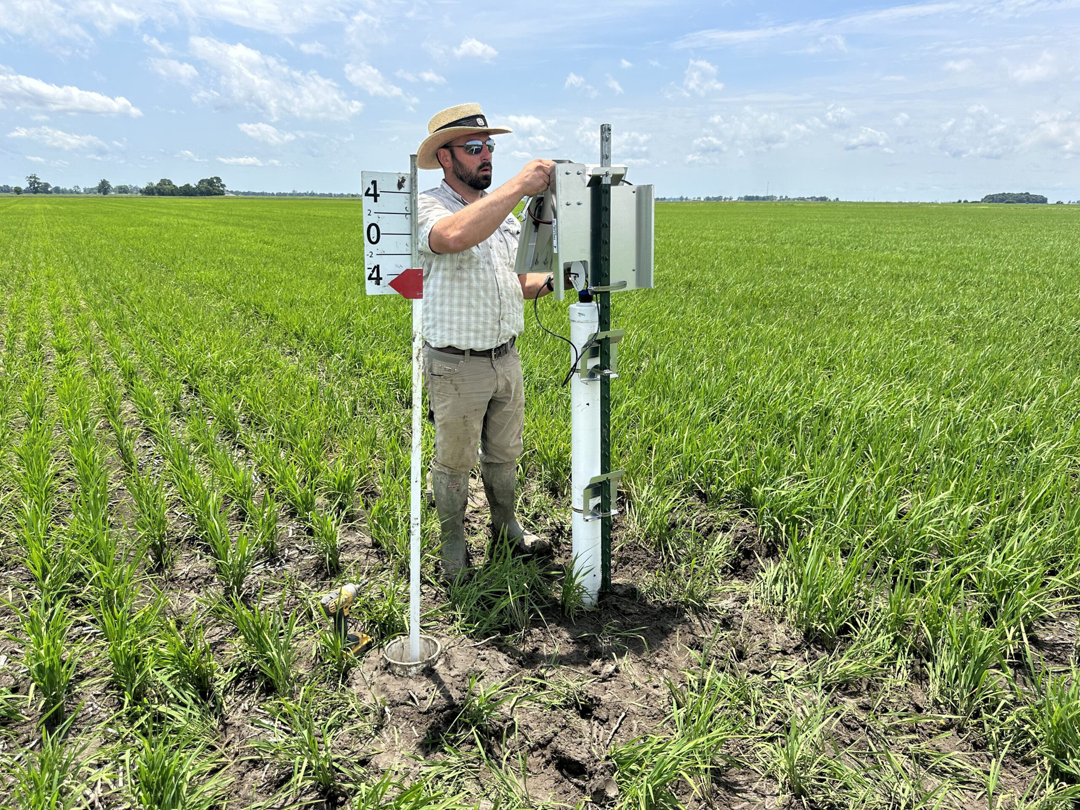
OUR SOLUTION
Measuring what matters
We measure + certify rice growing outcomes that matter across the supply chain.
Water usage
GHG emissions
Carbon intensity
Heavy metals
Average Outcomes Across AgriCapture Farmer Network:
70% Methane Emissions Reductions
30% Water Savings
27% Reductions in Arsenic

Slide 16
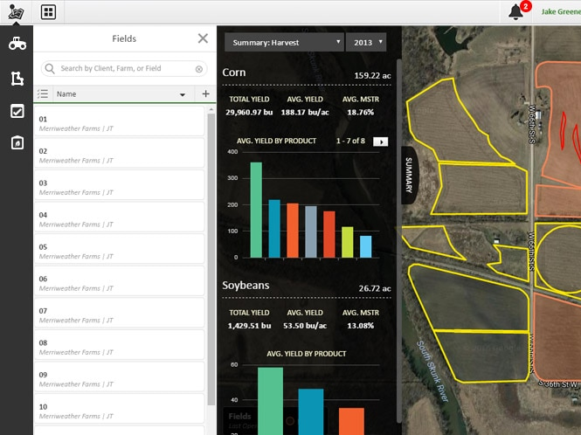

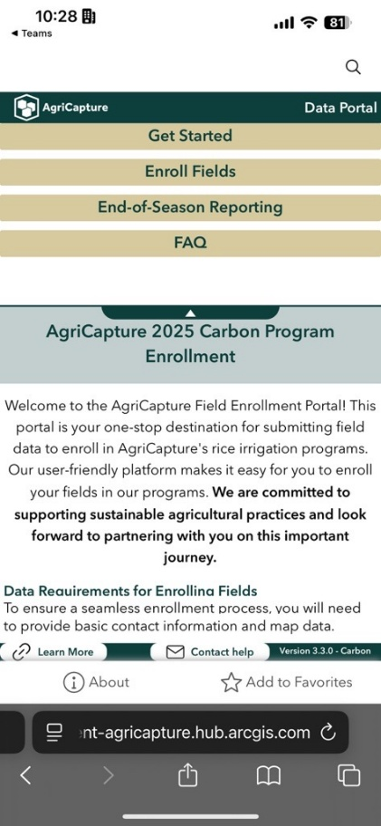
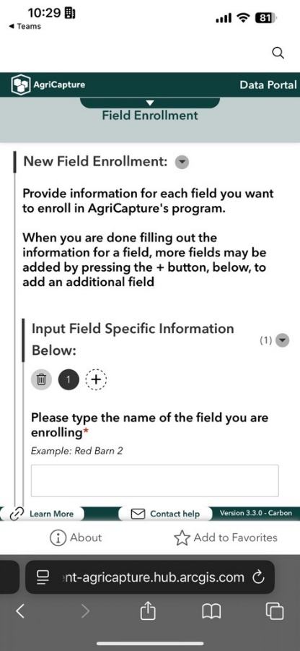
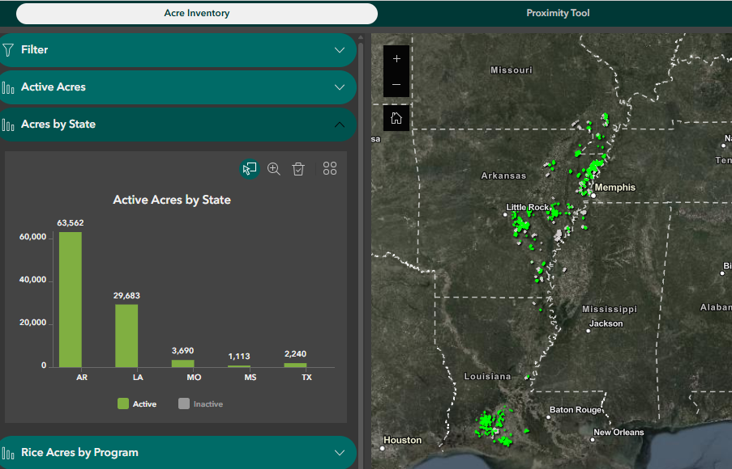
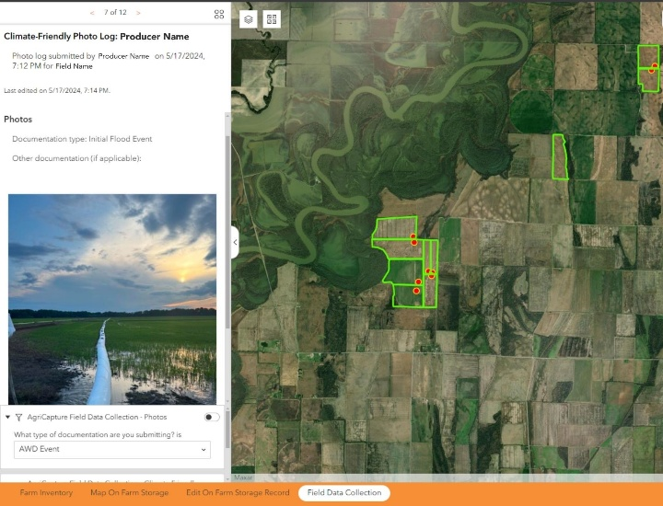
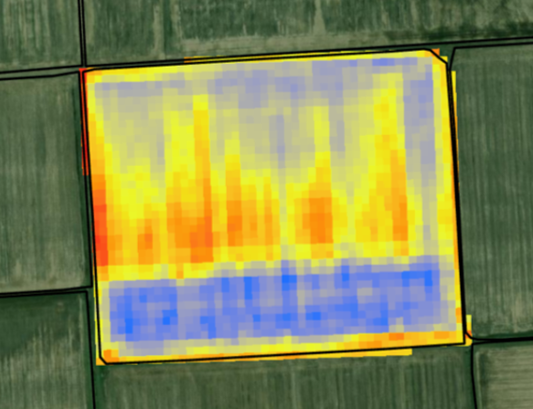
OUR SOLUTION
Farmer Enrollment
Field Data Collection
Acre360: Inventory Management
API with John Deere Operations Center to directly pull data into AgriCapture’s platform
Farmer photo app to record time and location of irrigation events.
Farmer-tested and mobile-friendly enrollment platform
Platform for monitoring and managing all field data and auto-generating reports
Satellite moisture detection to monitor field irrigation.

Slide 17
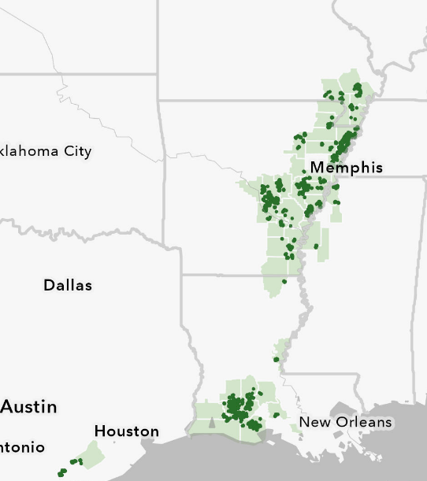
OUTCOMES
Impact to Date
As of 2024 harvest, AgriCapture’s rice programs have resulted in:
70,000 tons of CO₂e reduced
21 billion gallons of water saved
27% reduction in heavy metals in the grain
In 2025, AgriCapture has:
Scaled regenerative farming across 6% of all U.S. rice acres
Increased farmer enrollment by 264%
Expanded project globally to Brazil

Slide 18
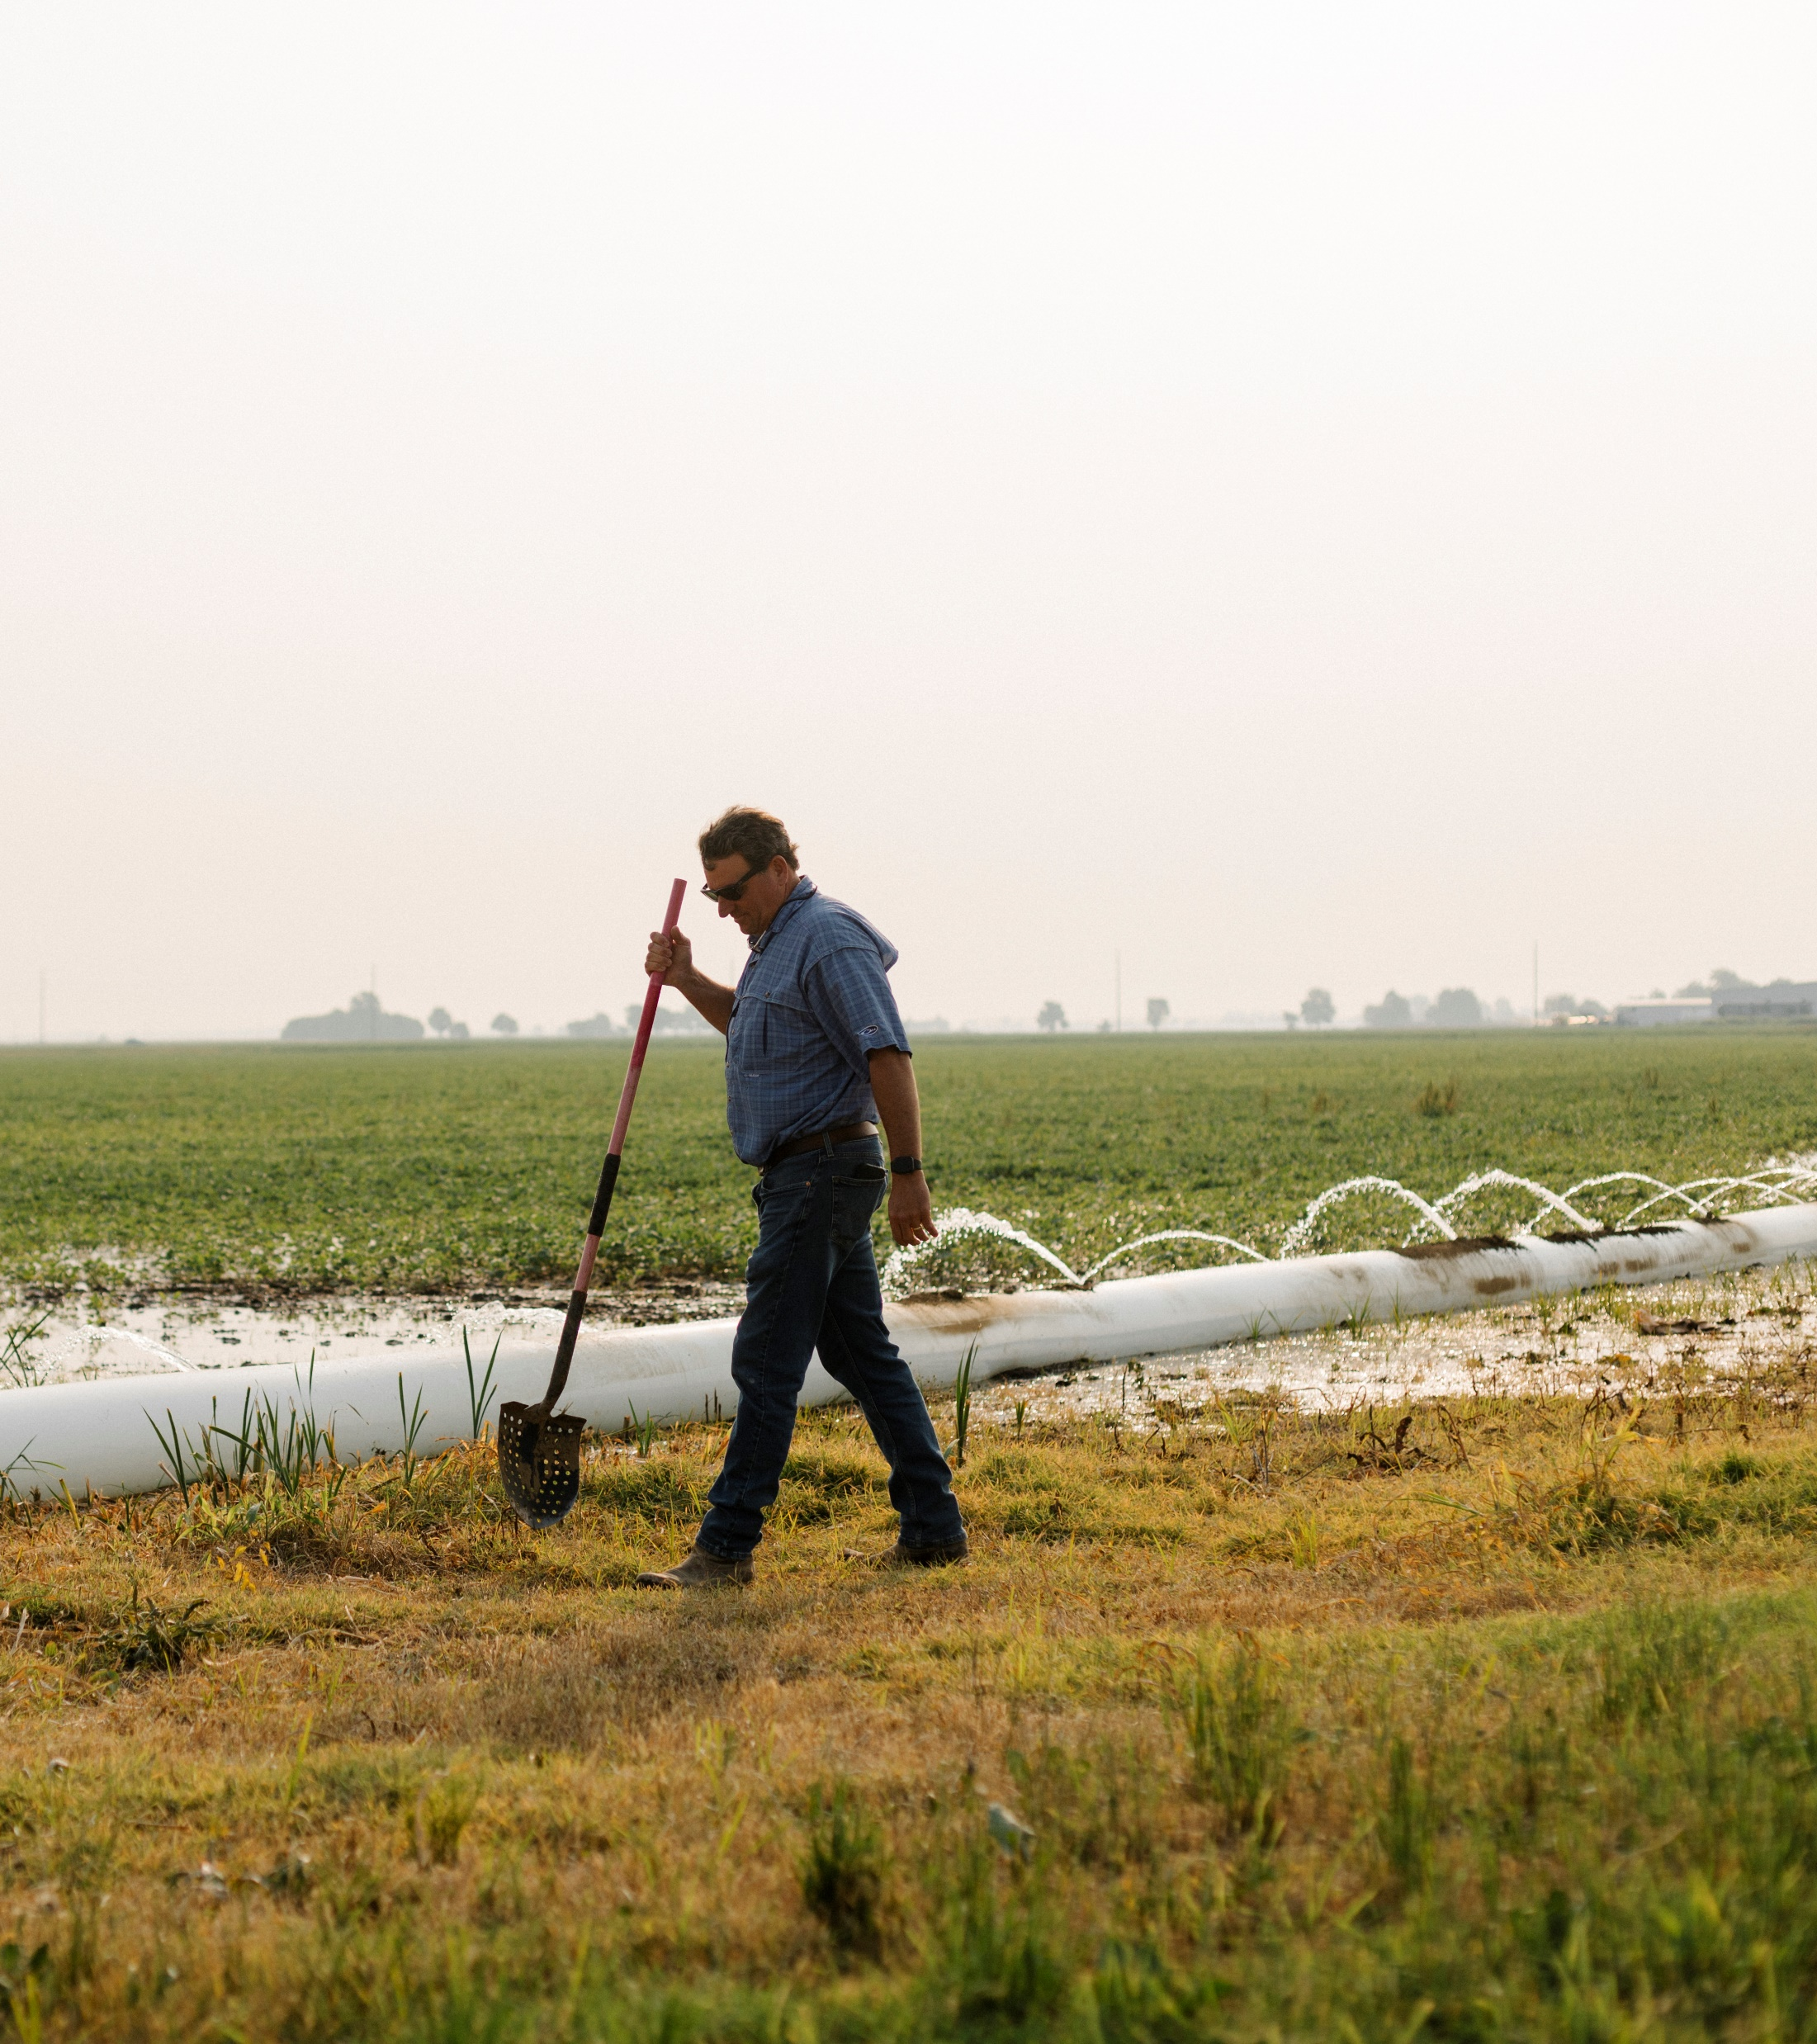
Supporting farmers + farmland
AgriCapture incentivizes regenerative farming to deliver trusted sustainability solutions:
Rice Methane Carbon Credits
Scope 3 Solutions
Identity-Preserved Rice
Water Stewardship
“AgriCapture makes it possible for us to turn our sustainable practices into revenue. It’s a win for both our farm and the environment.“
Michael McCarty
Arkansas Rice Farmer

Slide 19
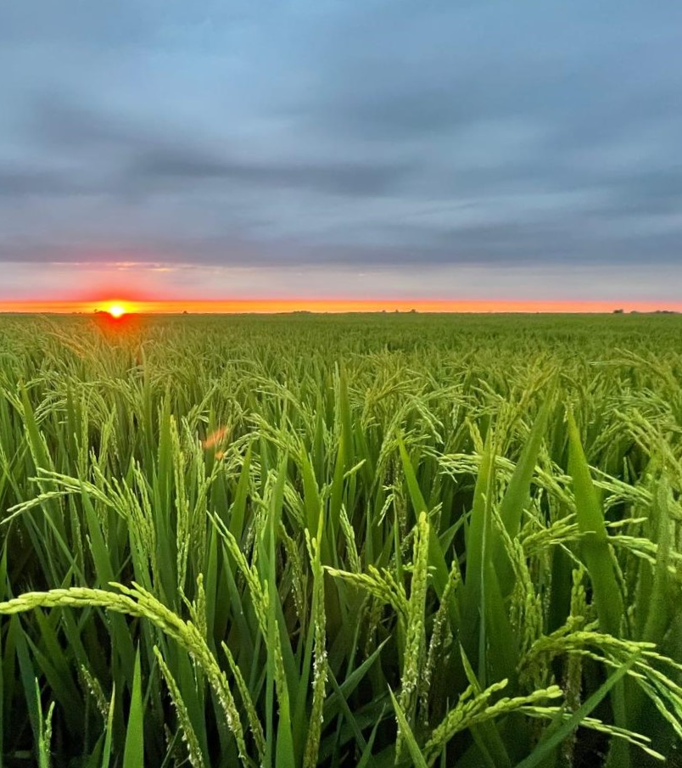
EMISSIONS REDUCTIONS
Rice Methane Reduction Credits
Farmers received historic first-of-a-kind payments for carbon credits generated by adopting methane-reducing practices.
Project Results:
21 billion gallons of water saved
70,000+ tons CO₂e reduced
Sold 33,025 credits to date to large international banks, travel, and technology companies
“Carbon credits help us adopt sustainable practices that require higher investment, and this project allows us to do so in a way that works for our operation.”
Gavin Sullivan
Arkansas Rice Farmer

Slide 20
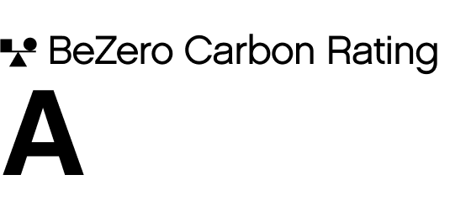
EMISSIONS REDUCTIONS
Rice Methane Reduction Credits
Farmers received historic first-of-a-kind payments for carbon credits generated by adopting methane-reducing practices.
Project Results:
21 billion gallons of water saved
70,000+ tons CO₂e reduced
Sold 33,025 credits to date to large international banks, travel, and technology companies
Top 10% of projects in the VCM
Highest-rated U.S. agriculture project
Highest-rated rice methane project in the world

Slide 21

SUPPLY CHAIN
Scope 3 Solutions
 | Inventory Accounting | Intervention Accounting
What it Measures | Actual emissions in the value chain | Emissions reduction from a specific project
AgriCapture Process | AgriCapture partners with suppliers, leveraging historical farmer data to measure baselines, and incorporates any emission reductions from AgriCapture farmer network | AgriCapture enrolls additional acres and farmers, incentivizes practice changes, and delivers third party verified emissions reduction credits.
Deliverable | LCA and Emission Factor Report from specific supply shed | Verified emission reduction inset credits
Use case | GHG reporting, SBTi targets | Insetting, climate finance, carbon markets
Example | Lower Emission Factor from switching suppliers | Paying farmers to adopt AWD
Mill Relationships in Priority Rice Regions
AgriCapture Program Emission Factor
Emissions/Finished CWT by Life Cycle Stage
Supreme Rice, Crowley, LA
Producers Rice Mill, Stuttgart, AR
Specialty Rice, Brinkley, AR
Windmill Rice, Jonesboro, AR
Land Use Conversion
Input Acquisition
On-Farm Calculation
+
=
22.36
kg CO₂e
+
0.0 kg CO₂e
6.25 kg CO₂e
16.11 kg CO₂e

Slide 22
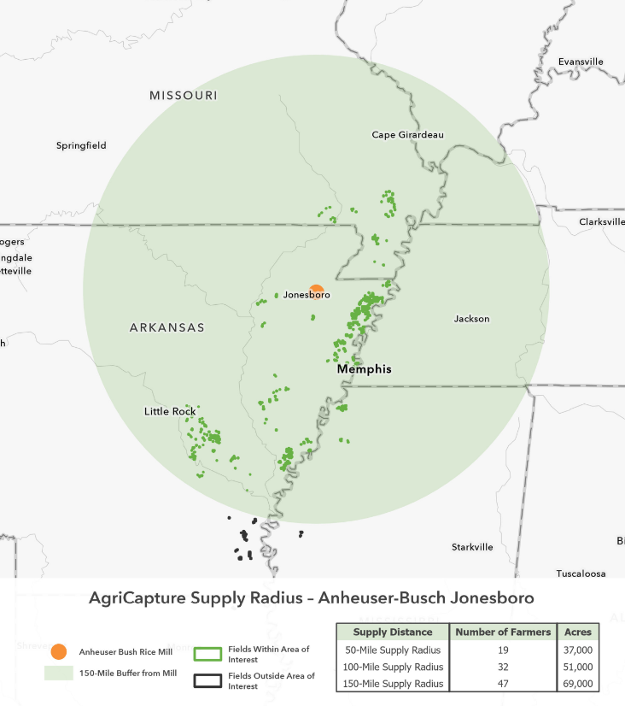
RICE PROCUREMENT
Identity-Preserved Rice
AgriCapture’s logistics network ensures regenerative rice is not comingled at any point in the supply chain:
  Harvest and on-farm storage
  Milling and processing
  Packaging and transport
Make confident product & sourcing claims:
Reduced GHG emissions
Water savings
Farm stories
Nutrition + Heavy Metal content
Carbon footprint data
Homogenized Varietal + Grain Quality
AgriCapture Supply Radius: Sample Mill Location
Sample Mill

Slide 23

WATER SOLUTIONS
Water Stewardship
AgriCapture designs programs tailored to critical watersheds and high-risk regions, quantifying water outcomes with the Volumetric Water Benefit Accounting (VWBA) framework.
Scalable Water Programs
Rice irrigation system conversions that reduce water withdrawals
Regenerative agriculture practices that boost soil moisture retention
Irrigation automation technologies that increase water-use efficiency
Riparian buffers that filter runoff and protect waterways on grazing lands

Slide 24

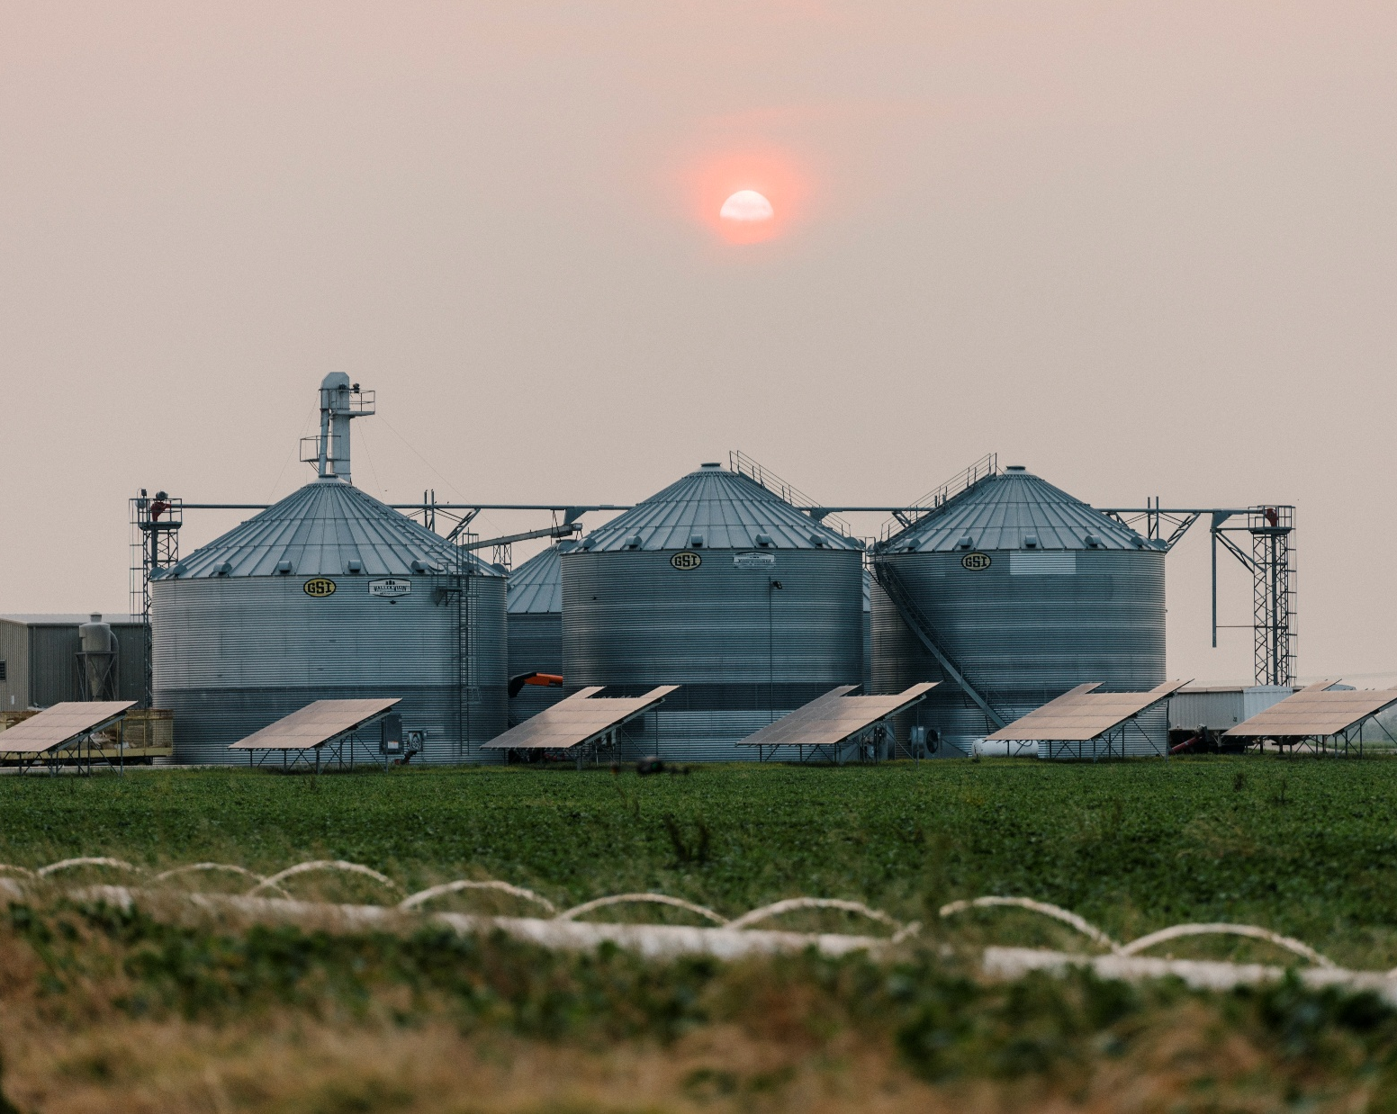
PILOT PROGRAMS
What’s Next
Grasslands Carbon Projects
Avoided Grassland Conversion prevents grassland ecosystems from being developed and converted to cropland, preserving below-ground carbon storage and avoiding greenhouse gas emissions.
Improved Grazing incentivizes ranchers to adopt regenerative grazing techniques that sequester carbon and improve long-term soil and ecosystem health.
45Z Tax Credits (Clean Fuel Production)
Lowering the carbon intensity of feedstocks is essential to maximizing the 45Z credit value per gallon.
In partnership with feedstock co-ops, AgriCapture is implementing MRV services such as
direct grower enrollment
remote sensing to detect cover crops
tracking field activities via farm management software integration

Slide 25
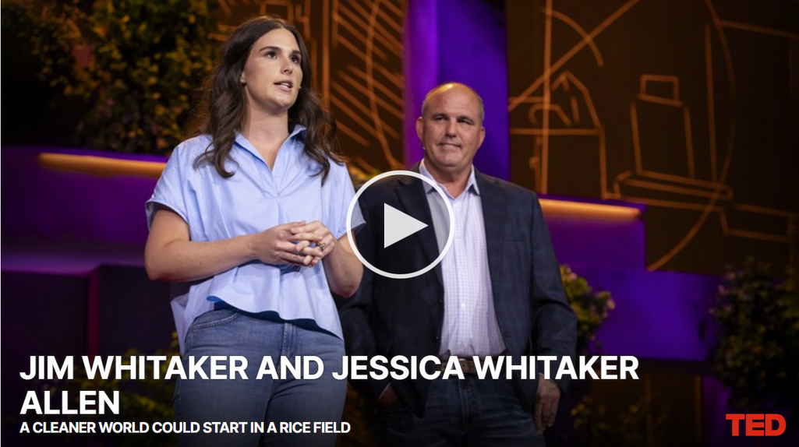
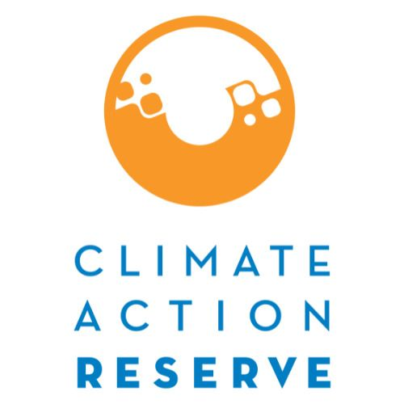







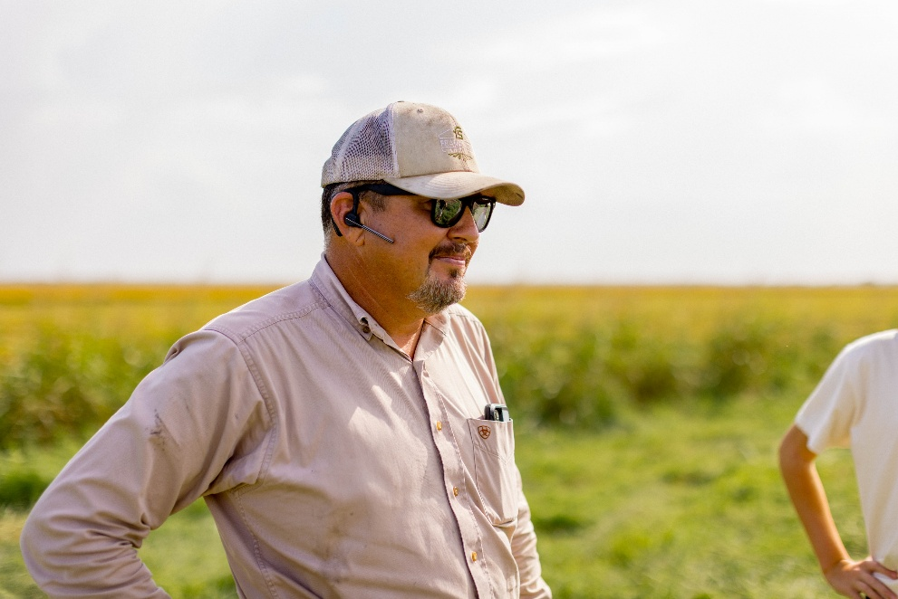
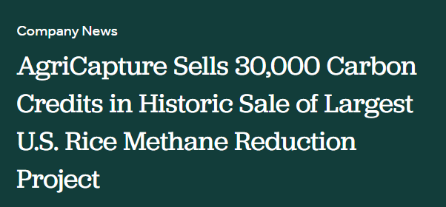


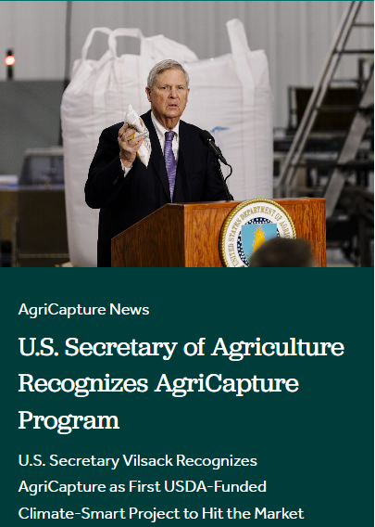

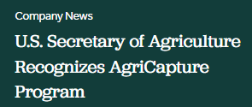

Our Partners
Data Sources + MMRV

Slide 26

Contact
John Lanahan
Director of Demand
Jlanahan@agricapture.com

Slide 27
Alliance to Advance
Climate-Smart Agriculture
www.allianceforcsa.org

Slide 28




Advancing Sustainability
Through changes on the land
Notes:
Intended for external use by Technical and Producer team.
Suited for associations, private companies, producer meeting, etc.

Slide 29

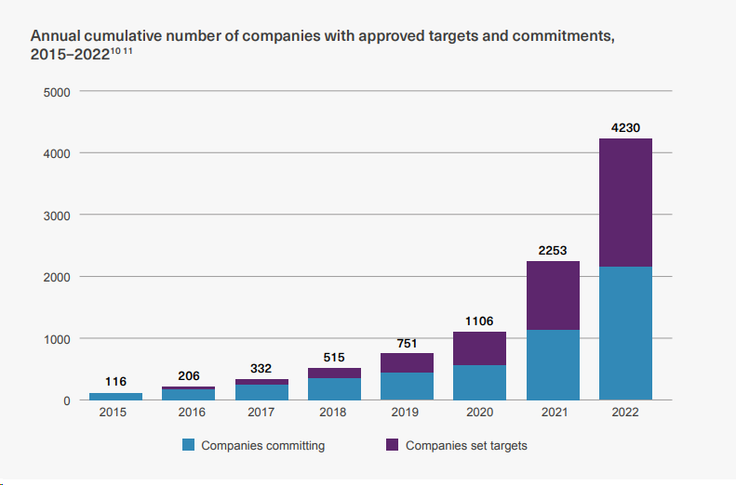


Current Private Sustainability Landscape
Most food & ag corporates and commodity groups have set public 2030 and 2050 GHG reduction targets.
Demonstrate climate neutrality of US cattle production by 2040.
Reduce greenhouse gas emissions by 13% by 2030.
Achieve greenhouse gas neutrality by 2050
Source: Science Based Targets Initiative
Notes:
More than 31% of the largest publicly-traded companies in the world by revenue have committed to net-zero.
Regardless of changing policy related to sustainability, clients are continuing to invest in sustainability and a robust and resilient supply chain.

Slide 30


AgSpire Approach
Producer-Centric Perspective
We lead with deep agricultural roots – building programs that prioritize:
Resiliency, profitability, and long-term viability
The realities of production agriculture
The importance of family legacy and trust
We bridge the gap between producers and ag and food companies – designing flexible, grounded solutions that work for both.
Supply Chains
Our programs are focused on real progress, contributing to:
Claimable, verifiable Scope 3 impacts
Resilient product supply
Healthy producer relationships
Notes:
Work with corporate clients to design programs that make sense for ranchers and farmers.
Tailor the program to meet their sustainability goals.
For some it’s about supporting farmers and ranchers and telling their story on the importance to the food value chain.
Others want to generate insets to reduce their Scope 3 (supply chain) emissions while also having a positive impact on supple sheds they source from.

Slide 31
AgSpire Programs
Free, voluntary, incentive programs – centered around conservation and regenerative practices to increase resiliency, productivity, and profitability for producers.
Programs offered focused on:
Beef
Specialty Grains: Oats, Buckwheat, Winter Camelina, Rye, and Flax
Corn
By State
Enrolling Now
Practices supported through the programs:
Forage and range seeding
Cover crops
Herd productivity & efficiency – herd health, feed efficiency, reproductive efficiency
The Grass is Greener
Ranching for the Future
Covering America
Notes:
We always focus first and foremost on what makes sense for production agriculture producers.
How can we design a program that provides dollars to the support the practices like cover crops, forage or range plantings, or herd efficiency and productivity improvements.
Our goal is always a win-win for producers and buyers.

Slide 32
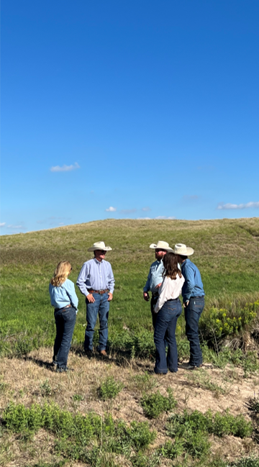
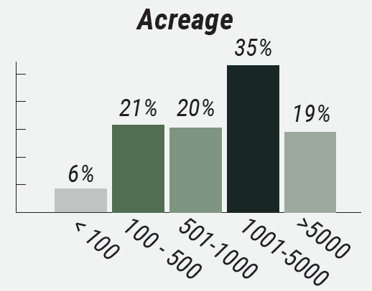
AgSpire works with a broad range of producers
2024
2025
Future
Began producer recruitment and program enrollment
Over 300 producers from 11 states.
Expanding current programs and launching programs in new states
Current Demographics:
Current States Enrolling
Future States Enrolling
150-200
average herd size
>40,000
acres with cover crop, forage, or range seeding
Notes:
As of April 2025

Slide 33
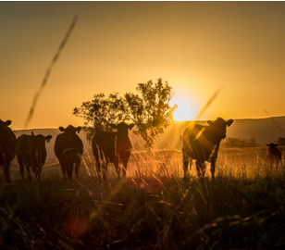


Ranching for the Future
Supporting producers to enhance herd productivity and efficiency, leading to more pounds produced on-farm.
Implementation of best practices for cow-calf operation
> Customized improvement plan and free technical assistance focusing on increasing pounds produced on farm, through:
Feed efficiency
Herd health
Reproductive efficiency
> Sponsored by partners promoting efficiency, productivity, and reduced environmental impact of beef production.

Slide 34
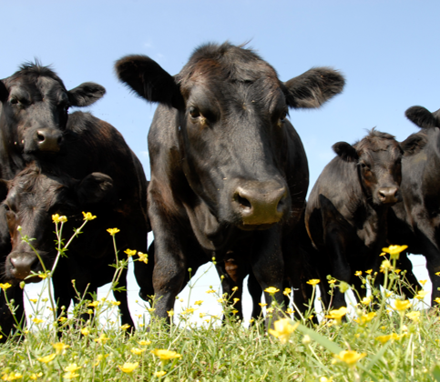
The Grass is Greener
Rewarding producers for the environmental benefits of grazing cattle and sustainable forage production.
Beef + Forage Program for producers in:
> Technical Assistance:
Our advisory team provides one-on-one guidance and technical assistance for seedings and grazing management.
> Seeding & Cattle Payments
$40 - $100
Notes:
Our technical advisors provide custom grazing and seeding plans to improve operational resilience.
Public / Private Partnership (SDSU / OSI & McDonalds)

Slide 35

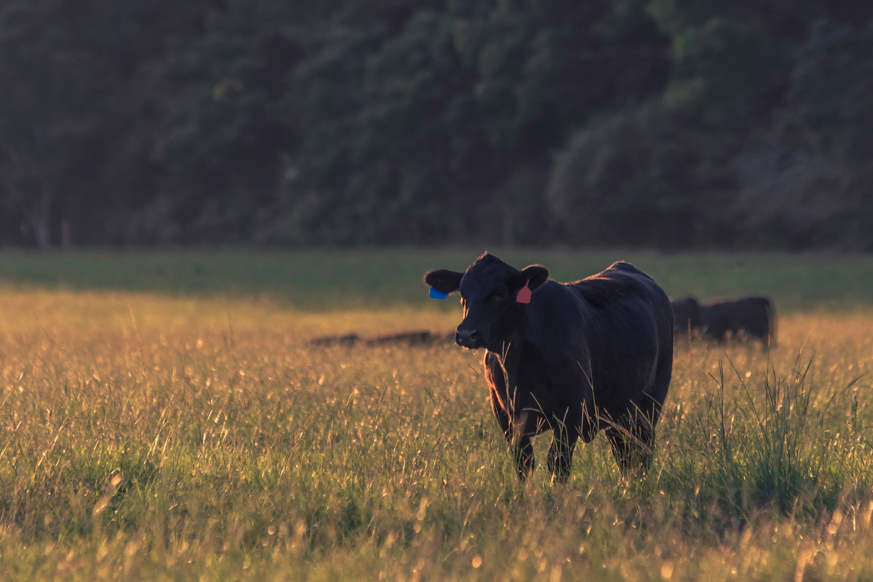
Forage, Feed, and Beef Efficiency Program
Program designed for cow-calf and stocker operations in the Southeast United States
> Technical assistance, payment incentives, and customized implementation plans to support productivity and resilience on your beef operation through:
Use of cover crops
Forage, and rangeland seedings
Herd productivity practices
> Sponsored by partners focused on promoting efficiency, productivity, and reduced environmental impact of beef production.
Phase 1
Phase 2
Enrolling soon:
Kentucky, Tennessee, Virginia, and North Carolina, South Carolina
Examples of possible herd productivity practices:
Use of AI
Synchronization plans
Genetic selection
Vaccinate protocols
Feed efficiency tools
Producer incentives between $40-$115 depending on chosen practices.

Slide 36
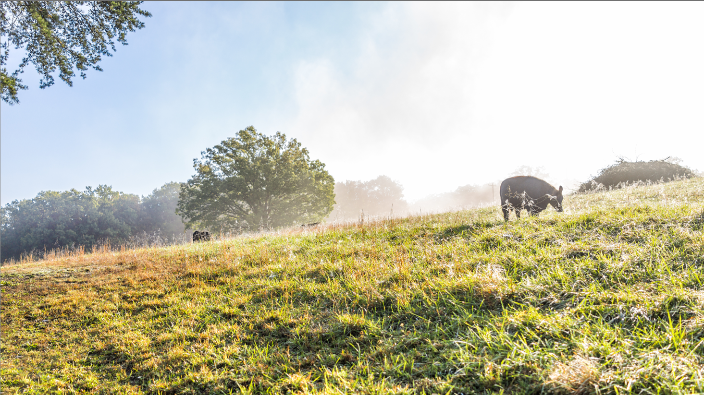
AgSpire’s Approach
Agriculture experts helping farmers and ranchers maximize the impact of regenerative and conservation practices
> Understand your operation and goals
> Connect you with the best programs
Notes:
AgSpire focuses on understanding your operation, your short and long-term goals and then helping identify a program that can help you advance those goals.
We spend time getting to know you
When it comes to developing programs for ranchers and farmers we focus on what's realistic
Understand they have make sense operationally and financially

Slide 37

Thank You

Slide 38

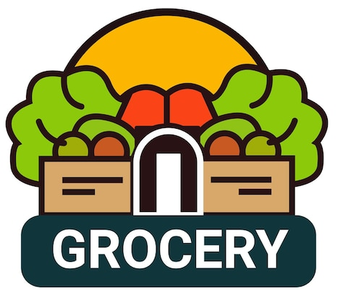

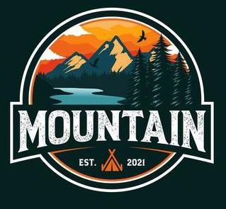
Flexibility for adhering to Corporate Climate Accountability Frameworks (GHG-P, SBTi)
Yes SBT - but doesn’t directly tie sustainability to their brand.
Yes SBT AND does directly tie to their brand. Thought leader in sustainability, core to company culture.
No Science Based Target (SBT)
No SBT - Certified B Corp which is tied to their brand which requires GHG-P adoption
Loose adherence
Strict adherence
BUSINESS FACTORS INFLUENCE WHERE COMPANIES FALL ON THE SPECTRUM
Regulatory Compliance Positioning
Proactive to anticipated regulations
Carbon Asset Development Strategy
Engaged in Scope 3, reporting against SBT
Investor Relations
Investor portfolio or lending requirement
Greenwashing Risk Management
Proactive vs reactive
Supply Chain Climate Risk Management
De-risk supply interruptions
Consumer and B2B Customer Pressure
Brand and company value
Notes:
Company 1 (Costco) - “While we are guided by Science Based Targets, we are not in a position to adopt them until we have plans to meaningfully implement them."
Regulatory Compliance Positioning
Requirements for European operations
Proactive vs. reactive approach to anticipated regulations
Investor Relations
ESG-focused investor portfolio percentage
Financial institution lending requirements
Supply Chain Climate Risk Management
Vulnerability assessment of agricultural suppliers and commodities to climate events
Carbon Asset Development Strategy
Engagement in generating Scope 3 intervention units (fungible, tradeable, certified carbon assets)
Reporting against a SBT
Reporting against GRI, B Corp, Customer Disclosure Requests, CDP, etc.
Greenwashing Risk Management
Proactive vs. reactive to unsubstantiated climate claims
Consumer and B2B Customer Pressure
Brand reputation impact of climate performance
Competitor climate commitment benchmarking

Slide 39
Alliance to Advance
Climate-Smart Agriculture
www.allianceforcsa.org

