Slide 1
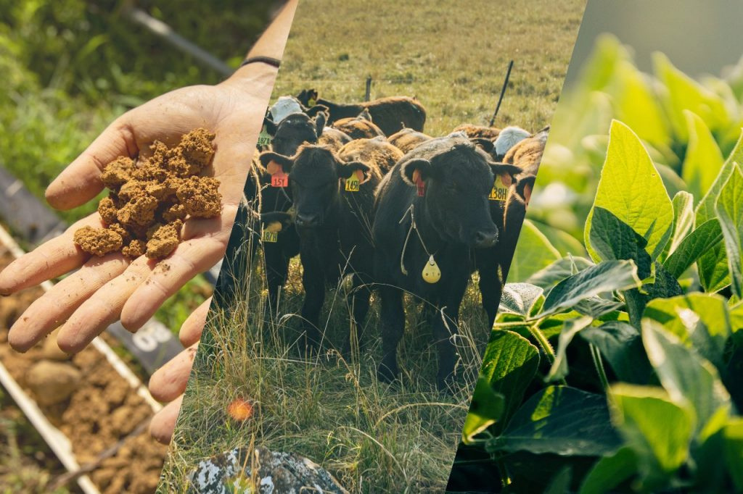
Alliance to Advance
Climate-Smart Agriculture
www.allianceforcsa.org

Slide 2
Sustainable Food Lab:
Certificate & Companion Document

Slide 3
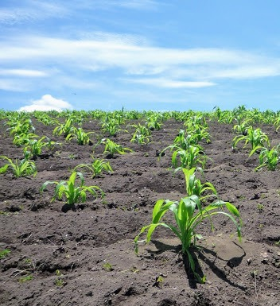
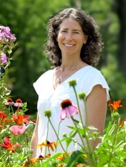


SFL Introduction
Our Team
SFL works to create a sustainable food system by helping organizations turn ideas into action
Daniella Malin
Kelly Rincon
The cornerstones of our approach are:
Harnessing a long-view and embracing the complexity of the whole system to foster unlikely partnerships
Creating a “kitchen table” culture where stakeholders can roll up their sleeves, speak candidly and learn from each other’s perspectives
Designing and managing supply chain initiatives and collaborations among food companies, NGO’s, farmer organizations and research institutions
Insha Momin

Slide 4
Sustainable Food Lab Scope
Design a certificate model
To help connect farmers to private markets to support the production of climate-smart commodities.
Focused on Scope 3 supply chain (food, feed, fuel) or regenerative qualifications
Provide Certificate Companion Guide
Launch pilot certificate program.
In Year 3 with companies and Alliance partners.
Produce certificate for each grower in the Alliance program, alongside the Certificate Companion Guide.
Notes:
Potential opportunity to test private market willingness to pay for biodiversity/water outcomes stacked on top of carbon
to assist farmers in moving from Alliance program to private-sector programs.

Slide 5






Our Work Plan
2024
2025
2026
White paper certificate design, opportunities and challenges
Adapt certificate model for livestock feed and/or ethanol
Train partners on delivering certificates and collect feedback
Interviews with 6 food and beverage companies plus virtual workshop to shape design of Alliance Certificate
Finalize design of Alliance Certificate
Launch pilot certificate program
Notes:
Note: timing of launch will depend on feedback from local partners and company partners

Slide 6




Rationale for an Alliance Certificate
Illustrate outcomes associated with pay for practice approach, to assist with further marketing these outcomes
Government funding is limited (timebound and 320-acre cap)
Use this approach as a bridge for something more durable
Growers extend practices to more acres (expand in space)
Growers continue practices (expand in time)
A Certificate recognizes growers, provides documentation that growers generated outcomes in carbon, soil, and water through practice adoption, and may provide a conduit to private and public sector programs
Notes:
Growers are getting their feet wet with new practices – this helps them market further
Provides tangible proof that growers generated outcomes in carbon, soil, and water through practice adoption

Slide 7
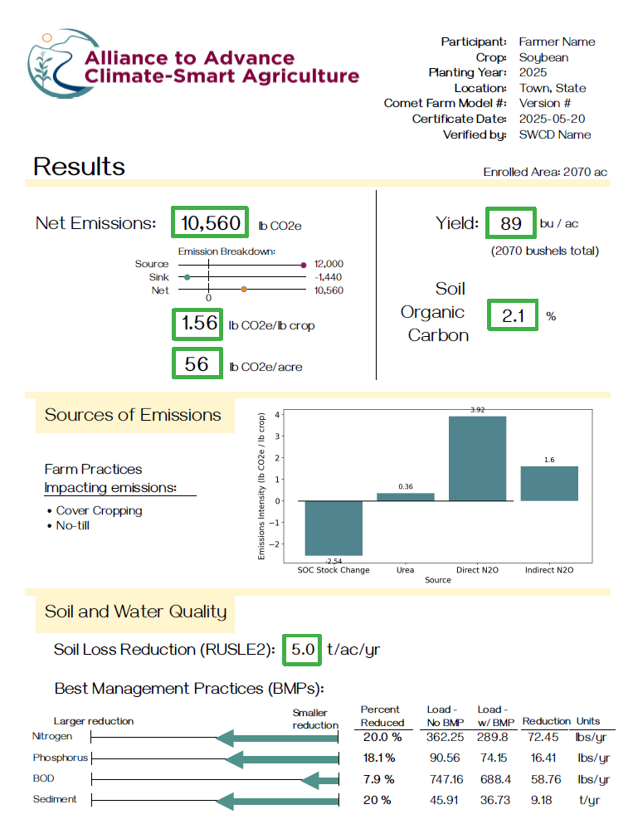
Climate Smart Certificate:
[Walk Through of Themes]
*Draft Doc in Summit Folder*

Slide 8
Companion Guide: accompany the certificate for producers
*Outline Doc in Summit Folder*

Slide 9
Companion Guide makes the certificate actionable
Explain the certificate and outcomes generated in clear, approachable language
Provide background and context on carbon markets and Scope 3 programs
Guide producers on how to move from the Alliance program to other programs available through public and private funding

Slide 10
Companion document
Components of the companion document
Technical explanations
Education
What does this mean and why you would care?
Uses
Marketing, carbon offset markets, Scope 3 or supply chain programs,
state and federal government programs, preferential financing and loans

Slide 11
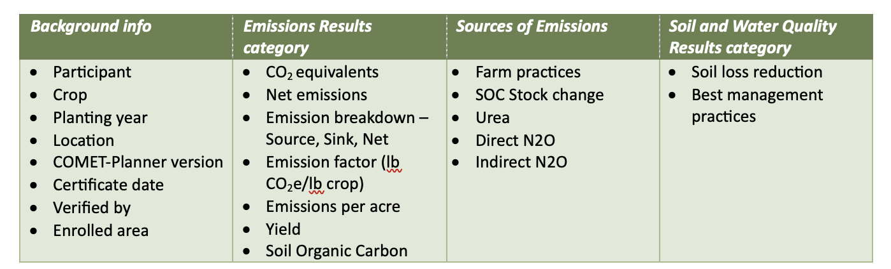
Companion document
Technical explanations
Units of each metric
Preparing for the Alliance dashboard power down

Slide 12


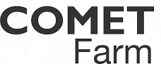
Show how to step to private / public programs
Carbon Markets
Scope 3 Programs
State/Federal Cost-Share
Preferential Financing
Producers gain familiarity with conservation practices and data collection.
Producers receive a certificate illustrating the outcomes of their practice change.
Producers can continue the work they started under the Alliance program and keep getting rewarded through public and private funding.
Notes:
For some farmers, the Alliance program might be the first cost-share program in which they have participated. Others may have more experience.
The Alliance certificate gets producers familiar with collecting data and using COMET-Farm and COMET-Planner to calculate carbon, soil, and water outcomes.

Slide 13






Carbon Offset Markets
A producer implements new practices that reduce or sequester carbon, which generates a “credit.” Buyers can purchase these credits on a marketplace.
Producer Perspective
Key Project Developers
Sign and fulfill contract to get payments
Sometimes get technical assistance
Historical data is often required
Payments can range from $5/acre up to $35/acre
Farm data, soil sampling, site visits, and satellite imagery may be used to verify practices
Notes:
Highlight Indigo Ag and AgriCapture as Alliance partners

Slide 14






Scope 3 & Supply Chain Programs
Companies with Science Based Targets establish insetting programs within their supply chain. Producers that grow their ingredients can participate in delivering carbon and ecosystem outcomes.
Producer Perspective
Example Project Developers and Companies
Companies work with on-the-ground partners to implement programs
Technical assistance may be offered
Outcomes are modeled through third-party MRV, which may require farm data, soil sampling, and site visits
Farmers can sometimes stack outcomes (e.g. carbon with water and biodiversity)
Practices may be funded for only one crop

Slide 15
State and Federal Government Programs
State and federal governments, as well as other public/private funders, may offer cost-share programs that reduce the financial burden of implementing conservation practices.
Producer Perspective
Example: Conservation Contracts Program in MN
Cost-share programs can be practice-based and not require quantification
Contracts can range from 1 year to 30+ years
Technical assistance may be offered
Incentives can be per-acre or per-project
Practices include cover crops, no or reduced till, nutrient management, biodiversity, land use conversion, etc.
The Minnesota Board of Water and Soil Resources works with local Soil and Water Conservation Districts (SWCDs) to offer cost-share programs.
Eligible practices include erosion control, water quality improvements, habitat enhancement, biodiversity, energy conservation, climate resiliency
Up to 100% cost-share is available
Each SWCD adapts the program, including the amount of cost-share and the availability of technical assistance.

Slide 16
Preferential Financing
Growers implementing conservation practices may be eligible for low-interest “green” loans or preferential insurance options. This space is not as defined as cost-share programs.
Producer Perspective
Ex: Regenerative Agriculture Financing (RAF) Land Loan
Can be operating loans or land loans
Lending programs may offer lower interest rates or longer financing
Often reward both early and new adopters of regenerative ag practices
Some programs don’t require practice change
Producers generally submit data on practices
Loans can often be used towards expenses not only associated with regenerative activities
By Farmer Business Network (FBN), Environmental Defense Fund (EDF), and Gradable
Producers receive discounted interest rates, with a rebate ranging from 0.25% to 0.5%, or savings up to $5,600 in interest payments per year, on newly financed land for 7 years. Farmers must have a minimum credit score of 680.
Loan size ranges from $125,000 to $1,500,000.
The discounts come as a rebate, after producers implement sustainable soil and water health practices and meet environmental benchmarks.

Slide 17
Sustainable Food Lab:
Certificate & Companion Document

