Slide 1

Alliance to Advance
Climate-Smart Agriculture
www.allianceforcsa.org

Slide 2
VT Research Snapshots
VT Agronomy Research Team

Slide 3
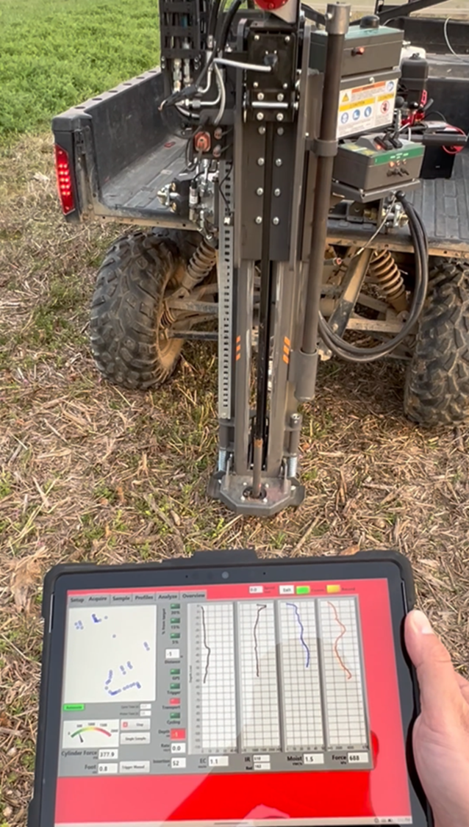
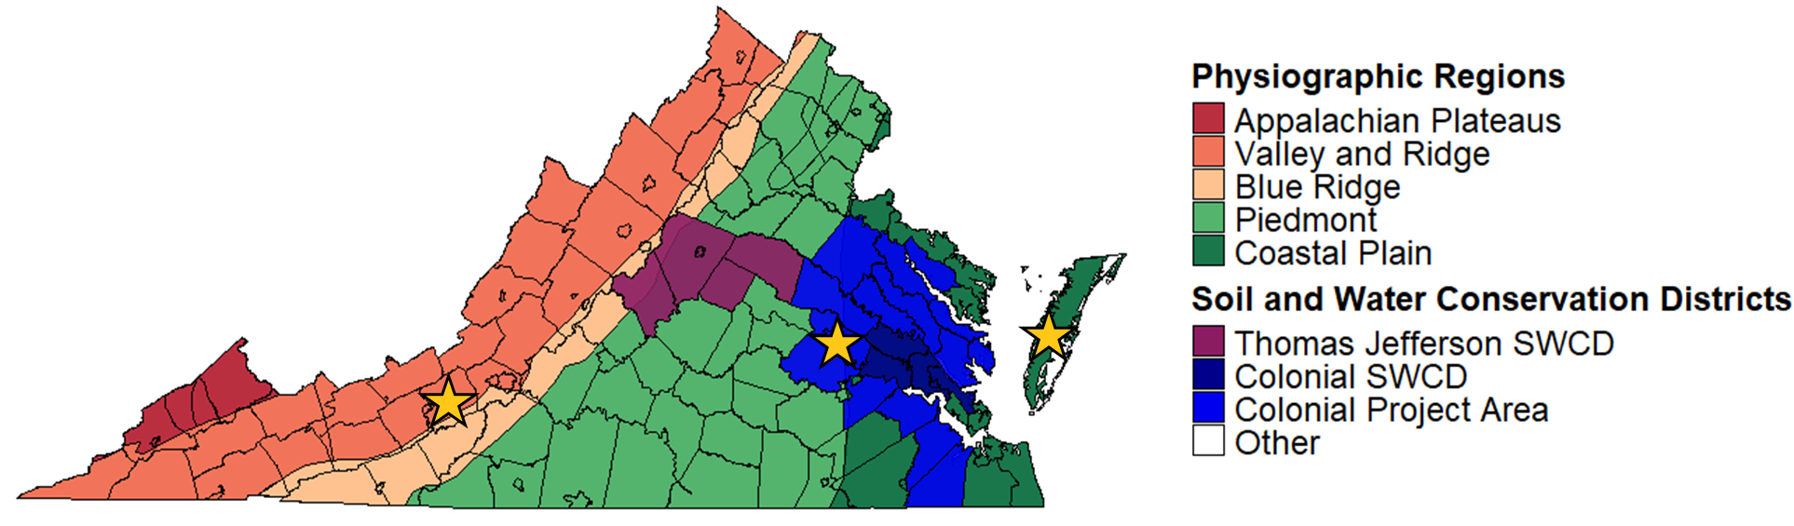
Soil Organic Carbon (SOC) Stock Evaluation in VA Row Crops
Paired fields (e.g., cover-cropped vs. non-cover-cropped)
Targeting ≥20 enrolled fields
Corn, wheat, soybean, cotton
Measuring SOC stocks using Veris CoreScan &
traditional sampling methods
GPS logging to enable long-term resampling

Slide 4
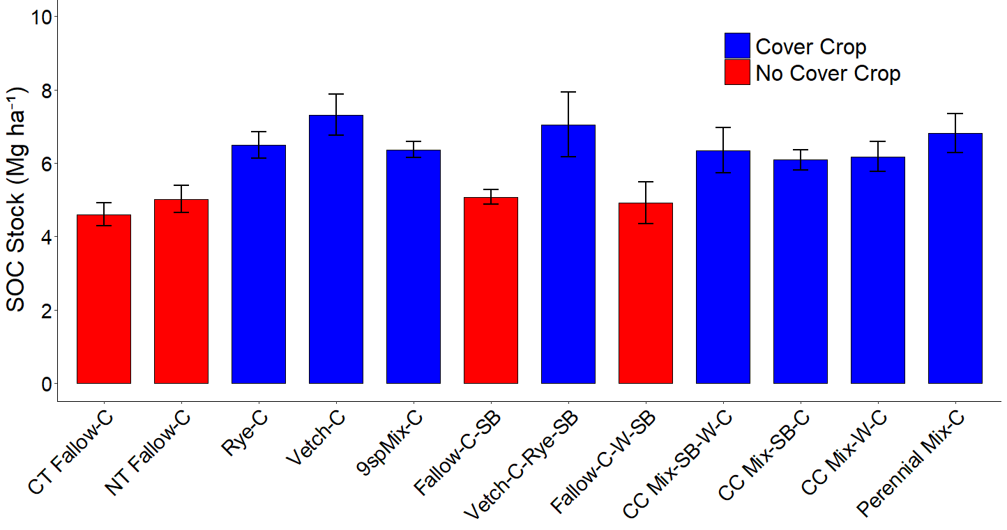
Cover Crop Effect on SOC stocks (0-5 cm) after nine years
Continuous Corn
Corn/Soybean
a
ab
abc
bc
bc
bc
c
c
d
d
d
d
Treatment

Slide 5
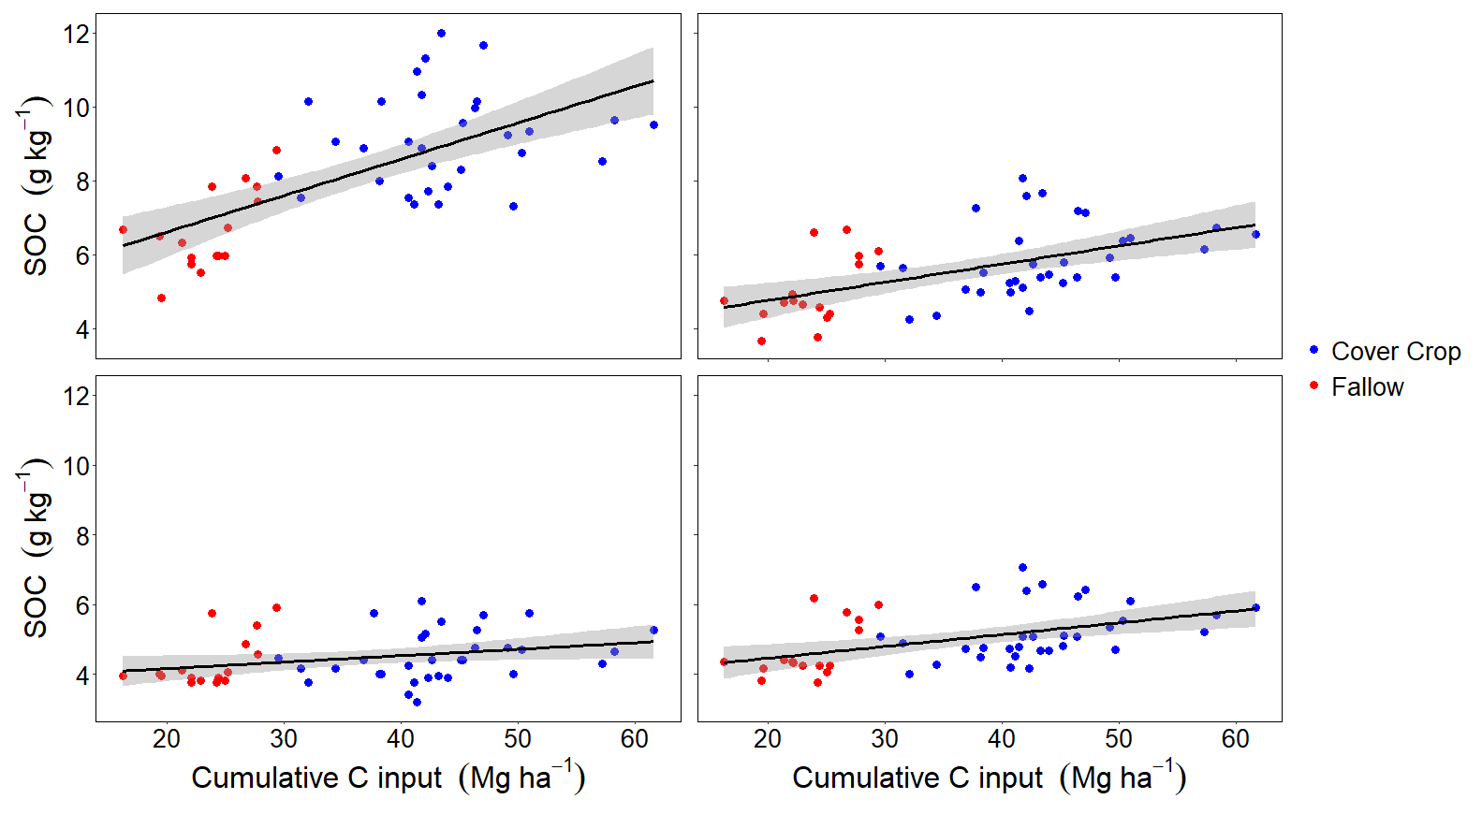
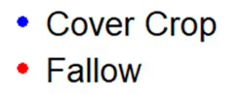
Linear Relationship of Carbon Inputs and SOC
y = 0.10x + 4.71
R² = 0.38
0-5 cm
y = 0.05 x + 3.77
R² = 0.28
0-15 cm
y = 0.02 x + 3.80
R² = 0.08
15-30 cm
y = 0.03 x + 3.79
R² = 0.21
0-30 cm

Slide 6
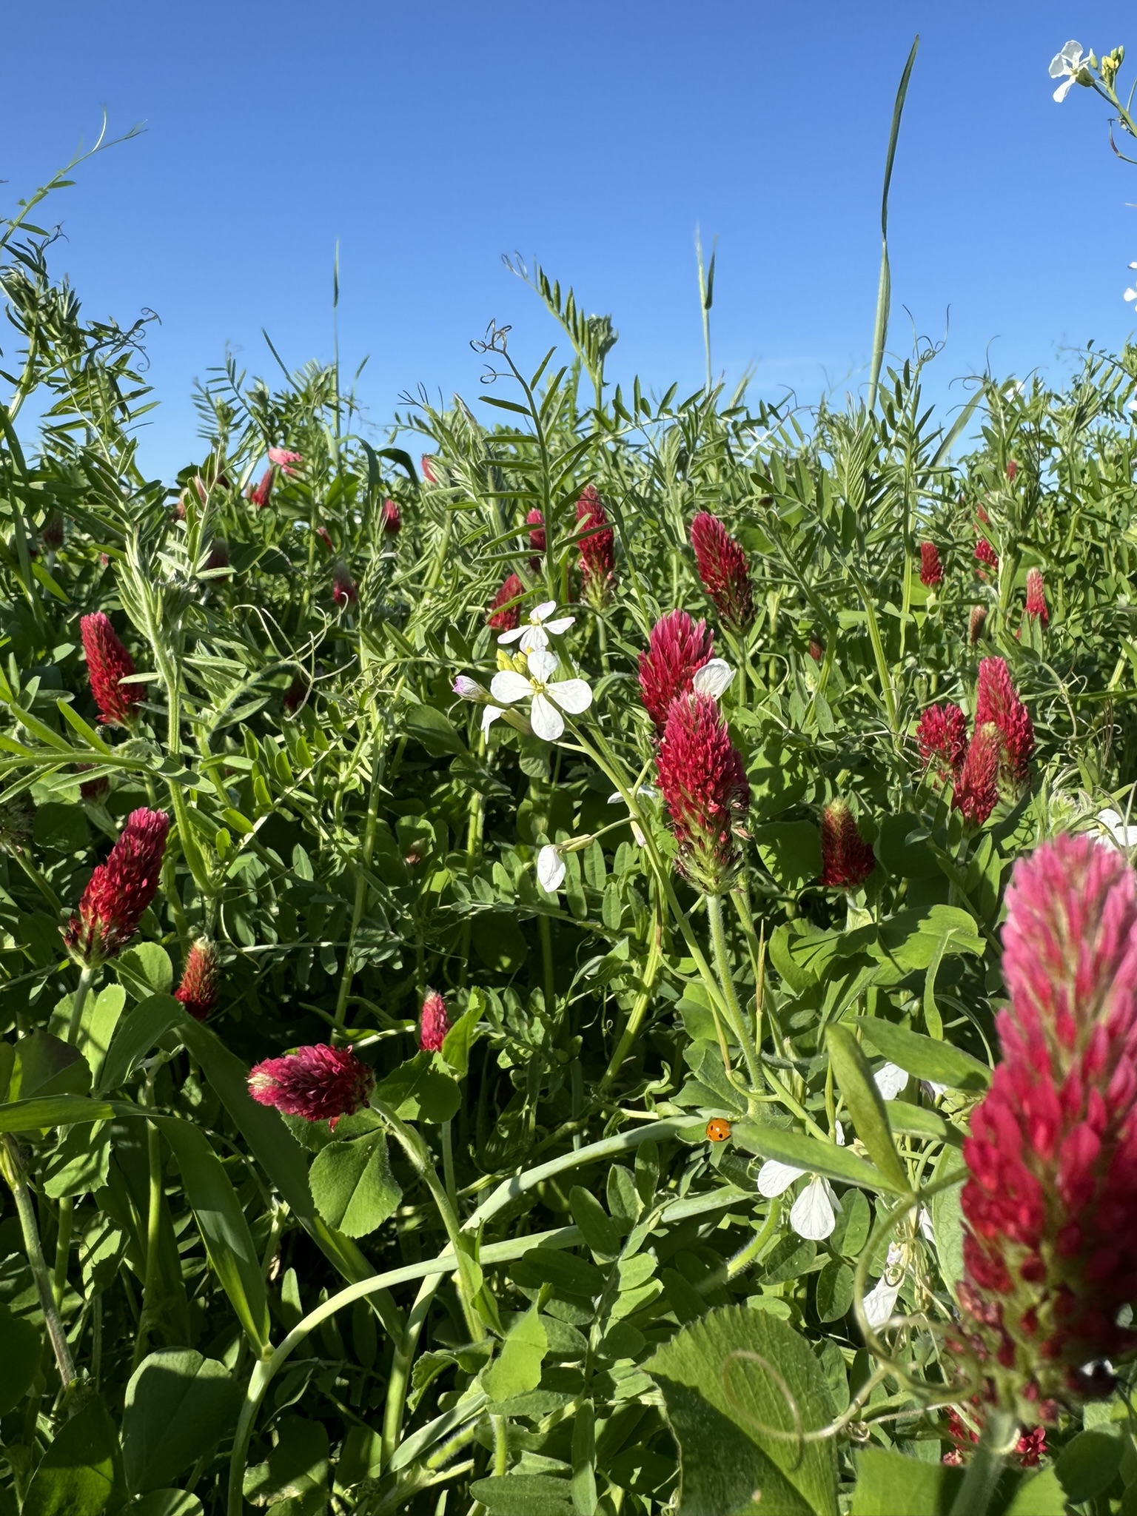
Nitrogen Rate Trials in Corn Following Cover Crop
Goals
  Refine N fertilizer recommendations post-cover crop
  Improve COMET’s GHG crediting model
Current COMET Model Only Credits for:
  25% N reduction for non-legumes
  50% N reduction for legumes
2025 Research
  ESAREC trials with hairy vetch, cereal rye, and multispecies mixes
  Measuring corn N response post-cover crop
2026 Expansion
  On-farm trials with Alliance producers
  Capturing climatic and physiographic variability across Virginia

Slide 7

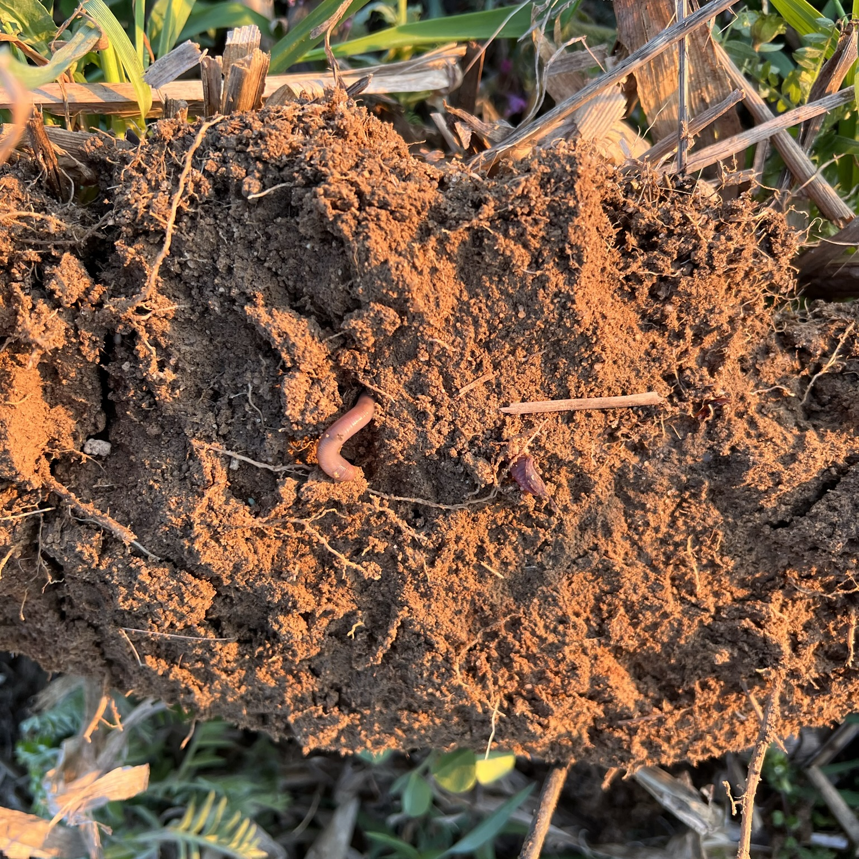


Agronomy Research Team
Ryan Stewart, Ph.D.
Professor
Email: rds@vt.edu
Phone: 540-231-0253
Joseph Haymaker, Ph.D.
Postdoctoral Associate
Email: jrhaymaker@vt.edu
Phone: 410-603-7957

Slide 8
VT Research Snapshots
Livestock Working Group

Slide 9
Research Themes
Practices & GHGe
MMRV
Broader Impacts
Prescribed Grazing and Methane?
Outcome
Outcome
Outcome

Slide 10
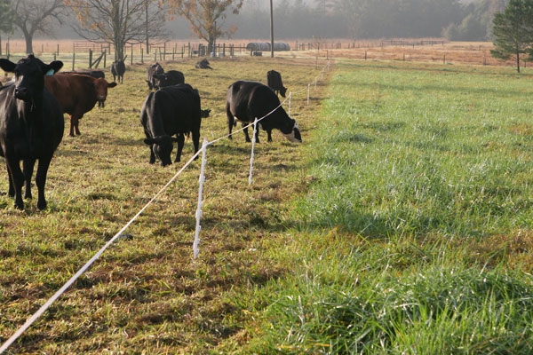
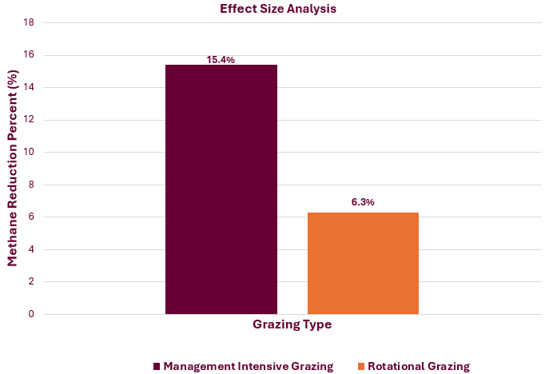
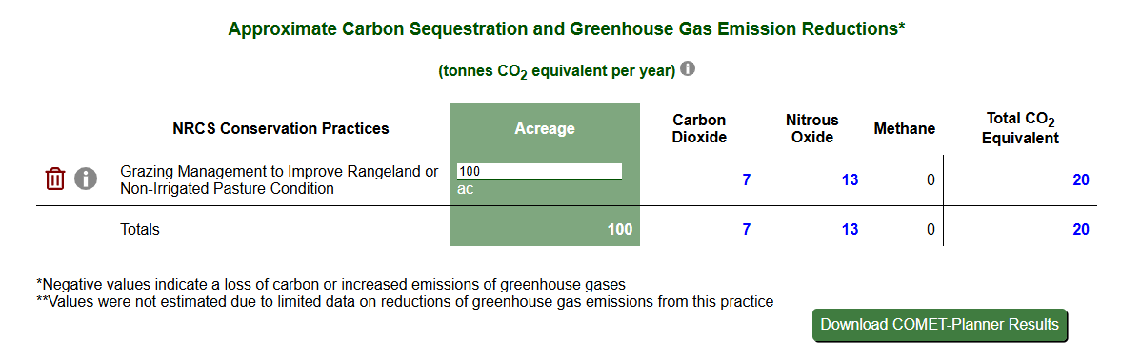

Slide 11
Research Themes
Practices & GHGe
MMRV
Broader Impacts
Prescribed Grazing and Methane?
Manure management and GHGe?
Reduced Methane During Prescribed Grazing
Outcome
Outcome

Slide 12
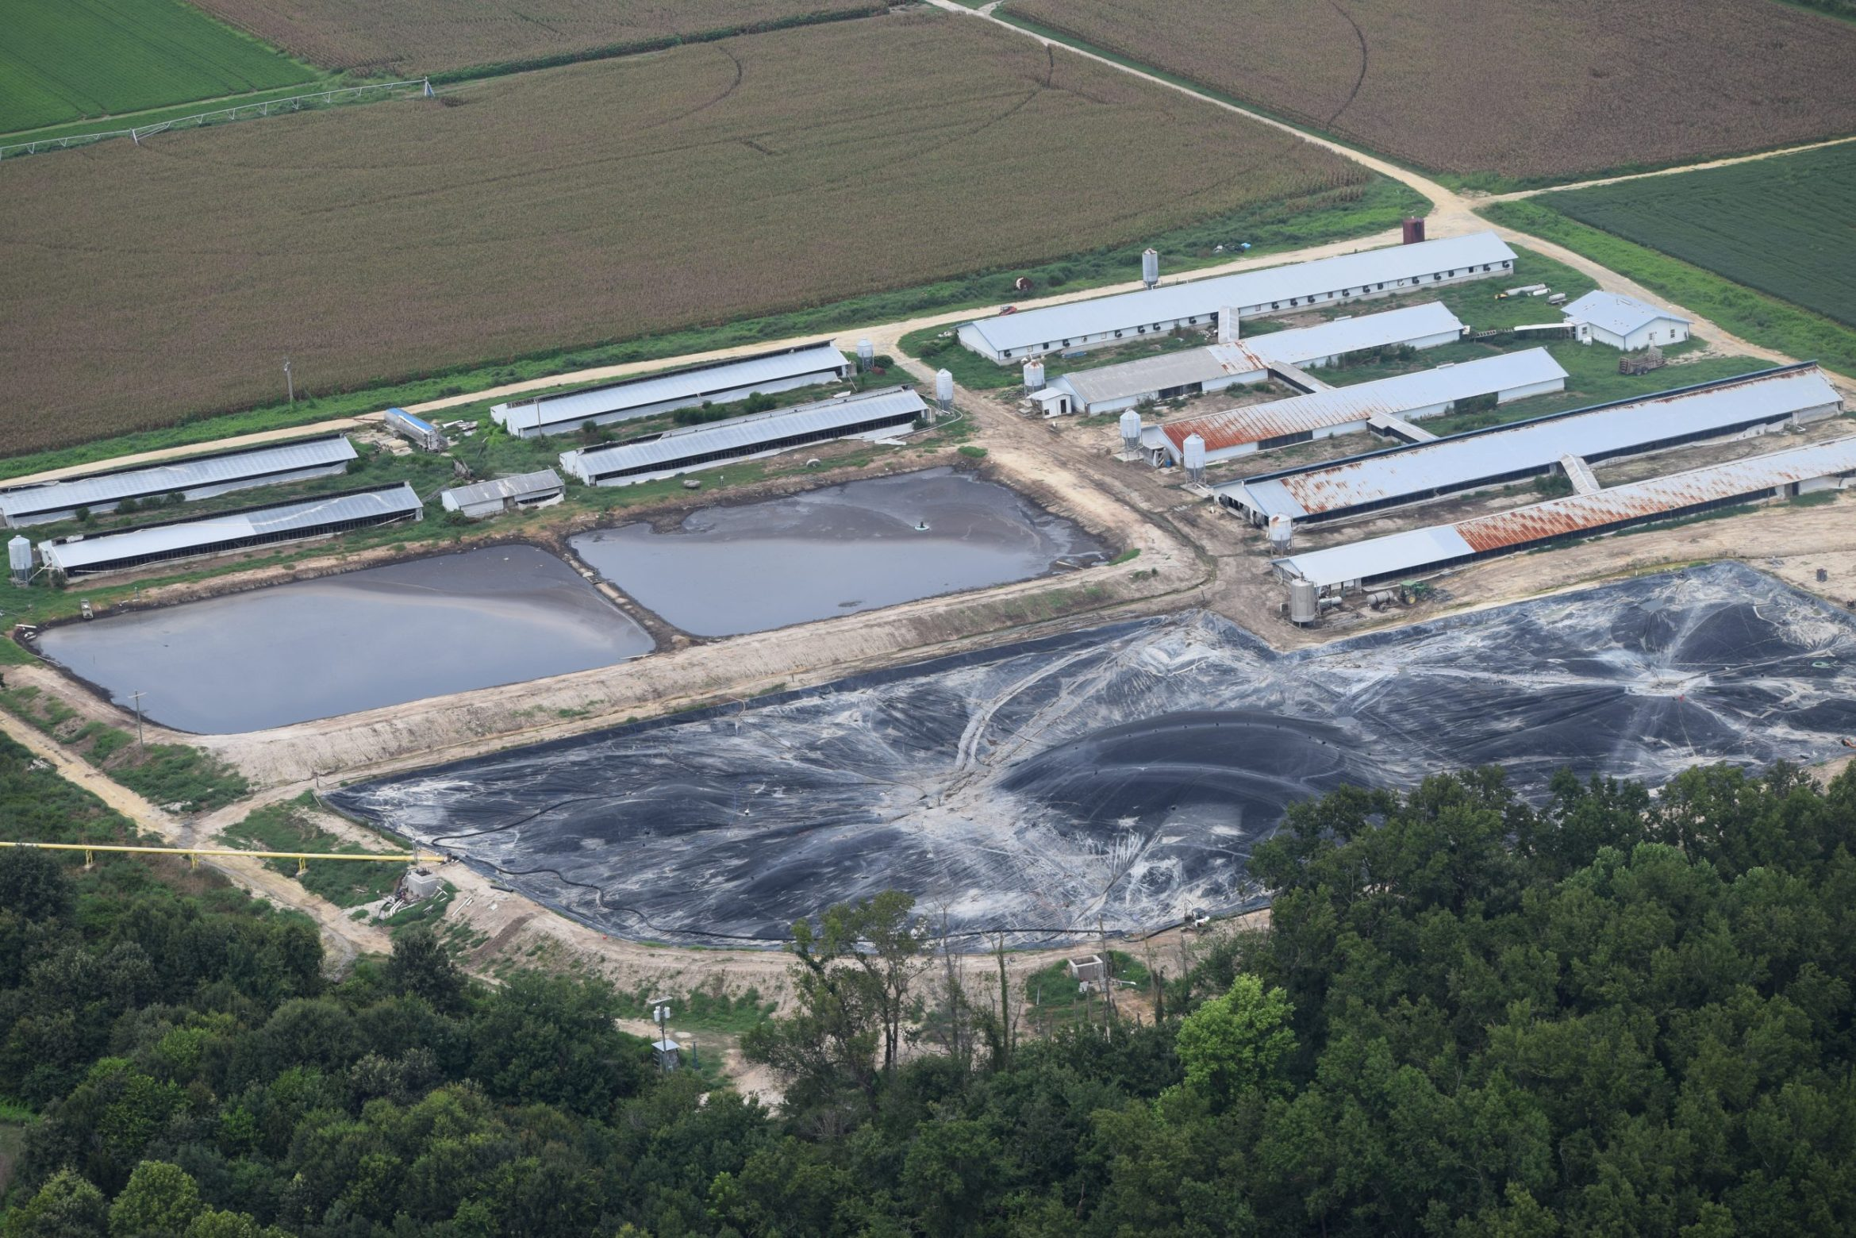
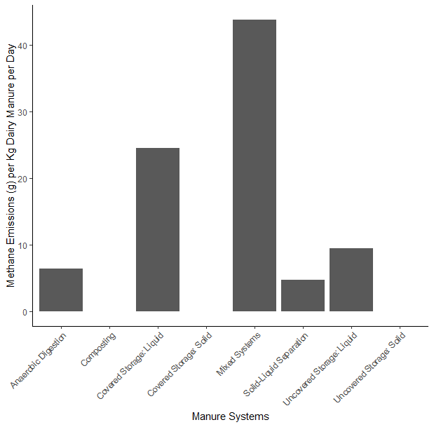
This Photo by Unknown Author is licensed under CC BY-ND

Slide 13
Research Themes
Practices & GHGe
Adoption
MMRV
Prescribed Grazing and Methane?
Manure management and GHGe?
Drivers and barriers to participation in cost share programs?
More expensive = more effective
Outcome
Outcome

Slide 14
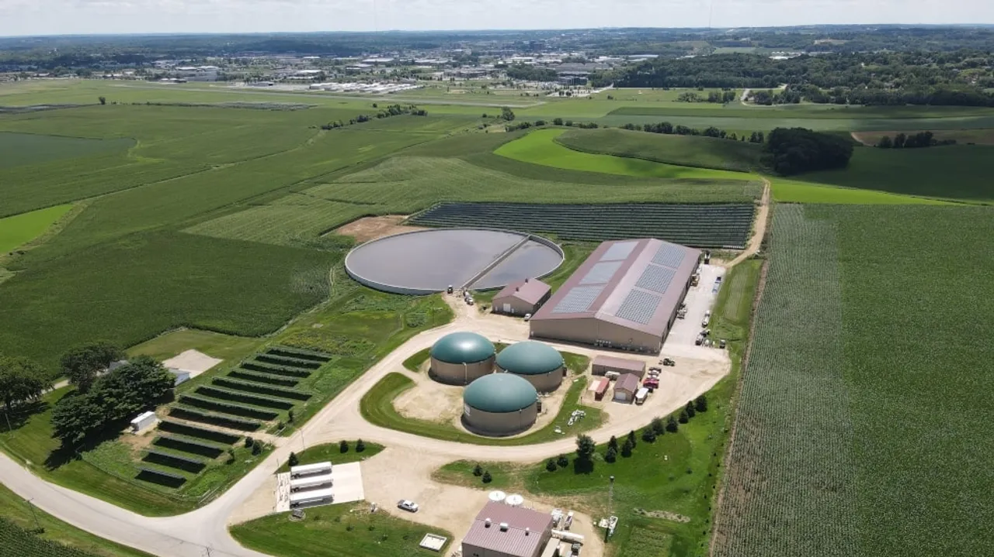
Producers were most interested in funding for manure storage facilities.
Project cost was the major limiting factor.
Ongoing support for facility maintenance and technical assistance and installation were desired as attributes in cost share programs.

Slide 15
Research Themes
Practices & GHGe
Adoption
MMRV
Prescribed Grazing and Methane?
Manure management and GHGe?
Drivers and barriers to participation in cost share programs?
Is there an intermediate between Comet Planner and Comet Farm?
More expensive = more effective
More expensive = more challenging
Outcome

Slide 16
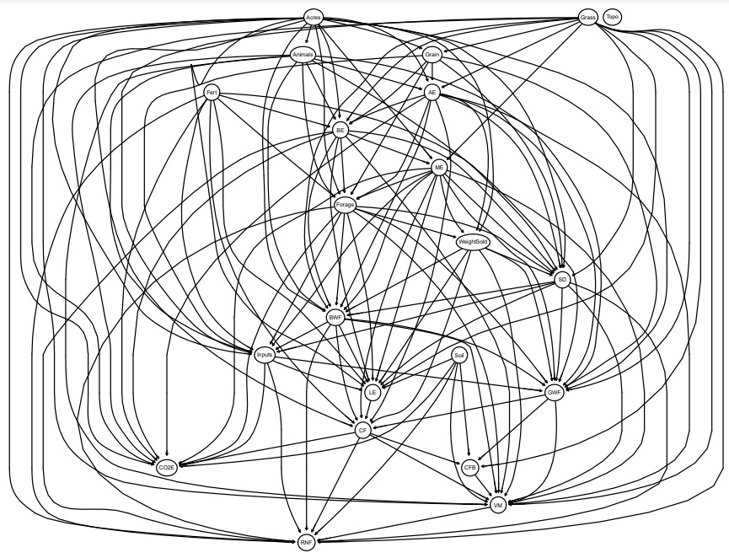
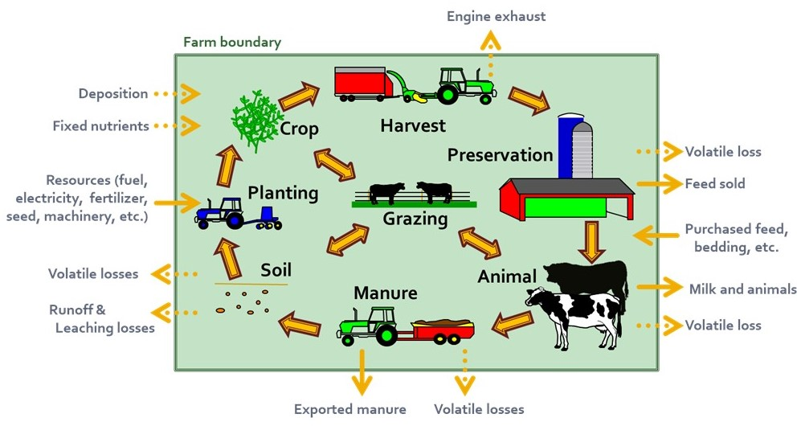
Environmental Footprints | RMSE
Green Water Footprint (GWF) | 19.8
Blue Water Footprint (BWF) | 4.5
Reactive Nitrogen Footprint (RNF) | 16.1
Carbon dioxide Emissions (CO2E) | 1.99
Carbon Footprint (CF) | 7.9
Animal Emissions (AE) | 0.4
Manure Emissions (ME) | 1.6
Land Emissions (LE) | 4.5

Slide 17
Research Themes
Practices & GHGe
Adoption
MMRV
Prescribed Grazing and Methane?
Manure management and GHGe?
Drivers and barriers to participation in cost share programs?
Is there an intermediate between Comet Planner and Comet Farm?
More expensive = more effective
More expensive = more challenging
Can develop intermediates

Slide 18
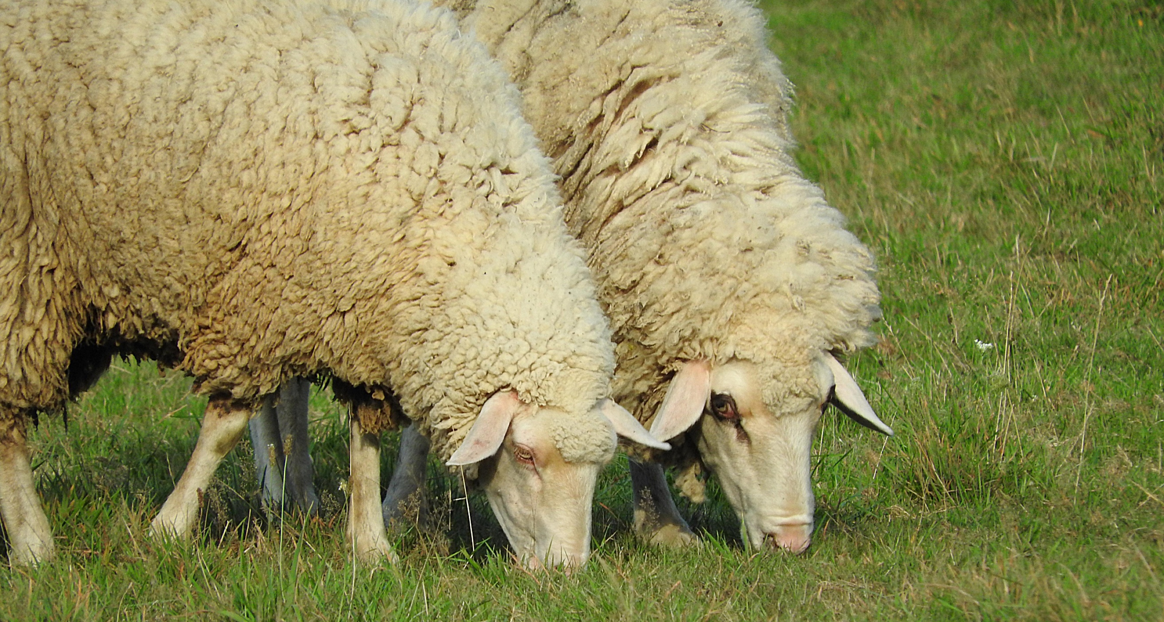
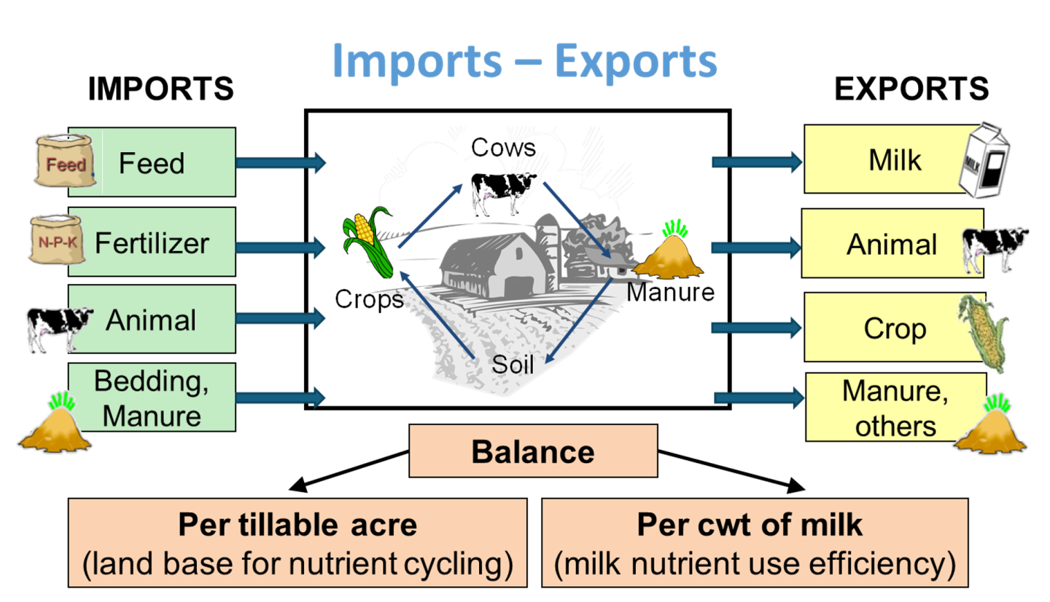

Slide 19
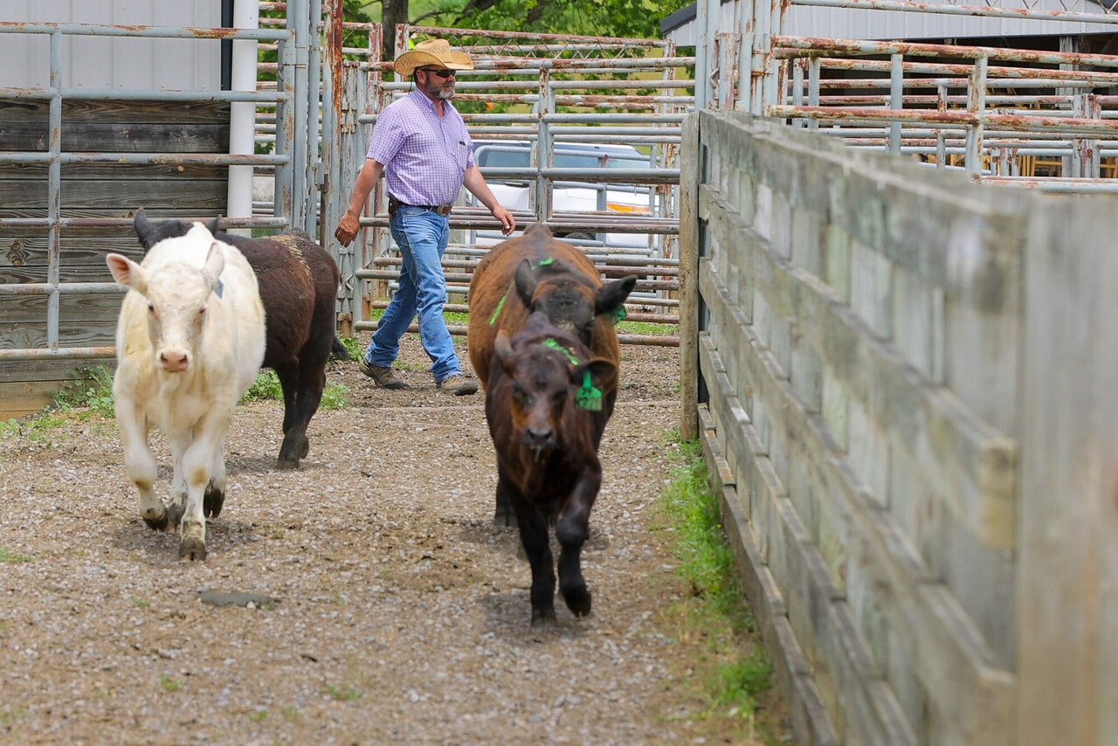
Robin White Ph.D.
Professor, School of Animal Sciences
Virginia Tech
rrwhite@vt.edu | 540-231-7384

Slide 20

VT Research Snapshots
Agricultural & Applied Economics

Slide 21


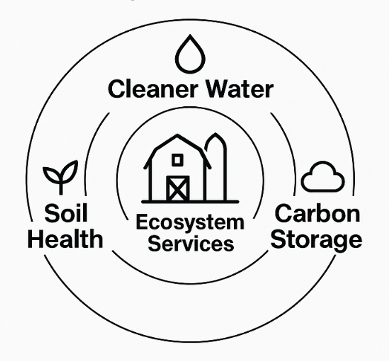


Motivating Questions
Imagine a ND soybean farmer adopts low tillage with Alliance $.
The next season? Yields are down.
Was the program a failure?
2. When new practices deliver benefits beyond the farm (water quality, soil erosion, GHG mitigation), how large is that value to the public as a whole?
3. Do consumers value climate-smart practices enough to pay for them? How does demand vary based on the label and its design?

Slide 22
What do these questions have in common?
They’re rooted in problems modern economists are trained to address:
1. What works? Impact evaluation
2. What’s the value to society? Public goods & ecosystem services valuation
3. What will people pay? Market demand & willingness to pay estimation
These aren’t just academic questions: they shape how we design smarter programs & scale what works for producers and consumers alike.

Slide 23
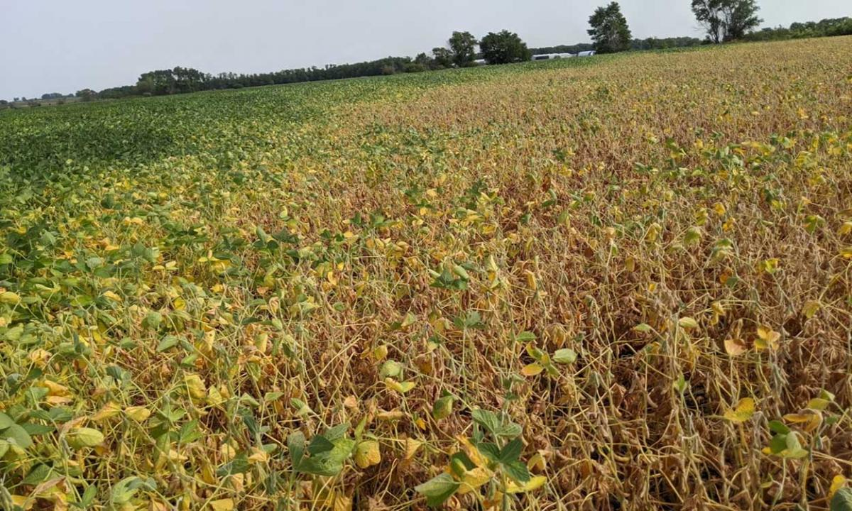
Back to our ND farmer adopting low tillage with Alliance $
Next season yields are down. Did Alliance funds harm them?
That year, drought hit hard
But when we compare this farm to others like it, we see:
Smaller yield losses
Lower input costs
Less erosion
Increasing organic soil content
Source: SDSU Extension

Slide 24
How do we know Alliance support really have an impact?
What if we compared outcomes with and without low tillage adoption?
Comparing before-and-after for 1 farm
Is not a true measure of Alliance impact: as we can’t separate impact from weather or luck.
Comparing “raw” applicants to non-applicants:
is biased, as applicants may (for example):
Be more experienced
Be better resourced
Face different risks

Slide 25

How can we measure impacts only from the Alliance?
A: Comparing outcomes with and without low tillage adoption on farms that are, on average, alike in all ways except for our $$ offer
That’s why we select producers in a way gives every farm an equal shot:
so that differences between selected & unselected groups reflect the program, not who got picked or what year it was.
This is what “randomized selection” helps us build

Slide 26
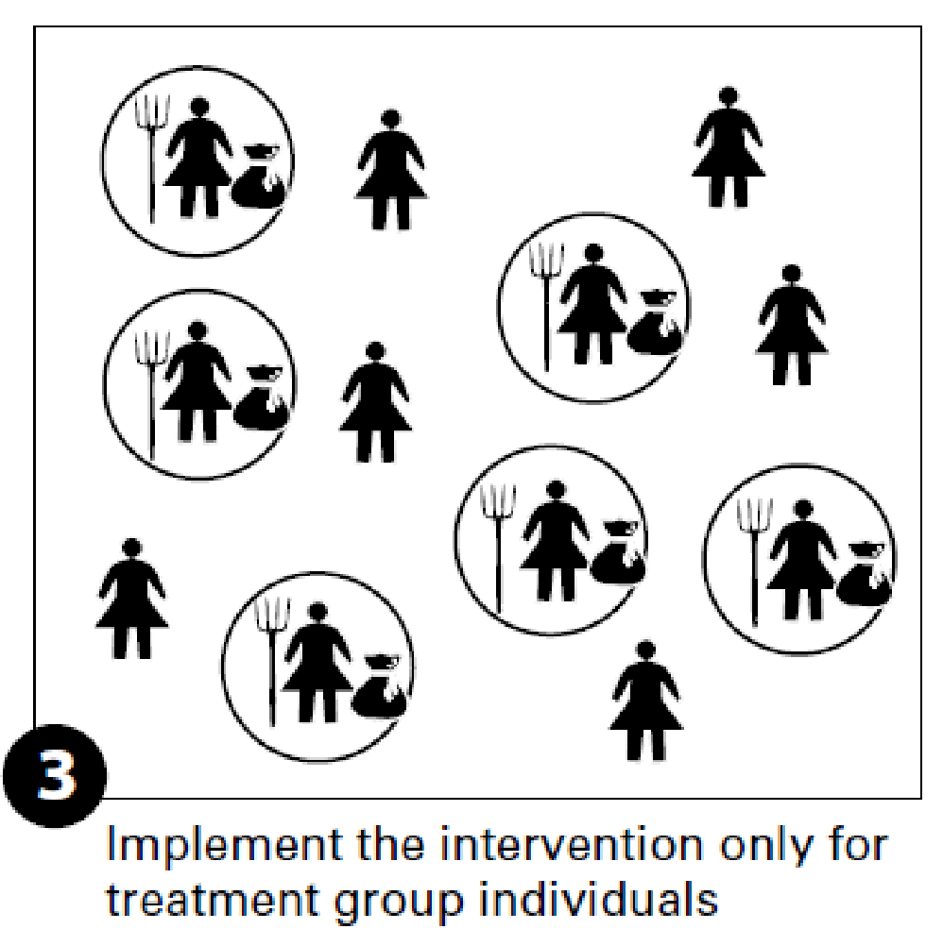
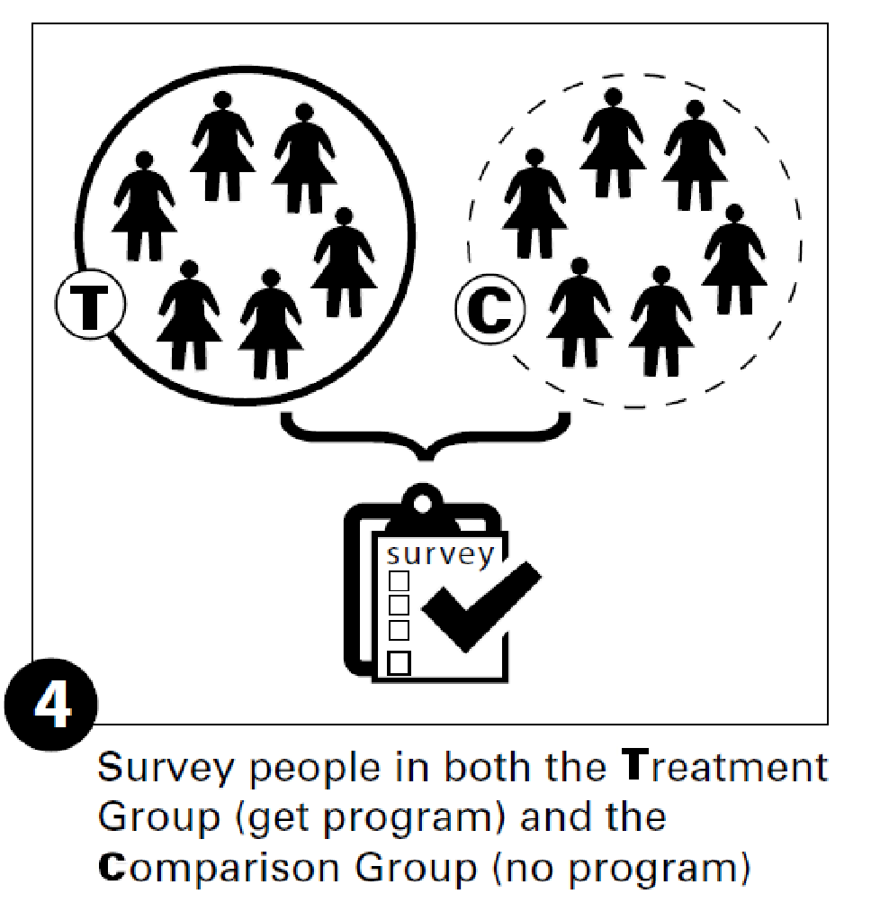
Address recruitment — not the selection – to avoid biasing results (if you want more producers of particular type)
Define program eligibility
Recruit producers to apply
Randomly assign eligible applicants to the treatment and comparison groups
Implement the program for the treatment group
Compare outcomes for those in treatment and comparison groups
Source: Glennerster & Takavarasha 2013. Running Randomized Evaluations. Princeton University Press
Notes:
Source of images: http://runningres.com/lecture-notes
Glennerster, R., & Takavarasha, K., (2013). Running Randomized Evaluations: A Practical Guide, Princeton University Press, Princeton, NJ.
https://nulib.github.io/moderndive_book/7-causality.html

Slide 27
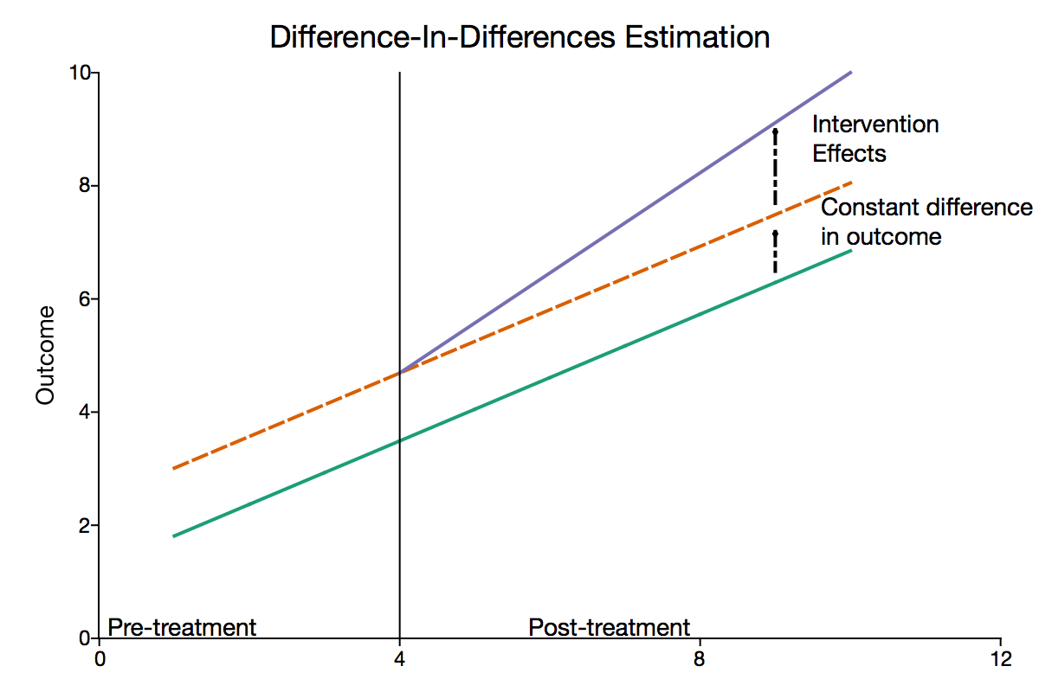
Robust valuation also hinges on randomized selection
Randomization allows seeing what’s new due to the program, not what would’ve happened anyway (business as usual).
It lets us quantify impacts on cleaner water or carbon storage, and translate those into (a range of) $ values that reflect their broader societal benefits.
Evaluation approaches that focus only on contracts issued/people funded will mis-state impact:
Underestimate: evidence of social learning
Overestimate: lots of background adoption of practices

Slide 28
Valuing Carbon & Co-Benefits
From newly adopted practices, quantify:
1) Incremental GHG mitigation benefits
2) Other environmental benefits (e.g., water quality improvement)
Goals
Data
Review
Analysis
Valuation
Enrollment
Outcomes from COMET-FARM and -Planner
Literature review of conservation practices’ GHG and ecosystem service values
Approach
Design and apply economic and statistical models
Translating results into monetary values ($)
And more…
Provide quantitative estimates of the societal values of conservation practices
Outcomes

Slide 29
Estimating Demand for CSA Products
Growing interest in “green” practices, but unclear definitions of climate smart ag
No standardization (e.g., USDA Organic); mix of verified and unverified claims (“carbon neutral”, “regenerative organic certified” “climate friendly”)
Overlapping labels: “organic”, “local”, “regenerative”, “plant-based”
Producers seeking outlets for funding beyond one-off grants
Context
1. What is the Demand/Willingness to Pay (WTP) for CSA products?
2. How does stated WTP vary by attribute (e.g., “organic”, “local”, and “regenerative”)?
3. How does label design (about the climate-smart attribute) affect WTP?
Questions

Slide 30
Estimating Demand for CSA Food Products
Defining the Problem
Working with Retailers
Focus Groups
Experiment
Analysis, Publication, & Outreach
Climate-smart food products are new
Can farmers get a premium for them?
Retailers want to know consumer demand
Experiments can help.
Pratyoosh is reaching out to retailers to determine suitable experiment locations
He’s also seeking to coproduce experimental protocols:
Which products are they most interested in?
Which products can be verified as climate-smart?
Which product attributes are most important?
What package/label features are most salient?
How much information on packaging is meaningful/useful?
Goal: in-person experiment with randomized coupons to develop “demand schedule”
Complement in-person experiment with other methods (e.g., online retailers)
Design incentive-compatible experiment (have skin in the game, meaningful responses)
Statistical analysis to evaluate willingness to pay for climate-smart products
Assess if price premiums are meaningful (statistically and economically) relative to values in literature

Slide 31
How can the experiment work?
In-person evaluation & transaction
Vary prices & product attributes
Ask consumers to evaluate (single-ingredient) products, some of which are climate-smart
Present several different labels and prices of products for sale, for which 1 is randomly chosen
Compensate consumers for their time with a gift card (redeemable for CSA product) and/or discount
Present similar products emphasizing different features (e.g., organic, local, climate-smart)
Randomly vary prices (discounts)
Observe product purchases to estimate WTP range
Administer short survey to clarify shoppers’ demographics, attitudes, & stated preferences
Realistic shopping experience
Realistic estimates of WTP

Slide 32


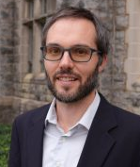

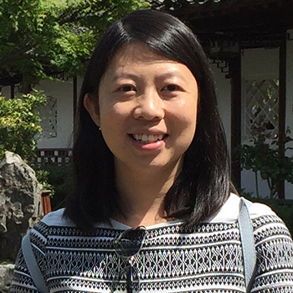
New Full-Time Research Scientist Staff
Dr. Pratyoosh Kashyap
Designing and implementing demand study (May 2025)
Dr. Seojin Cho
Designing and implementing ecosystem service valuation (June 2025)
Faculty co-PI’s. Advising on research amid other Teaching, Research, & Extension needs. Focal areas:
Dr. Wei Zhang
Ecosystem service valuation
Dr. Elinor Benami
Impact evaluation, WTP study
Dr. John Bovay
WTP study

Slide 33
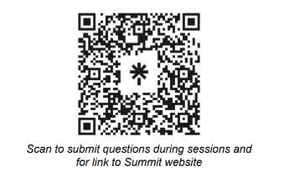
https://linktr.ee/alliancesummit

