Slide 1
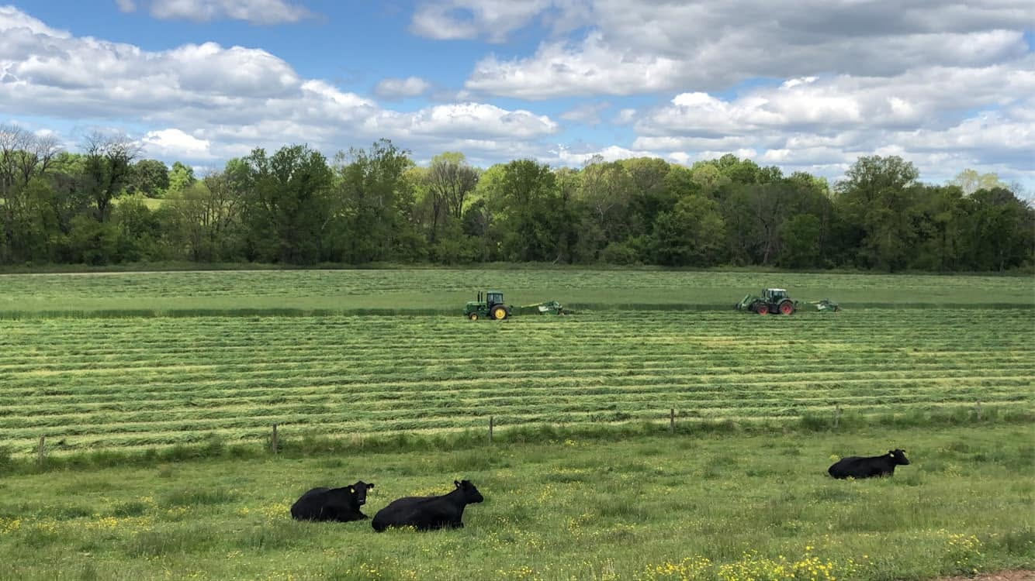


Overview of General Program and Pasture Renovation Subpilot
Q&A for 512 Pasture and Hay Planting
Notes:
REBEKAH
_______________________________________
APPRECIATE ALL OF YOU FROM VIRGRINIA COOPERATIVE EXTENSION AND THE SOIL AND WATER CONSERVATION DISTRICTS FOR JOINING US TODAY
WE HOPE THIS WEBINAR TODAY PROVIDES YOU WITH THE INFORMATION YOU NEED TO HELP PROMOTE THE PROGRAM AND OFFER WHATEVER LEVEL OF ASSISTANCE YOU ARE INTERESTED IN PROVIDING TO YOUR CONSTITUENTS. THAT ASSISTANCE CAN BE A SIMPLE SHARE ON A LISTSERV OR SOCIAL MEDIA, A CONVERSATION WITH AN INDIVIDUAL OR GROUP OF PRODUCERS, HELPING SOMEONE WITH THE APPLICATION PROCESS, WORKING ON A PRACTICE WORKSHEET OR FPC, HELPING COLLECT A BIOMASS SAMPLE. OR IT CAN SIMPLY BE FORWARDING QUESTIONS TO MY TEAM. HOWEVER YOU CHOOSE TO BE ENGAGED IS WELCOME AND APPRECIATED.

Slide 2
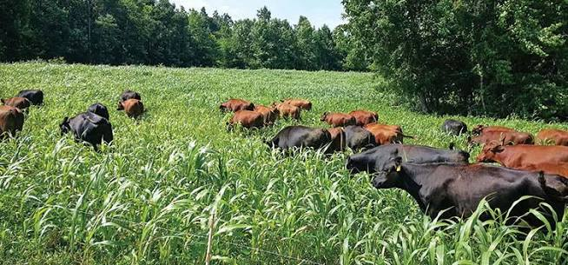
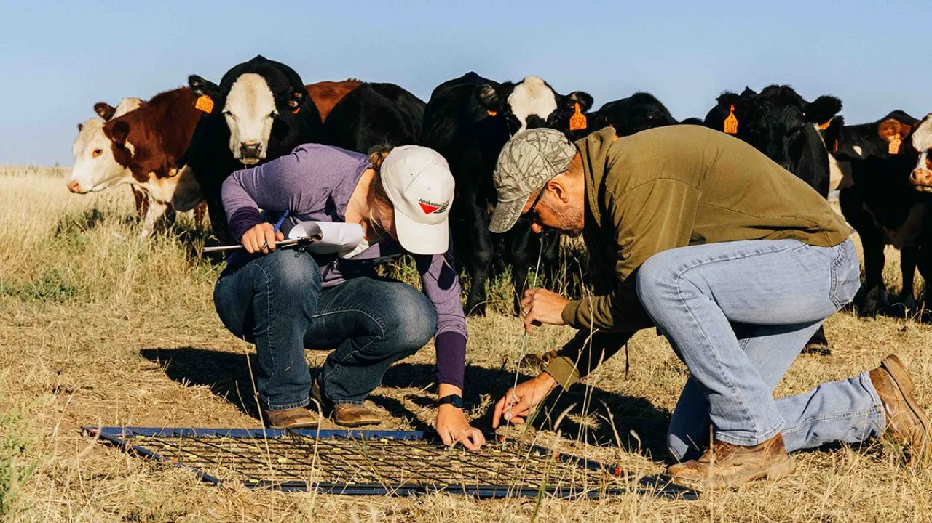
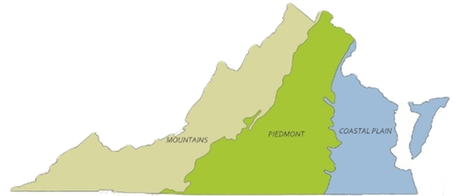
VA General Program 512 vs. Pasture Renovation Subpilot (PRS)
Pasture Renovation Subpilot:
Implementing ALL 3 of these practices:
512 – Pasture + Hay Planting
528 – Grazing Management
590 – Nutrient Management
VA General Program:
Single Practice Enrollment:
ONLY 512 Practice with the Alliance
COVER CROP PLANTING DEADLINES
Mountain
Oct. 27
Piedmont
Nov. 1
Coastal Plain
Nov. 17
Notes:
REBEKAH
Please raise your zoom hand or on camera raise your hand if you are in PRS, then if you are only in single practice 512, and then if you don’t know (please reach out to use after this if you are in the last group so we can help you).

Slide 3

What did I sign up for?
Application Submitted
Application Accepted
Complete 1 OR 3 Practices
Complete 1 OR 3 Practice Worksheets
Complete Exit Surveys
Pasture and Hay Planting
Nutrient Management
Grazing Management
Notes:
REBEKAH

Slide 4
How do I get paid?
Payment 2: 25%
Application Submitted
Application Accepted
Complete 1 OR
3 Practices
Complete 1 OR 3 Practice Worksheets
Complete Exit Surveys
Pasture and Hay Planting
Nutrient Management
Grazing Management
Payment 1: 50%
Payment 3: 25%
Notes:
REBEKAH

Slide 5

Check-In on Questions from Chat
Contract/Payment questions ONLY
More time for Practice Implementation
Q&A later in webinar
Notes:
REBEKAH

Slide 6
512 Implementation: Pasture & Hay Planting
Application Submitted
Application Accepted
Complete 3 Practices
Complete 3 Practice Worksheets
Complete Exit Surveys
Pasture and Hay Planting
Nutrient Management
Grazing Management
What It Is:
Contract Requirements:
  Plant a Perennial before May
  Take photo of the seed tag for practice worksheet
  Keep notes on planting rate and method for practice worksheet
  Complete practice worksheet after Planting
Establishing adapted and compatible species, varieties, or cultivars of perennial herbaceous plants suitable for pasture or hay production.
Notes:
ROBIN

Slide 7
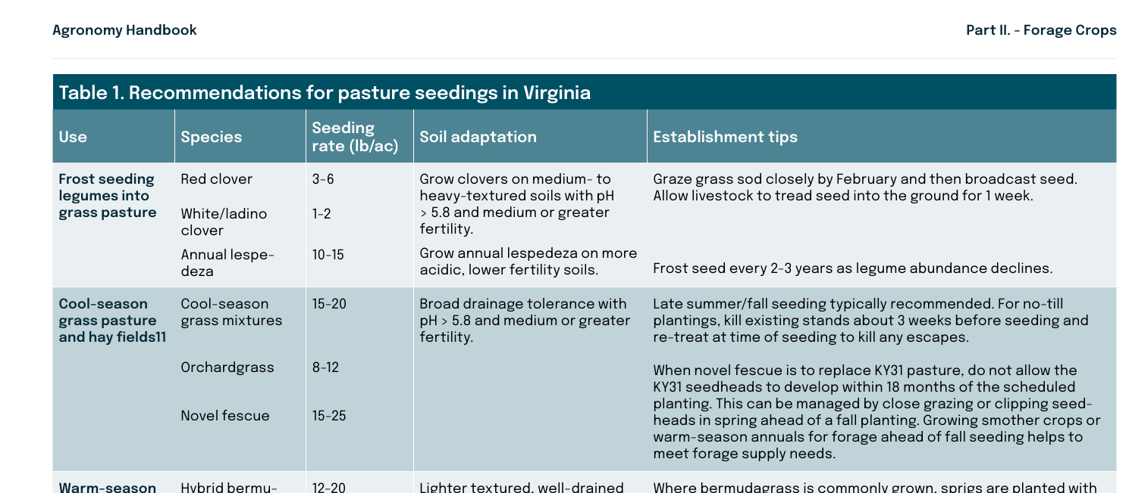
512: Pasture & Hay Planting Technical Assistance
Seed Selection & Rate Calculations:
Consider grazing needs & soil suitability
Contact Alliance team for TA Questions
Planting Considerations:
Planting depth appropriate for seed size
Planting time (temperature and soil moisture) – planted by May 2027
Resource Planning:
Follow height guidelines for 1st grazing/cutting
Prevent grazing access until forage is fully established
Virginia Cooperative Extension Agronomy Handbook
Notes:
ROBIN

Slide 8
590 Implementation: Nutrient Management
Application Submitted
Application Accepted
Complete 3 Practices
Complete 3 Practice Worksheets
Complete Exit Surveys
Pasture and Hay Planting
Nutrient Management
Grazing Management
ONLY
PRS
Participants
What It Is:
Contract Requirements:
  Engage a VA certified nutrient management planner
  Collect soil samples
  Work with planner to develop plan
  Implement part of NMP
  Keep records of implementation
  Complete practice worksheet using NMP
Manage rate, source, placement, and timing of plant nutrients and soil amendments while reducing environmental impacts.
Notes:
ROBIN

Slide 9
528 Implementation: Grazing Management
Application Submitted
Application Accepted
Complete 3 Practices
Complete 3 Practice Worksheets
Complete Exit Surveys
Pasture and Hay Planting
Nutrient Management
Grazing Management
ONLY
PRS
Participants
What It Is:
Contract Requirements:
  Gather information for grazing tool
  Enter farm details in grazing tool
  Review tool results and identify periods where forage shortages may occur
  Download Grazing Plan (PDF)
  Download Grazing Management
  Tool results
Managing the harvest of vegetation with grazing and/or browsing animals with the intent to achieve specific ecological, economic, and management objectives.
Notes:
ROBIN

Slide 10
Pasture Renovation Subpilot (All 3 practices): Key Contract Details
Application Submitted
Application Accepted
Complete 3 Practices
Complete 3 Practice Worksheets
Complete Exit Surveys
Pasture and Hay Planting
Nutrient Management
Grazing Management
After practice implementation – not eligible for 2nd payment before 6 months into contract (January)
Practice Worksheets:
Field Number | Site Prep Method | Site Prep Date | N Applied | P2O5 Applied | Fertilizer Application Date | Species | Planting Rate | Planting Date | Planting Method
  Nutrient Management: Provide name and certification number for your NMP
  Upload a copy of your nutrient management plan
  Pasture + Hay Planting: Define species included in seed mix (if applicable)
  Grazing Management: Upload Grazing Management Plan + Grazing Management Tool Results
Notes:
ROBIN

Slide 11
Completing Your Contract
Application Submitted
Application Accepted
Complete 3 Practices
Complete 3 Practice Worksheets
Complete Exit Surveys
Pasture and Hay Planting
Nutrient Management
Grazing Management
Due by the last day of contract:
(5/31/27)
Exit Surveys:
Program Experience Survey: These are general questions regarding your opinion about the program as well as help you received.
Virginia Tech Exit Survey: This survey supports research being done by the Agricultural and Applied Economics Department at Virginia Tech.
USDA Exit Survey:
USDA is interested in learning if you experienced an economic benefit selling commodities produced using climate-smart practices.
Research (Land Use Survey): These are general questions regarding how your pastures have historically been managed.
Can we design more producer-friendly
cost-share programs?
Did this program help producers enter new markets?
Can we develop better advice on long-term land management strategies?
Notes:
REBEKAH

Slide 12
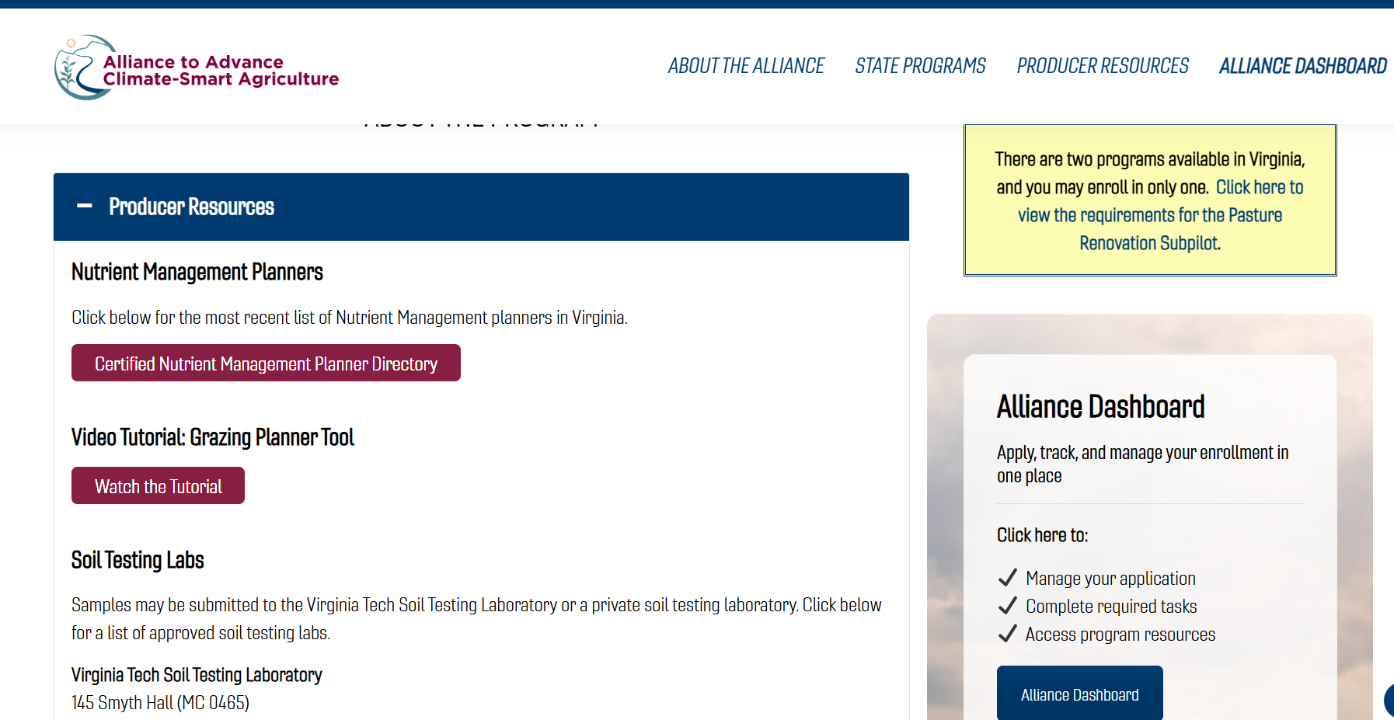
Alliance Website + Resources
Notes:
REBEKAH

Slide 13
Pasture Renovation Subpilot: What is this research thing?
PRS Participants Complete Additional Exit Survey
Application Submitted
Application Accepted
Complete 3 Practices
Complete 3 Practice Worksheets
Complete Exit Surveys
Pasture and Hay Planting
Nutrient Management
Grazing Management
VT Team Collects Pasture and Soil Samples (Represents Initial Pasture Conditions)
PRS Participants Collect Pasture and Soil Samples (Represents End Pasture Conditions)
Notes:
ROBIN

Slide 14
Completing Your Research Contract
Application Submitted
Application Accepted
Complete 3 Practices
Complete 3 Practice Worksheets
Complete Exit Surveys
Pasture and Hay Planting
Nutrient Management
Grazing Management
Between March 1 and April 15
Final Forage and Soil Samples
  Follow sampling directions
  Label sample bags
  Send samples in to VT
  Original fields + any additional forage samples you would like analyzed
Notes:
ROBIN

Slide 15

Technical Q&A Time
Notes:
TA Questions:

Slide 16

Educational Webinar Series
OCT – Nutrient Management Plans
(590 – Nutrient Management Practice) – date TBD
NOV 9 – Grazing Management Tool
(528 – Grazing Management Practice)
(Basic content +30 minutes Advanced content; 90 min total)
FEB 22 – Spring Check-In
(Practice Worksheets, Q&A, Spring Sampling Process)
Monday evenings at 7 PM ET
Live Webinars will be recorded
Follow up email with link & resources will be sent out after every webinar
COVER CROP PLANTING DEADLINES
Mountain
Oct. 27
Piedmont
Nov. 1
Coastal Plain
Nov. 17
Notes:
REBEKAH

Slide 17
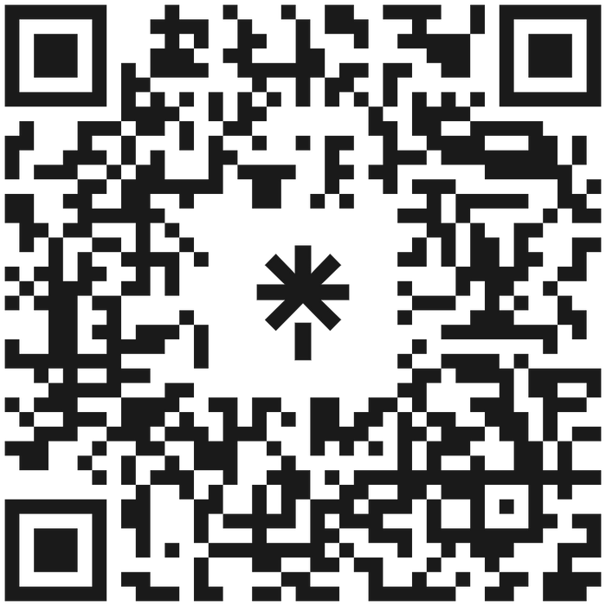



allianceforcsa
allianceforcsaVA@vt.edu
www.allianceforcsa.org/Virginia
540-231-3990
Dr. Robin White, PRS Research Lead
Email: rrwhite@vt.edu
Notes:
REBEKAH
QR CODE – LINKS TO EVERYTHING OR VISIT ALLIANCEFORCSA.ORG/VIRGINIA DIRECTLY
SIGN UP FOR NEWSLETTER
OPEN UP FOR QUESTIONS
STOP SHARING AND PRESENTORS TURN ON CAMERAS

