Slide 1
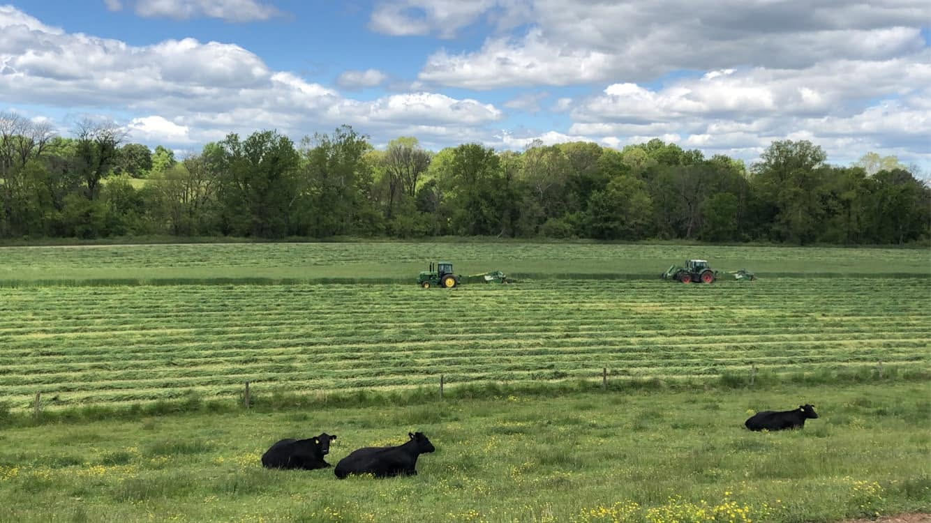


Nutrient Management (590)
Q&A Session
Notes:
REBEKAH
_______________________________________
APPRECIATE ALL OF YOU FROM VIRGRINIA COOPERATIVE EXTENSION AND THE SOIL AND WATER CONSERVATION DISTRICTS FOR JOINING US TODAY
WE HOPE THIS WEBINAR TODAY PROVIDES YOU WITH THE INFORMATION YOU NEED TO HELP PROMOTE THE PROGRAM AND OFFER WHATEVER LEVEL OF ASSISTANCE YOU ARE INTERESTED IN PROVIDING TO YOUR CONSTITUENTS. THAT ASSISTANCE CAN BE A SIMPLE SHARE ON A LISTSERV OR SOCIAL MEDIA, A CONVERSATION WITH AN INDIVIDUAL OR GROUP OF PRODUCERS, HELPING SOMEONE WITH THE APPLICATION PROCESS, WORKING ON A PRACTICE WORKSHEET OR FPC, HELPING COLLECT A BIOMASS SAMPLE. OR IT CAN SIMPLY BE FORWARDING QUESTIONS TO MY TEAM. HOWEVER YOU CHOOSE TO BE ENGAGED IS WELCOME AND APPRECIATED.

Slide 2
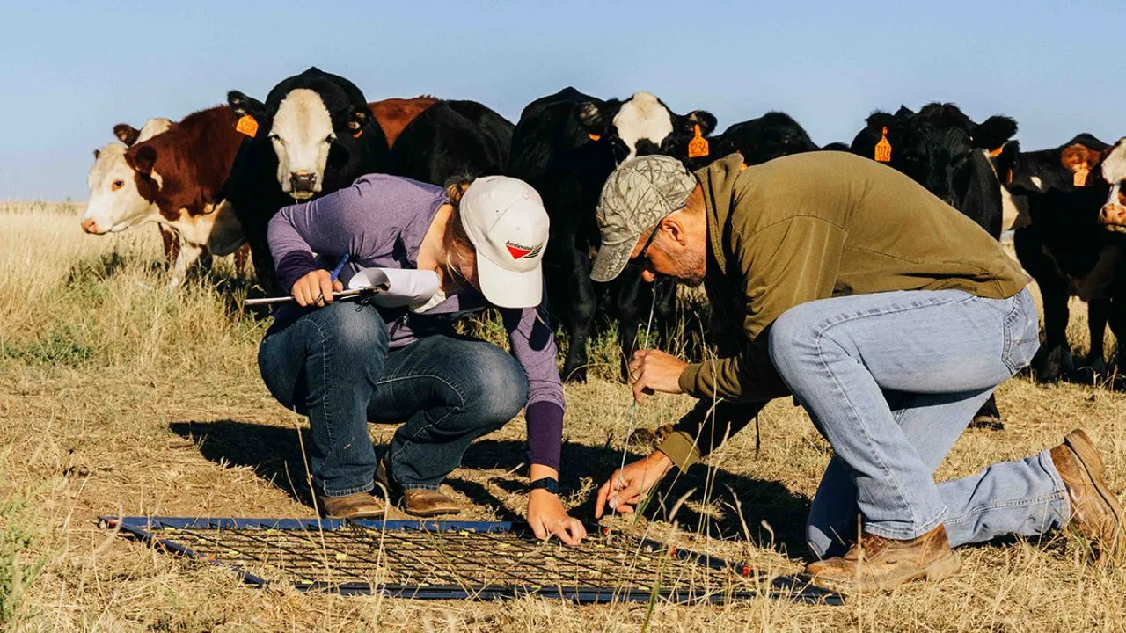
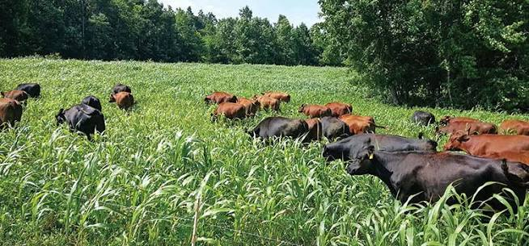
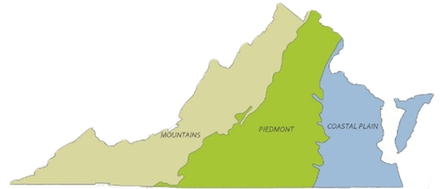
VA General Program 590 vs. Pasture Renovation Subpilot (PRS)
Pasture Renovation Subpilot:
Implementing ALL 3 of these practices:
512 – Pasture + Hay Planting
528 – Grazing Management
590 – Nutrient Management
VA General Program:
Single Practice Enrollment:
ONLY Nutrient Management (590)
COVER CROP PLANTING DEADLINES
Mountain
Oct. 27
Piedmont
Nov. 1
Coastal Plain
Nov. 17
Notes:
REBEKAH
Please raise your zoom hand or on camera raise your hand if you are in PRS, then if you are only in single practice 512, and then if you don’t know (please reach out to use after this if you are in the last group so we can help you).

Slide 3

What did I sign up for?
Application Submitted
Application Accepted
Complete 1 OR 3 Practices
Complete 1 OR 3 Practice Worksheets
Complete Exit Surveys
Pasture and Hay Planting
Nutrient Management
Grazing Management
Notes:
REBEKAH

Slide 4
How do I get paid?
Payment 2: 25%
Application Submitted
Application Accepted
Complete 1 OR
3 Practices
Complete 1 OR 3 Practice Worksheets
Complete Exit Surveys
Pasture and Hay Planting
Nutrient Management
Grazing Management
Payment 1: 50%
Payment 3: 25%
Notes:
REBEKAH

Slide 5
Completing Your Contract
Application Submitted
Application Accepted
Complete 3 Practices
Complete 3 Practice Worksheets
Complete Exit Surveys
Pasture and Hay Planting
Nutrient Management
Grazing Management
Due by the last day of contract:
(5/31/27)
Exit Surveys:
Program Experience Survey: These are general questions regarding your opinion about the program as well as help you received.
Virginia Tech Exit Survey: This survey supports research being done by the Agricultural and Applied Economics Department at Virginia Tech.
USDA Exit Survey:
USDA is interested in learning if you experienced an economic benefit selling commodities produced using climate-smart practices.
Research (Land Use Survey): These are general questions regarding how your pastures have historically been managed.
Can we design more producer-friendly
cost-share programs?
Did this program help producers enter new markets?
Can we develop better advice on long-term land management strategies?
Notes:
REBEKAH

Slide 6

Payment Schedule
1st Payment: Contact Alliance team if you have not received your 1st payment
2nd Payment: 6 months into contract, for many producers this will be early 2027
3rd Payment: complete exit surveys
--------------------------------------------------------
Note about Practice Worksheets:
*Will not be reviewed until 2nd payment processing
*Use the Practice Worksheet to plan the practice
*The Alliance team is available to answer questions about PW requirements, documentation, verify uploads
Notes:
REBEKAH

Slide 7

Check-In on Questions from Chat
Contract/Payment questions ONLY
More time for Practice Implementation
Q&A later in webinar
Notes:
REBEKAH

Slide 8
Alliance vs DCR Direct Pay
The intersection of the Alliance and DCR's existing Direct Pay Nutrient Management Program is difficult, as each program has unique requirements and timelines.
Direct Pay cannot pay for Alliance enrolled acres during contractual period of the Alliance.
If an Alliance participating producer has an existing nutrient management plan that was developed through the DCR Direct Pay Program, it does not expire before 5/1/2027, covers all Alliance enrolled acres and accurately represents the operation, the producer does not need an updated plan and may implement the K, lime, or a urease inhibitor portion of this plan before 5/31/2027 to satisfy the Alliance producer agreement.
After completion of the Alliance Contract, the plan may be updated through the Direct Pay Program for years 2 and/or 3 of the plan in accordance with the Direct Pay rules.
If an Alliance participating producer does not have an existing nutrient management plan, a new plan for the Alliance enrolled acres will be needed.
The producer must implement a portion of this plan before 5/31/2027 to satisfy your producer agreement.
Direct Pay may not be used to cover the cost of the plan for the Alliance enrolled acres.
If the producer's farm includes additional acres not enrolled in the Alliance, and they want a plan for those acres as well, those additional acres may be written in a separate new Direct Pay plan (all Direct Pay procedures, including the producer consent form for the non-alliance acres, should be followed). In years 2 and 3, both plans may be updated through the Direct Pay Program in accordance with the Direct Pay rules. A producer consent form for the Alliance acres must be submitted and approved in advance.
Notes:
REBEKAH

Slide 9

Nutrient Management Plans
  Guest Speaker:
  Rachel McAden Farmer
  Nutrient Management Planner
Notes:
REBEKAH introduce Rachel

Slide 10
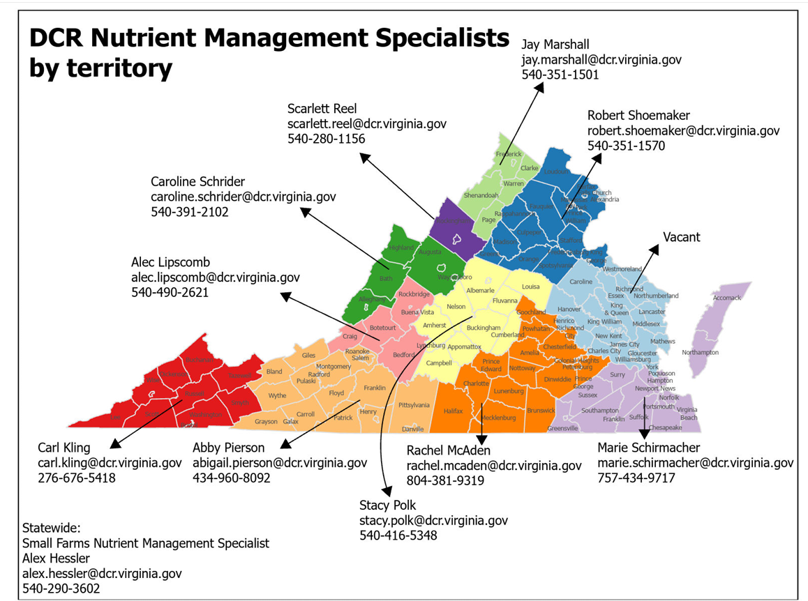
Nutrient Management Plans
  Guest Speaker:
  Rachel McAden Farmer
  Nutrient Management Planner
Notes:
REBEKAH introduce Rachel

Slide 11
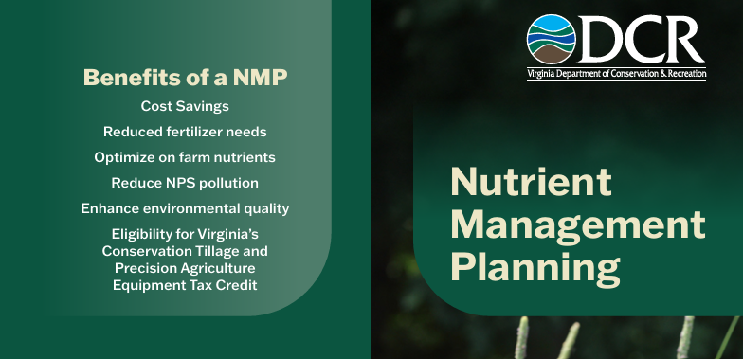
Nutrient Management Plans
Notes:
RACHEL

Slide 12
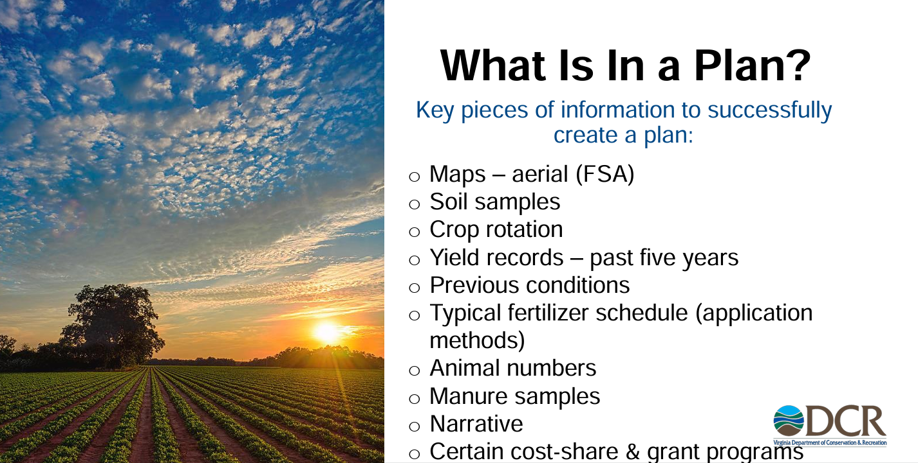
Nutrient Management Plan essentials
Contract/Payment questions
ONLY
More time for Practice
Implementation
Q&A later in webinar
Notes:
RACHEL

Slide 13
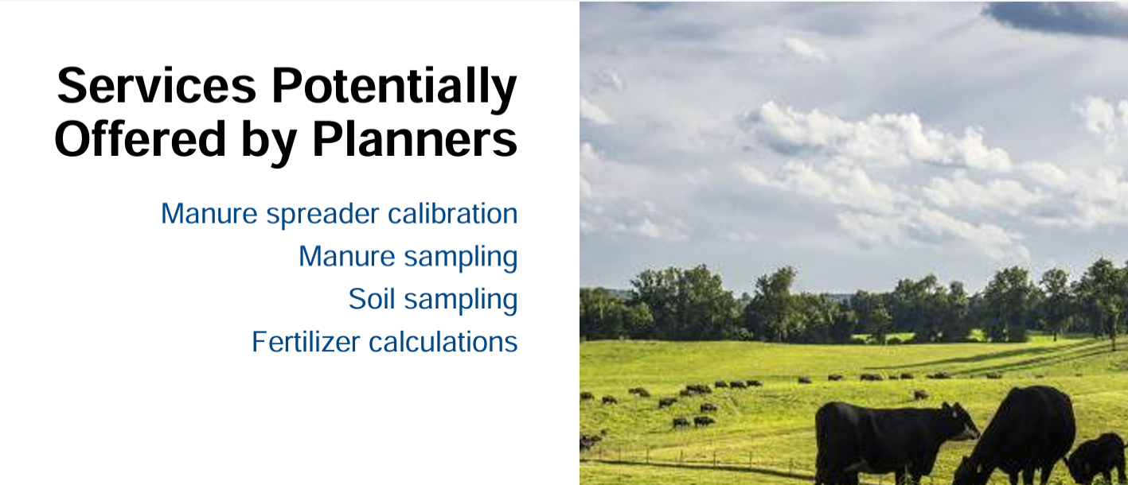
Nutrient Management Plan essentials
Contract/Payment questions
ONLY
More time for Practice
Implementation
Q&A later in webinar
Notes:
RACHEL

Slide 14
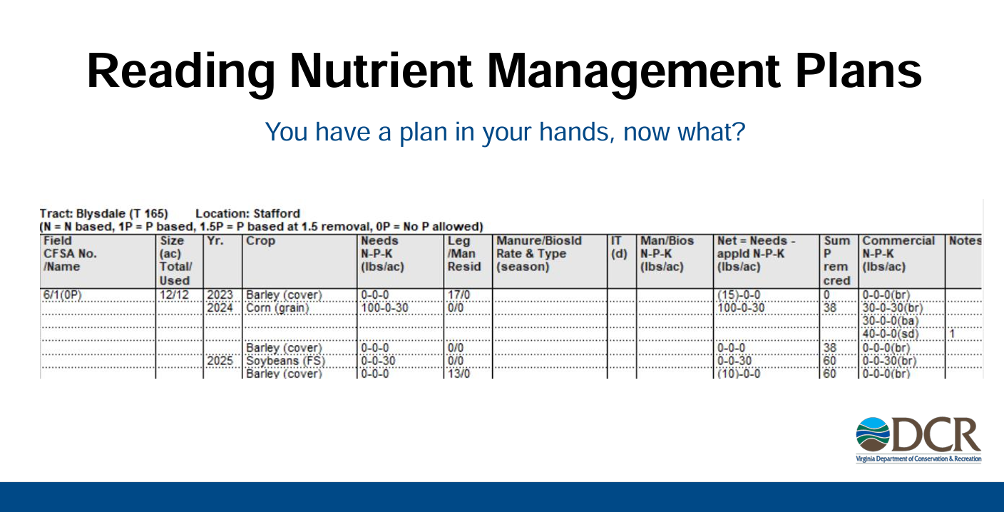
Nutrient Management Plan essentials
Contract/Payment questions
ONLY
More time for Practice
Implementation
Q&A later in webinar
Notes:
RACHEL

Slide 15
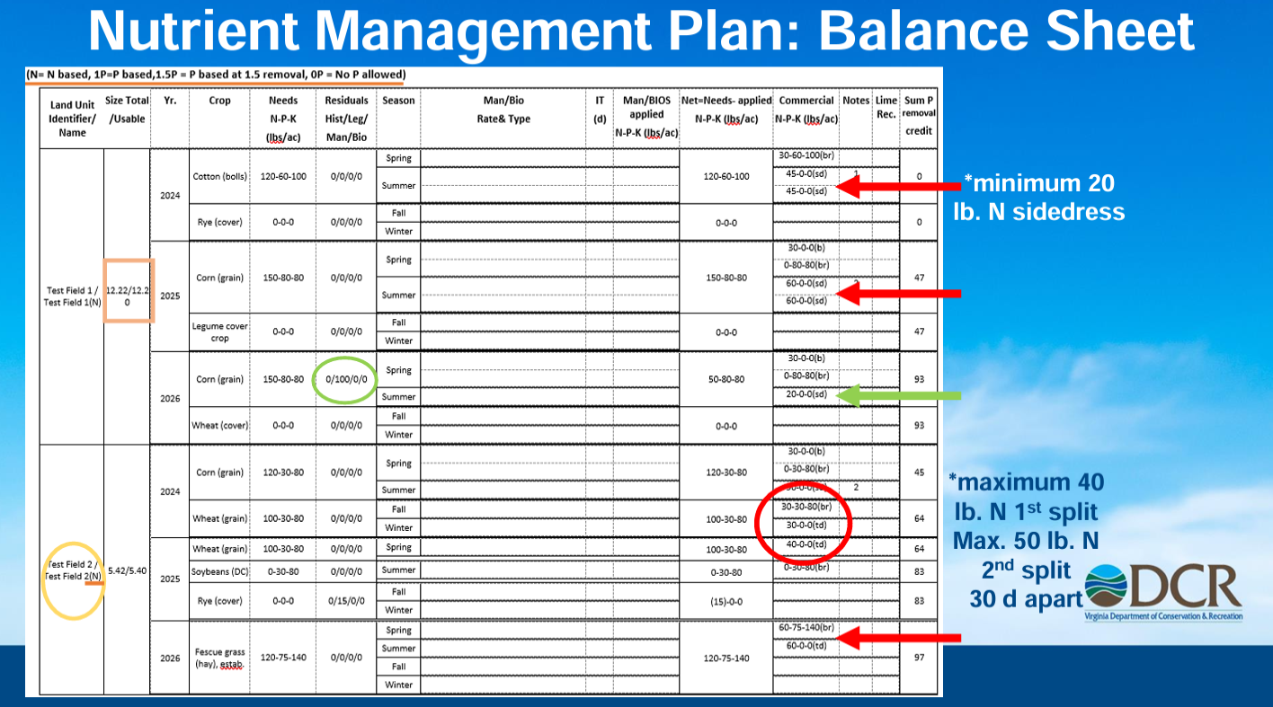
Notes:
RACHEL

Slide 16
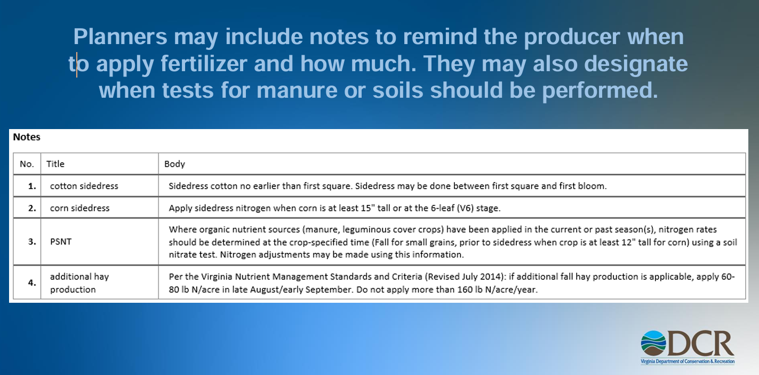
Notes:
RACHEL

Slide 17
Nutrients + Application Options in 590
      Soil Amendment
      Lime – supplies Calcium, & if
      dolomitic line, also magnesium
      Surface Application:
      Urease Inhibitor – prevents volatilization (Nitrogen loss) & buys time for rainfall + tillage
      NPK – Fertilizer Nutrients
      Nitrogen
      Phosphorus
      Potassium/Potash
Contact Alliance team
for TA Questions
Notes:
RACHEL

Slide 18

NMP Q&A Time
Notes:
NMP Questions

Slide 19
Implementation: Nutrient Management (590)
Application Submitted
Application Accepted
Complete 3 Practices
Complete 3 Practice Worksheets
Complete Exit Surveys
Pasture and Hay Planting
Nutrient Management
Grazing Management
Only 1 of 3 practices for PRS Participants
What It Is:
Contract Requirements:
  Engage a VA certified nutrient management planner
  Collect soil samples
  Work with planner to develop plan
  Implement part of NMP
  Keep records of implementation
  Complete practice worksheet using NMP
Manage rate, source, placement, and timing of plant nutrients and soil amendments while reducing environmental impacts.
Notes:
REBEKAH

Slide 20
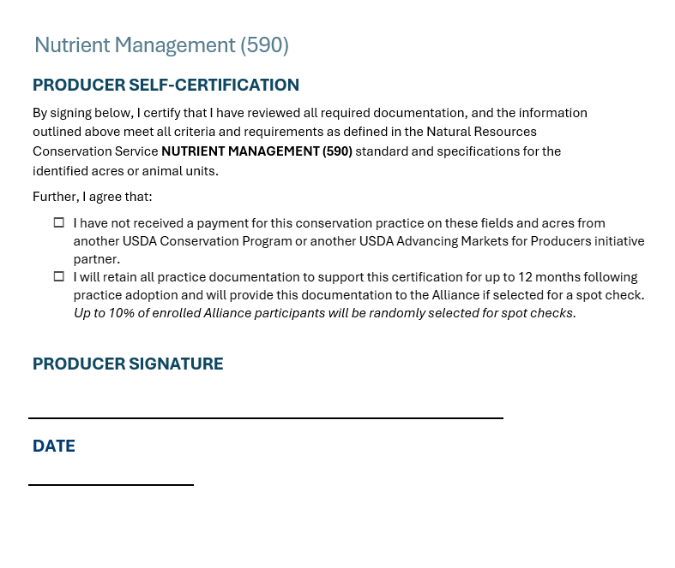
Nutrient Management (590): Practice Worksheet
Select land use for fields NMP will be applied
Name/Certification # of NM Planner
Check if you are currently enrolled in VACS
Contact Alliance team
for TA Questions
Crop Nutrients:
Check nutrients you have applied/plan to apply
based on your Nutrient Management Plan
Must apply at least 1
--Lime, Potassium/Potash, Urease Inhibitor,
Nitrogen, and Phosphorus
Pasture/Hay Planting:
Check nutrients you have applied/plan to apply
based on your Nutrient Management Plan
Must apply at least 1
--Nitrogen, Phosphorus, Potassium, Lime
Notes:
ROBIN

Slide 21
Crop Nutrients
Contact Alliance team
for TA Questions
Check nutrients you have applied/plan to apply
based on your Nutrient Management Plan
    Must apply at least 1
--Lime:
--Potassium/Potash
--Urease Inhibitor,
--Nitrogen
--Phosphorus
Notes:
ROBIN

Slide 22
Pasture/Hay Planting
Contact Alliance team
for TA Questions
Pasture/Hay Planting:
Check nutrients you have applied/plan to apply
based on your Nutrient Management Plan
Must apply at least 1
--Nitrogen
--Phosphorus
--Potassium
--Lime
Notes:
ROBIN

Slide 23

Practice Worksheet: Self-Verification
(Main examples, see whole PW for more!)
Do not exceed application rates recommendations for N, P, K and Lime
Follow timing recommendations in the NMP related to lime application + nitrogen fertilizer
Follow spreading schedule in NMP for any applied manure/biosolids
Follow any restrictions noted in NMP
(examples: snow/frozen ground, environmentally sensitive sites, designated set back areas)
Note: keep records detailed enough to demonstrate any implementation of the items listed above
*Random Spot Checks in the Spring*
Contact Alliance team
for TA Questions
Virginia Cooperative Extension Agronomy Handbook
Notes:
ROBIN

Slide 24
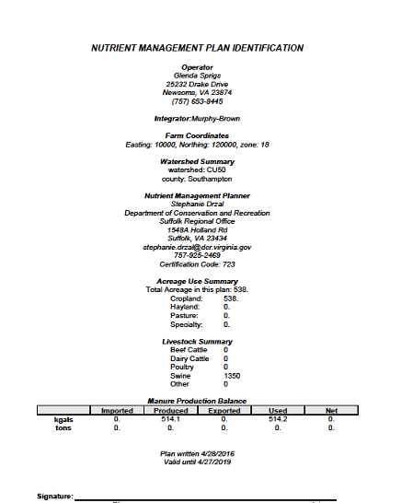
Practice Worksheet: Include Attachments
Cover Sheet
of NMP
Notes:
ROBIN

Slide 25
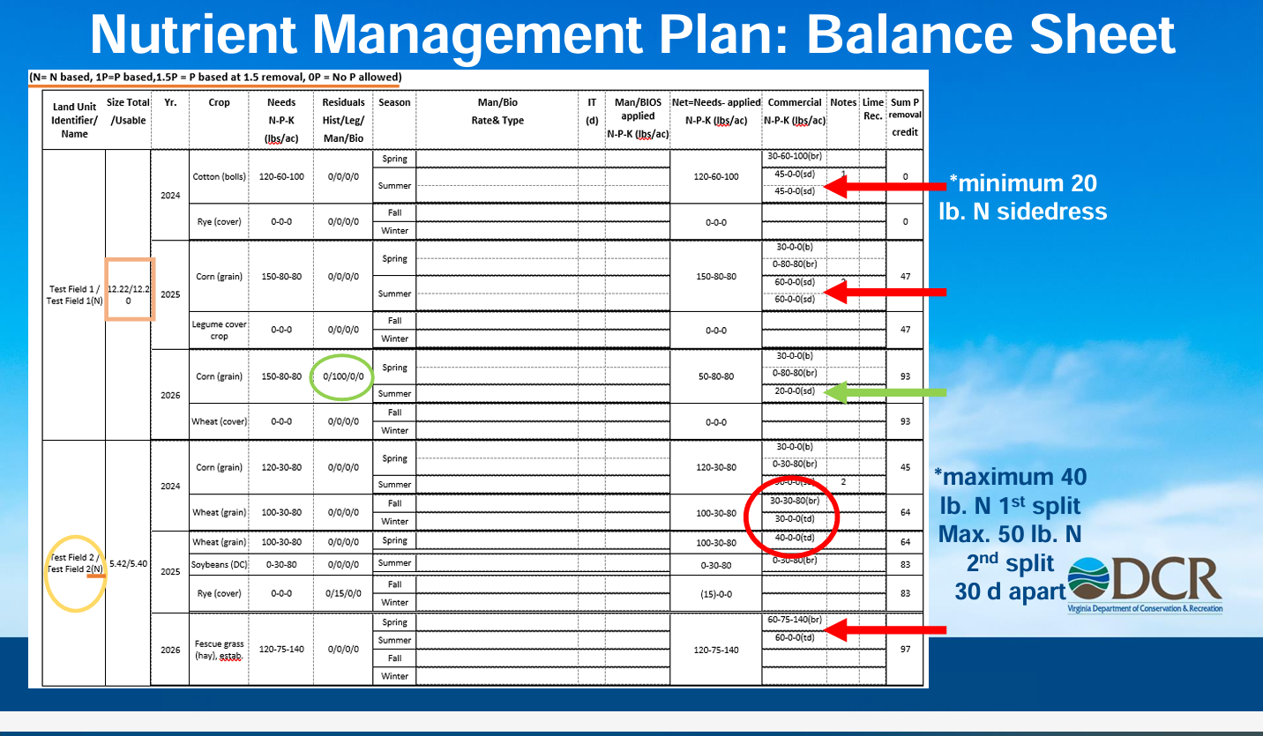
Practice Worksheet: Include Attachments
II. Nutrient
Balance
Sheet
Notes:
ROBIN

Slide 26
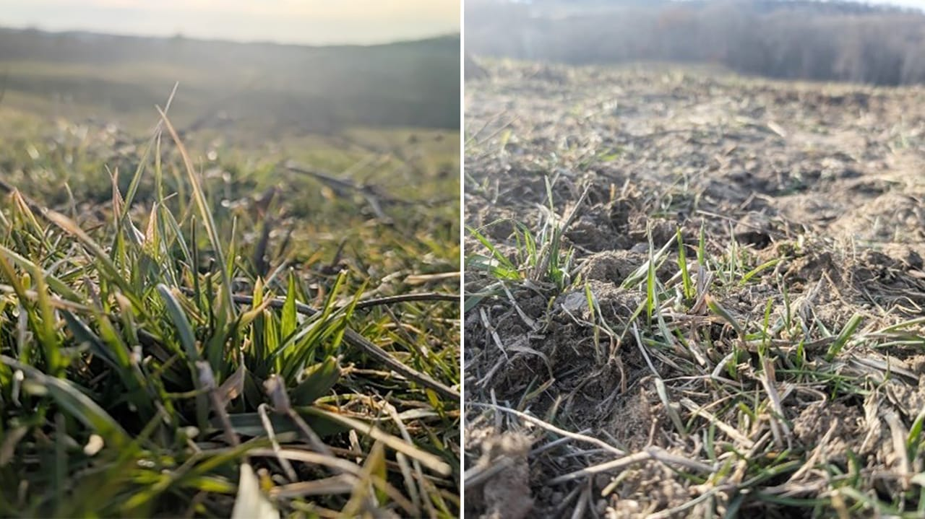
*Important Weather Consideration*
With implementing your NMP, we understand the weather challenges of this year require flexibility of when the best time is for your land.
The Alliance program allows for adjustments to planting/fertilizer application as long as it still meets the practice standard & allows for establishment/growth of what they are planting
Examples:
Your NMP calls for fertilizer application in the Fall – you have flexibility to apply in the early winter if that is a better time for your land.
*PRS participants who are also doing Pasture + Hay Planting
You have flexibility of the timing of when you seed – however Spring 2027 is the last chance. Back up plan is cheap rye grass as last resort!
Notes:
ROBIN: lead to TA question + answer time

Slide 27
Technical Q&A Time
Notes:
TA Questions:

Slide 28
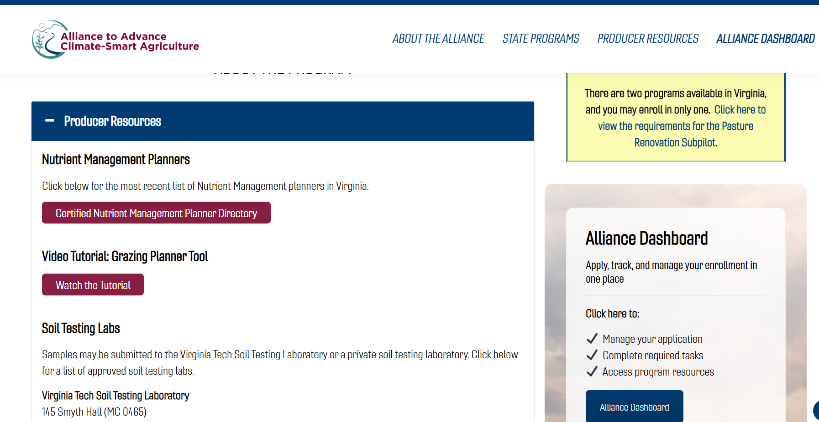
Alliance Website + Resources
Notes:
REBEKAH

Slide 29

Educational Webinar Series
*Previous Webinars are Recorded + Available Online
NOV 9 – Grazing Management Tool
Grazing Management (528)
Basic content +30 minutes Advanced content; 90 min total
FEB 22 – Spring Check-In
Practice Worksheets, Q&A, Spring Sampling Process
Monday evenings at 7 PM ET
Live webinars will be recorded
Follow up email with link & resources will be sent out after every webinar
COVER CROP PLANTING DEADLINES
Mountain
Oct. 27
Piedmont
Nov. 1
Coastal Plain
Nov. 17
www.allianceforcsa.org/webinar-series
Notes:
REBEKAH

Slide 30
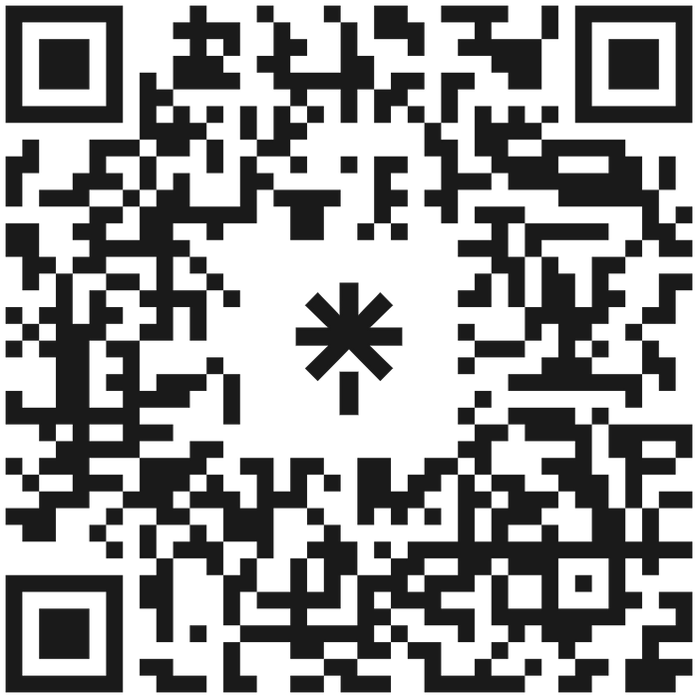
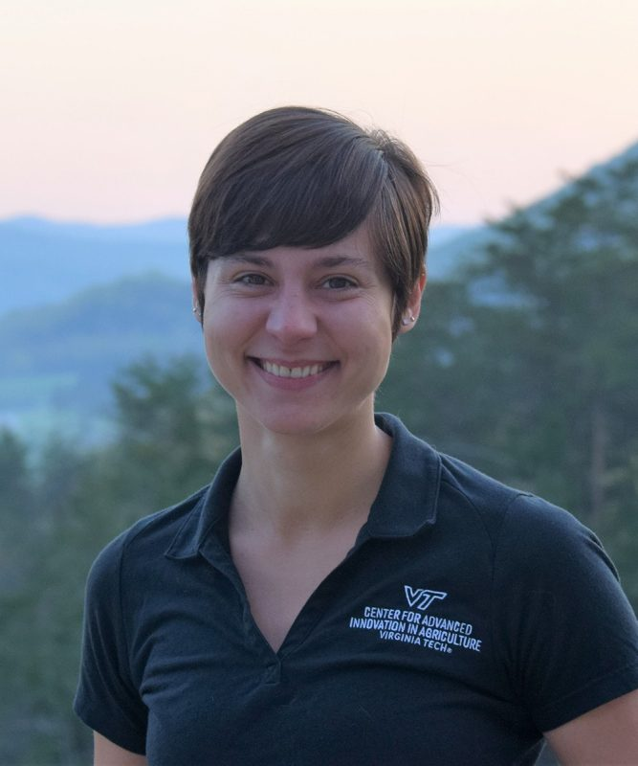


allianceforcsa
allianceforcsaVA@vt.edu
www.allianceforcsa.org/Virginia
540-231-3990
Dr. Robin White, PRS Research Lead
Email: rrwhite@vt.edu
Notes:
REBEKAH
QR CODE – LINKS TO EVERYTHING OR VISIT ALLIANCEFORCSA.ORG/VIRGINIA DIRECTLY
SIGN UP FOR NEWSLETTER
OPEN UP FOR QUESTIONS
STOP SHARING AND PRESENTORS TURN ON CAMERAS

